Slide 1
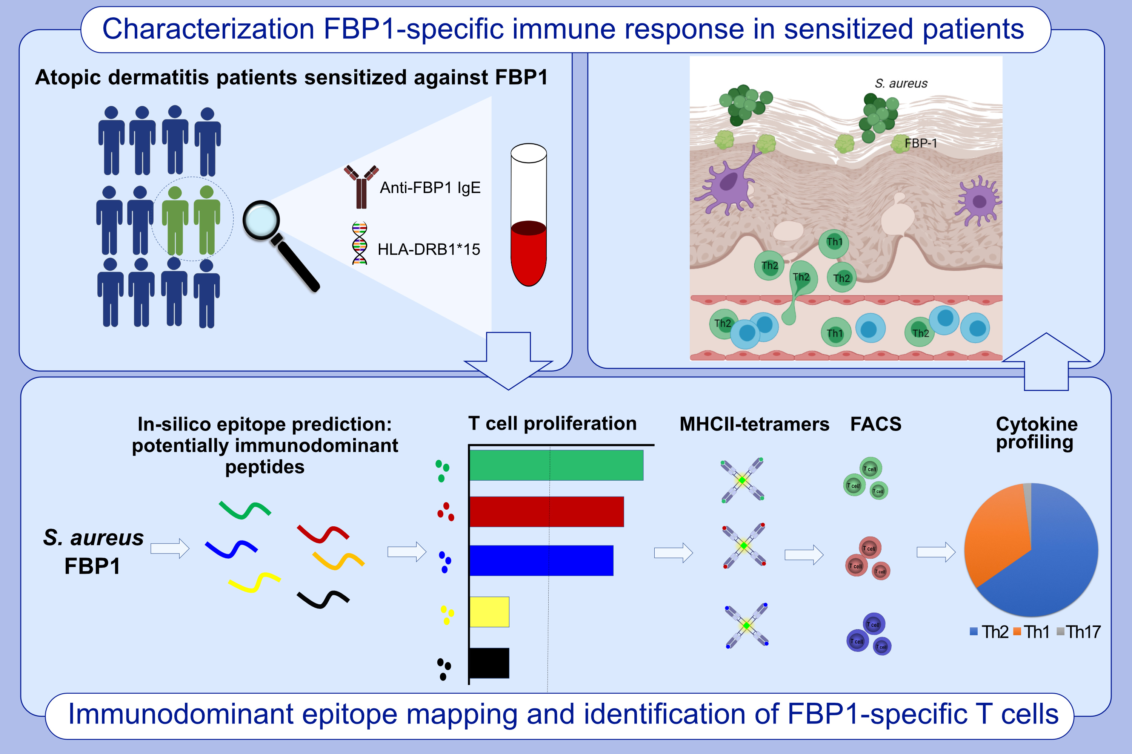
Specific T cells targeting Staphylococcus aureus fibronectin-binding protein 1 induce a type 2/type 1 inflammatory response in sensitized atopic dermatitis patients
Ahmed K. Farag,, Lennart M. Roesner,, Susanne Wieschowski,, Annice Heratizadeh,, Britta Eiz-Vesper,, et al.
Allergy. 2022; 1245-1253 https://doi.org/10.1111/all.15120
© 2019 EAACI and John Wiley and Sons A/S. Published by John Wiley and Sons Ltd.
Notes:
HIGHLIGHTS
By means of MHC-multimer staining, we describe quantity and quality of FBP1-specific T cells in patients suffering from atopic dermatitis.
We demonstrate that FBP1-specific T cells drive an allergic type-2 response in atopic dermatitis patients.
Our study highlights the role of FBP1 as a microbial allergen and its potential to aggravate atopic dermatitis.
Abbreviations: FACS, fluorescence-activated cell sorting; FBP1, fibronectin-binding protein-1; HLA-DRB1, major histocompatibility complex, class II, DR beta 1; MHC, major histocompatibility complex, Th, T helper cell; S. aureus, Staphylococcus aureus

