Slide 1
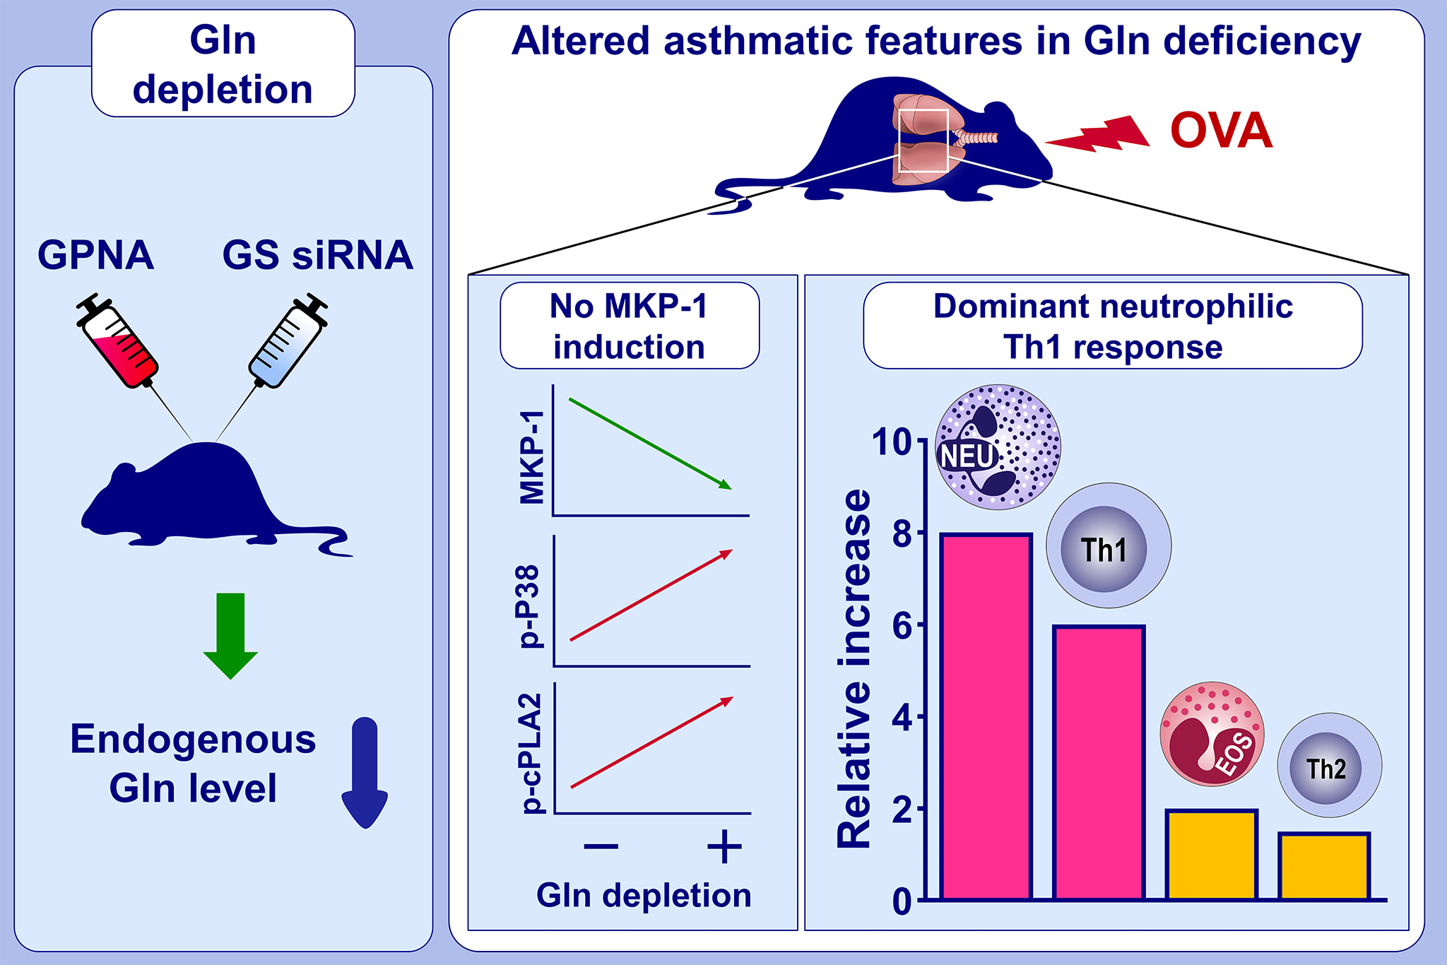
Glutamine deficiency shifts the asthmatic state toward neutrophilic airway inflammation
June-Mo Kim,, Yoo Na Im,, Yun-Jo Chung,, Jung-ho Youm,, Suhn Young Im,, et al.
Allergy. 2022; 1180-1191 https://doi.org/10.1111/all.15121
© 2019 EAACI and John Wiley and Sons A/S. Published by John Wiley and Sons Ltd.
Notes:
HIGHLIGHTS
Glutamine depletion was achieved by using the glutamine transporter ASCT2 inhibitor l-γ-glutamyl-p-nitroanilide or glutamine synthetase siRNA.
In glutamine deficiency, no MKP-1 induction and prolonged p38 and cPLA₂ phosphorylation were observed in response to airway ovalbumin challenge.
As a result, dominant neutrophilic Th1 response, rather than eosinophilic Th2 response occurred.
Abbreviations: ASCT2, solute carrier 1A5; cPLA₂, cytosolic phospholipase A₂; EOS, eosinophil; Gln, glutamine; GPNA, l-γ-glutamyl-p-nitroanilide; GS, glutamine synthetase; MKP-1, MAPK phosphatase-1; NEU, neutrophil; OVA, ovalbumin; siRNA, small interfering RNA.

