Slide 1
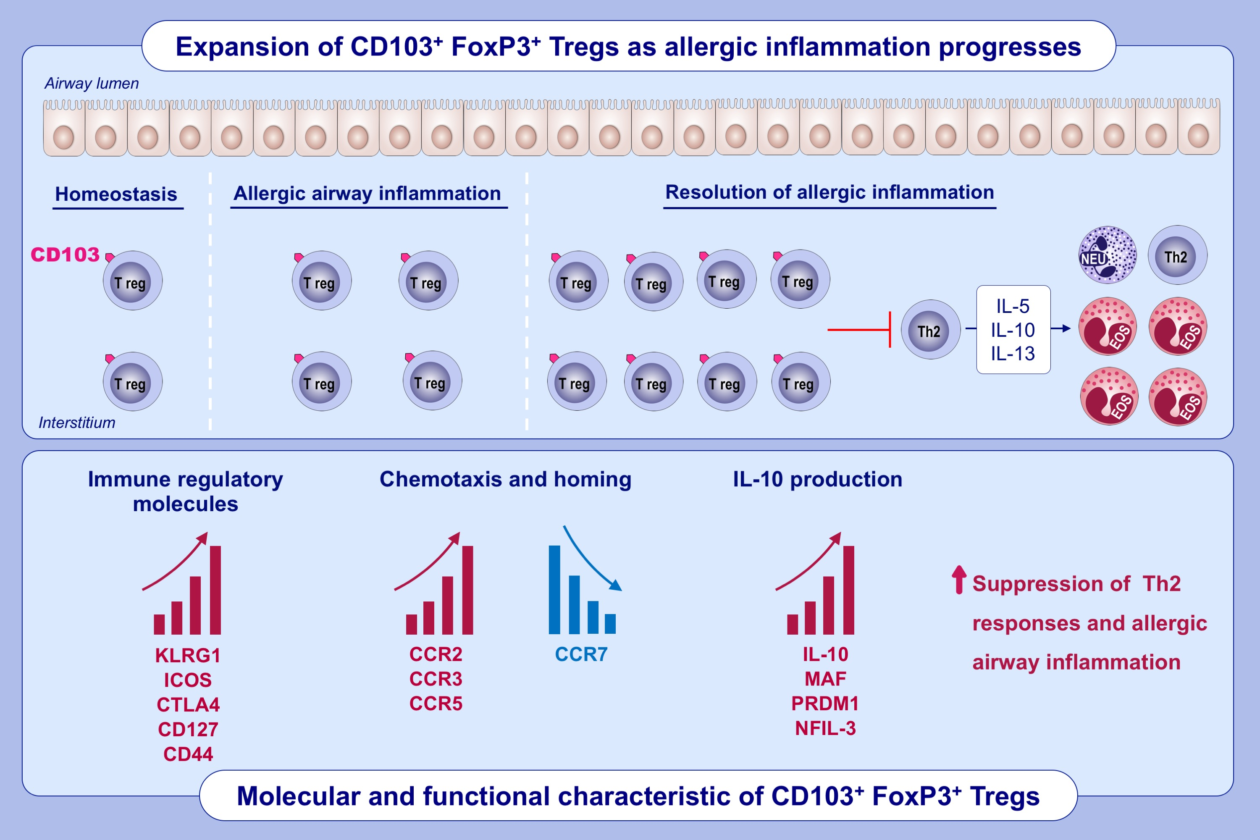
CD103 integrin identifies a high IL-10-producing FoxP3+ regulatory T-cell population suppressing allergic airway inflammation
Sofia Tagkareli,, Maria Salagianni,, Ioanna-Evdokia Galani,, Maria Manioudaki,, Eleftherios Pavlos,, et al.
Allergy. 2022; 1150-1164 https://doi.org/10.1111/all.15144
© 2019 EAACI and John Wiley and Sons A/S. Published by John Wiley and Sons Ltd.
Notes:
HIGHLIGHTS
CD103 marks a population of FoxP3⁺ Tregs in the lung that massively expands during the development of allergic airway inflammation.
CD103⁺FoxP3⁺ Tregs exhibit high expression of chemokine receptors, regulatory molecules and IL-10.
CD103⁺FoxP3⁺ Tregs specifically suppress Th2 responses and drive resolution of Th2-mediated allergic airway inflammation.
Abbreviations: CCR, C-C motif chemokine receptor; CTLA4, cytotoxic T lymphocyte-associated protein 4; Foxp3, forkhead box protein P3; ICOS, inducible T cell costimulator; KLRG1, killer cell lectin-like receptor G1; MAF, bZIP transcription factor; NFIL-3, nuclear factor, interleukin 3 regulated; PRDM1, PR/SET domain 1

