Slide 1
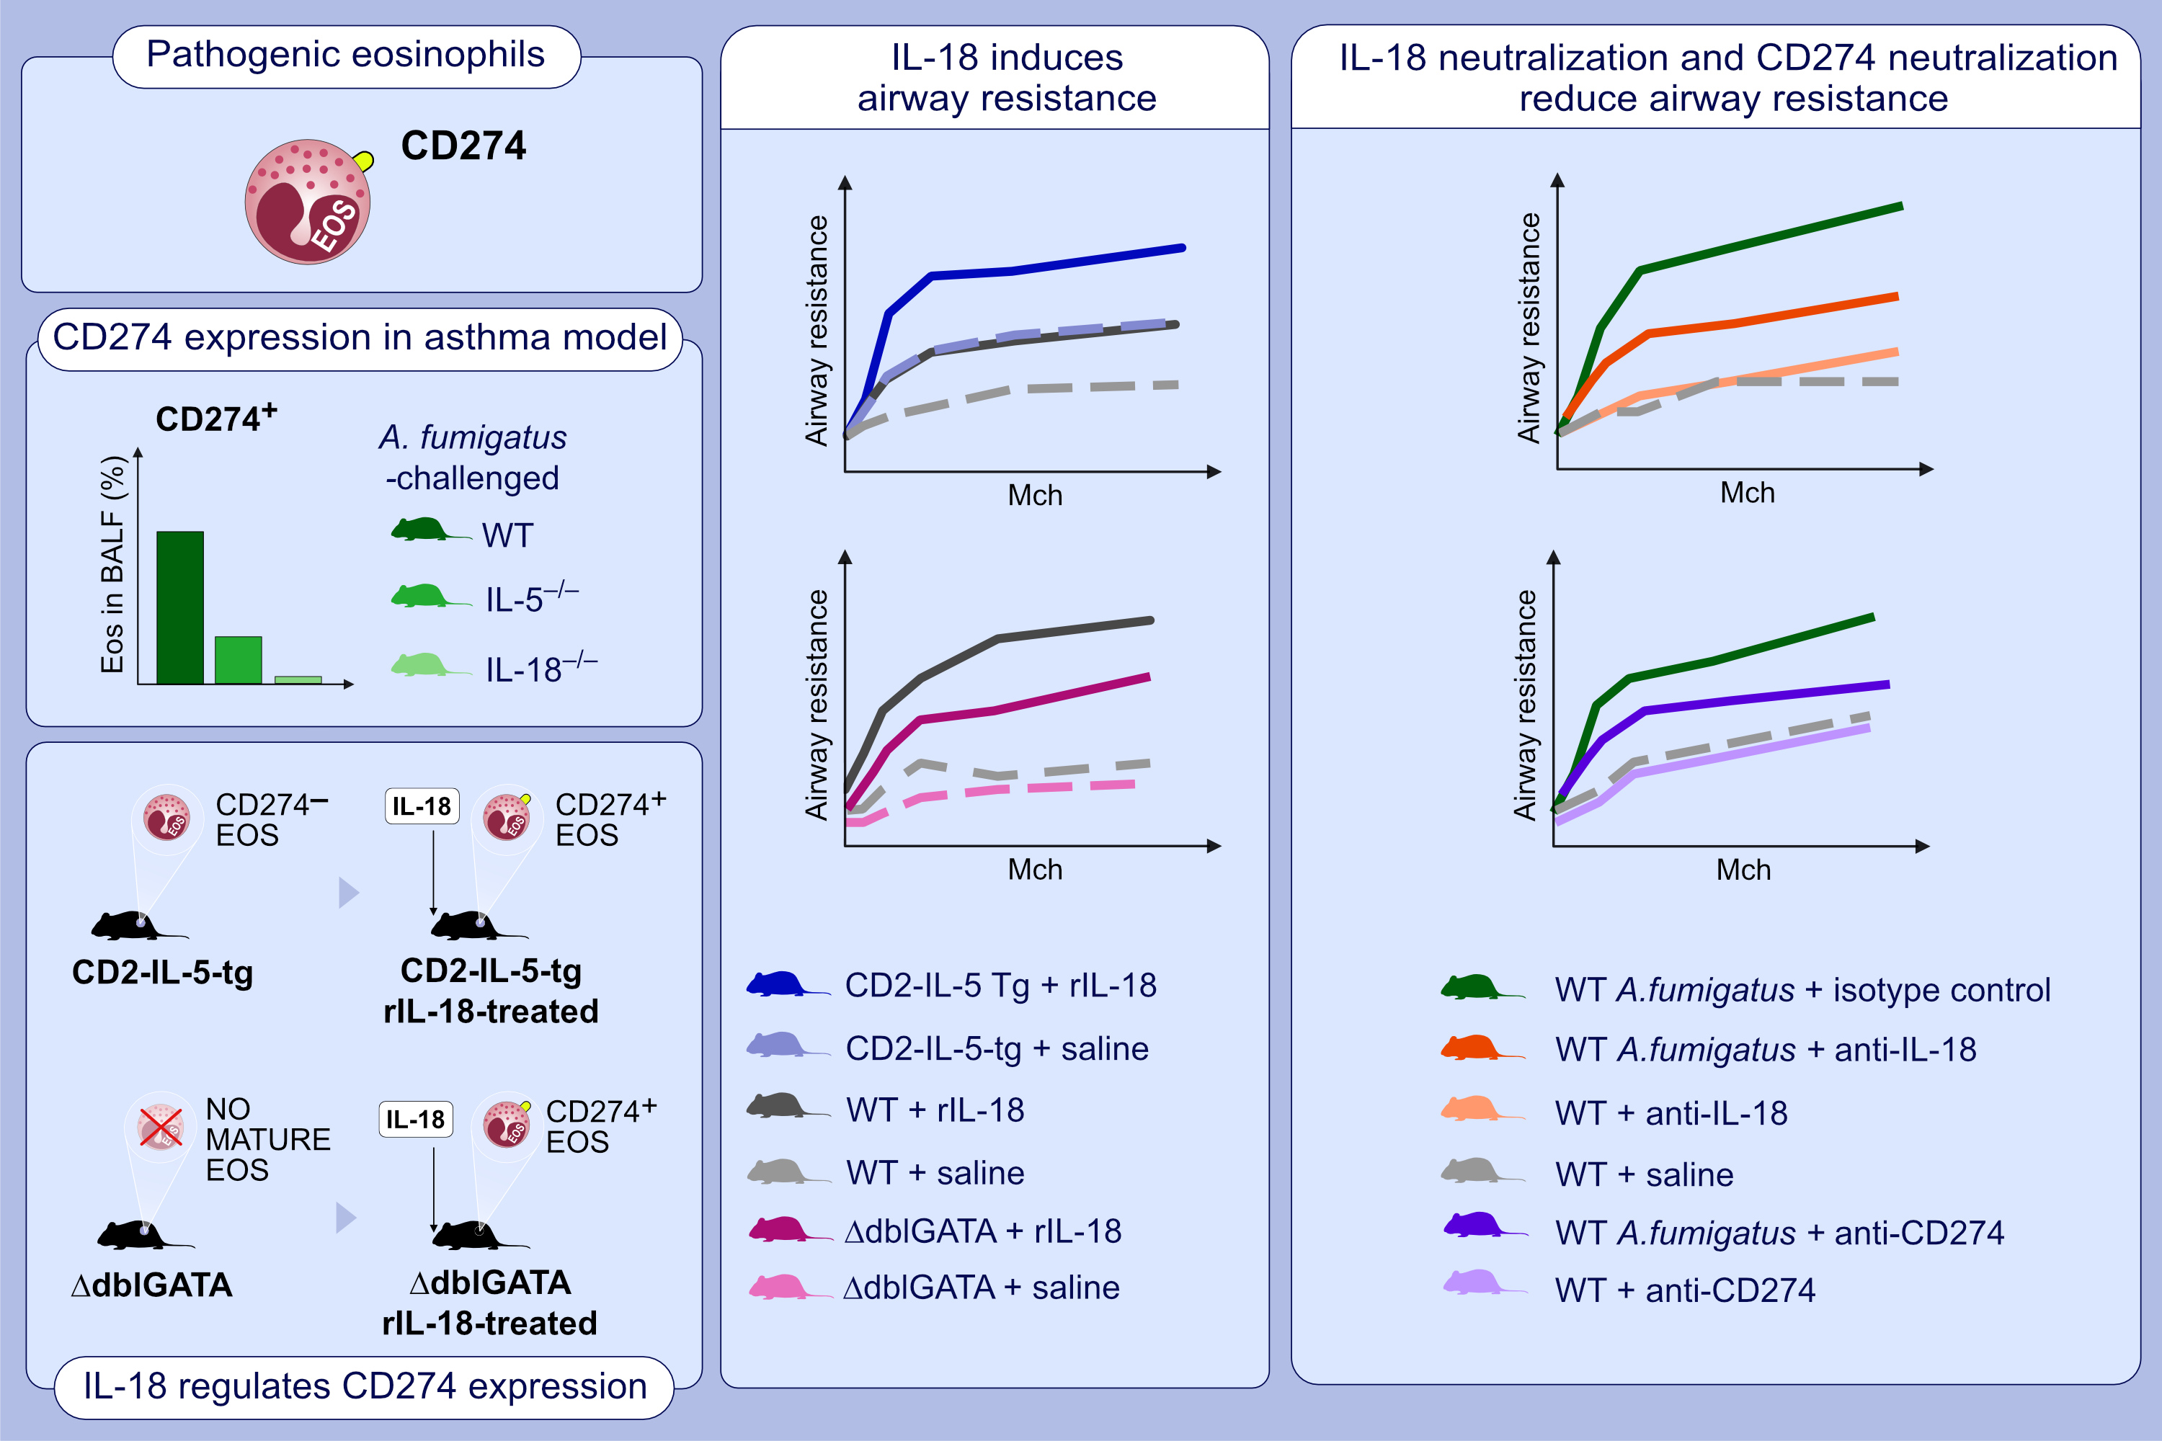
Role of IL-18-transformed CD274-expressing eosinophils in promoting airway obstruction in experimental asthma
Anil Mishra,, Dewan Majid,, Hemanth Kumar Kandikattu,, Chandra Sekhar Yadavalli,, Sathisha Upparahalli Venkateshaiah, et al.
Allergy. 2022; 1165-1179 https://doi.org/10.1111/all.15180
© 2019 EAACI and John Wiley and Sons A/S. Published by John Wiley and Sons Ltd.
Notes:
HIGHLIGHTS
Expression of CD274 in the BALF of IL-18^{-/-} mice is significantly reduced compared to IL-5^{-/-} and WT in A. fumigatus-challenged mice.
IL-18 treatment induces transformation of CD274⁻ eosinophil to pathogenic CD274⁺ eosinophils.
In vivo neutralization of CD274 and neutralization of IL-18 reduce airway resistance in A. fumigatus-challenged mice.
Abbreviations: A. fumigatus, Aspergillus fumigatus; BALF, bronchoalveolar lavage fluid; CD2-IL-5-tg, transgenic mice overexpressing IL-5 under the control of the Cd2 promoter; ΔdblGATA, eosinophil-deficient mice; Eos, eosinophil; Ig, immunoglobulin; Mch, methacholine; WT, wild type; IL-5^{-/-}, IL-5 knockout; IL-18^{-/-}, IL-18 knockout

