Slide 1
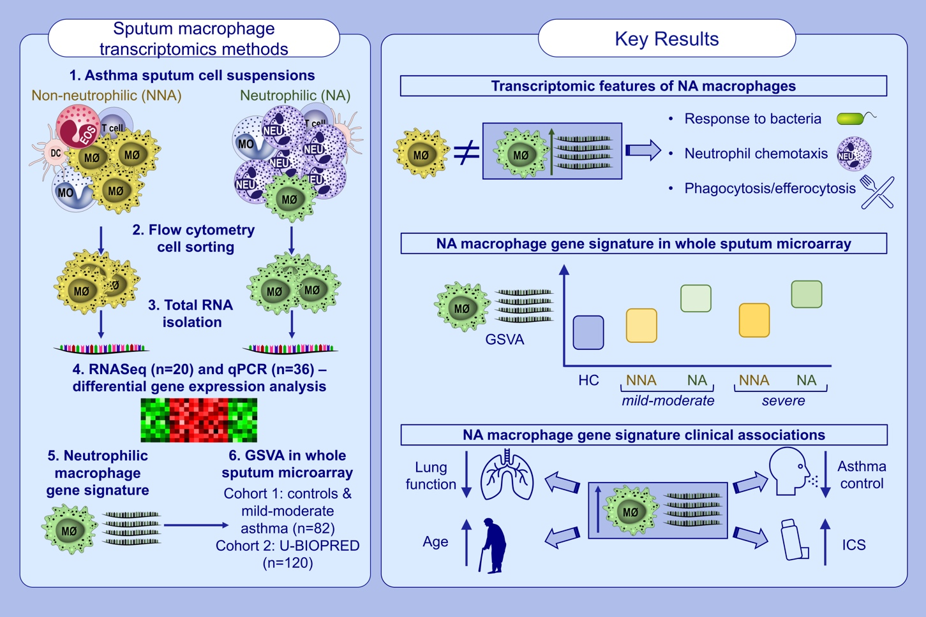
An altered sputum macrophage transcriptome contributes to the neutrophilic asthma endotype
Michael Fricker, Ling Qin, Stephany Sánchez-Ovando, Jodie L. Simpson, Katherine J. Baines, et al.
Allergy. 2022; 1204-1215 https://doi.org/10.1111/all.15087
© 2019 EAACI and John Wiley and Sons A/S. Published by John Wiley and Sons Ltd.
Notes:
HIGHLIGHTS
RNASeq of isolated sputum macrophages reveals transcriptomic alterations in neutrophilic asthma (NA) consistent with responses to bacteria, promotion of neutrophil recruitment and regulation of phagocytosis/efferocytosis.
NA macrophage gene signature is enriched in NA whole sputum microarray datasets across asthma severities.
NA macrophage gene signature correlates with increasing age, worse lung function, poorer asthma control and increased ICS dose.
Abbreviations: U-BIOPRED, Unbiased Biomarkers for the Prediction of Respiratory Disease Outcomes; DC, dendritic cell; EOS, eosinophil; GSVA; gene set variation analysis; HC, healthy control; ICS, inhaled corticosteroid; MØ, macrophage; MO, monocyte; NA, neutrophilic asthma; NNA, non-neutrophilic asthma; NEU, neutrophil; qPCR, quantitative PCR; RNA, ribonucleic acid; RNASeq, RNA sequencing

