Slide 1
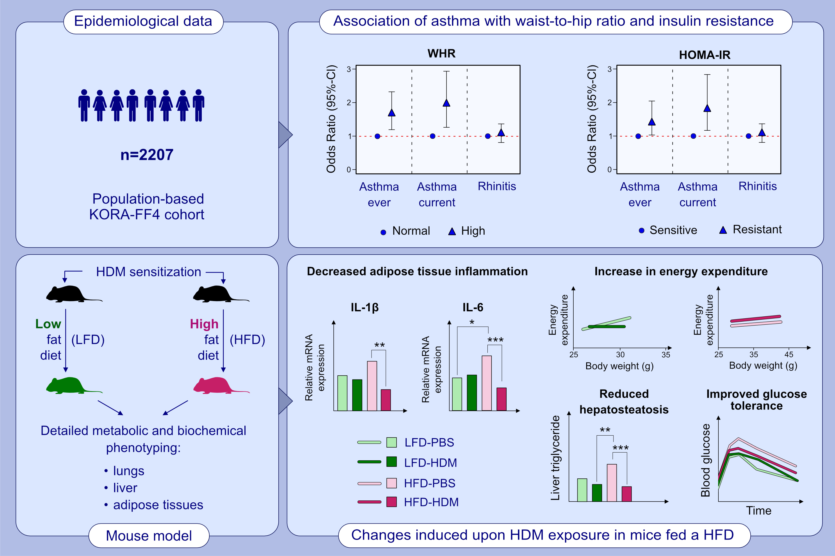
Differential effects of lung inflammation on insulin resistance in humans and mice
Ruth Karlina, Claudia Flexeder, Stephanie Musiol, Madhumita Bhattacharyya, Evelyn Schneider, et al.
Allergy. 2022; pages: 2482-2497
https://doi.org/10.1111/all.15226
© 2019 EAACI and John Wiley and Sons A/S. Published by John Wiley and Sons Ltd.
Notes:
HIGHLIGHTS
This study investigates the epidemiological association and physiological impact of lung inflammation on obesity and glucose homeostasis.
Asthma is associated with increased insulin resistance independently of a body fat mass.
HDM-induced lung inflammation increases energy expenditure, decreases adipose tissue inflammation and hepatosteatosis, resulting in improved glucose tolerance in high fat diet-induced obese mice.
Abbreviations: CI, confidence interval, HDM, house dust mite; HFD, high fat diet; HOMA-IR, homeostasis model assessment-estimated insulin resistance; KORA-FF4, Cooperative Health Research in the Augsburg Region; LFD, low fat diet; PBS, phosphate-buffered saline; WHR, waist-to-hip ratio

