Slide 1
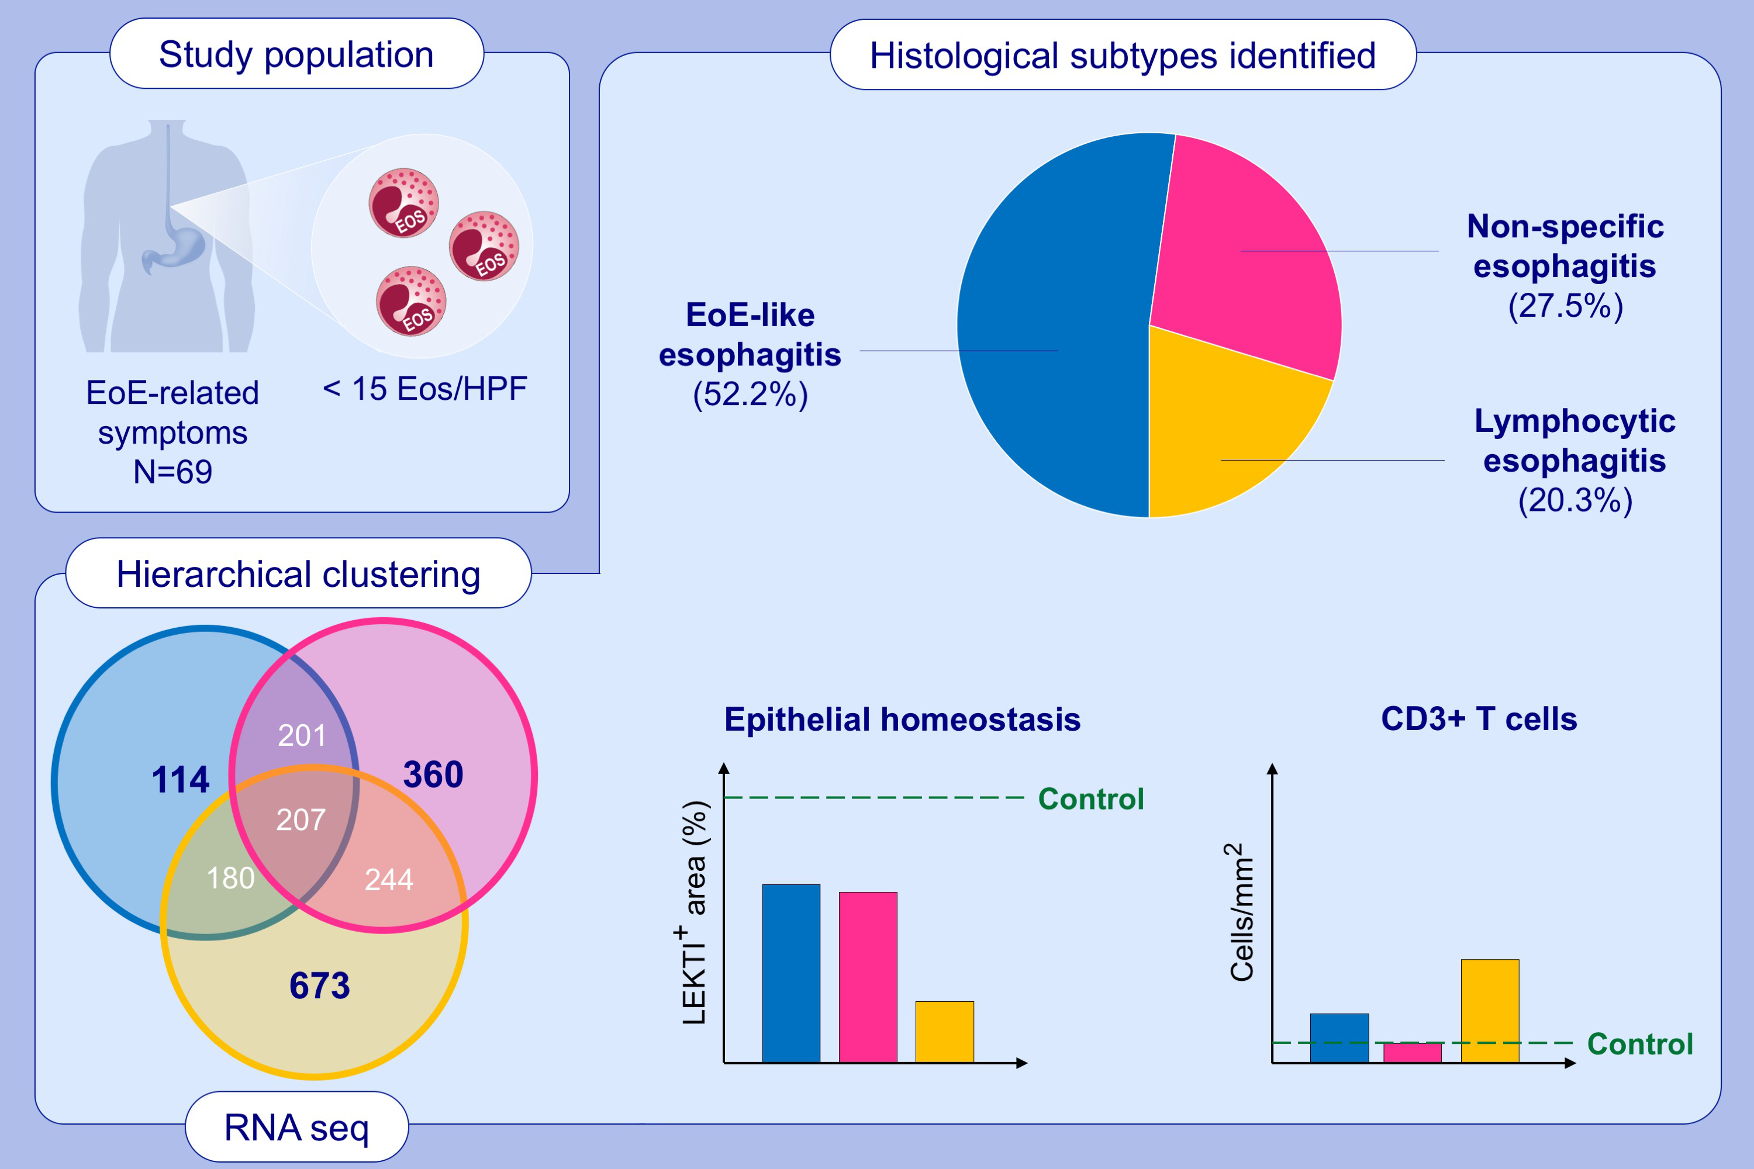
Characterization of eosinophilic esophagitis variants by clinical, histological and molecular analyses: a cross-sectional multi-center study
Thomas Greuter, Alex Straumann, Yuniel Fernandez-Marrero, Nina Germic, Aref Hosseini, et al.
Allergy. 2022; pages: 2520-2533
https://doi.org/10.1111/all.15233
© 2019 EAACI and John Wiley and Sons A/S. Published by John Wiley and Sons Ltd.
Notes:
HIGHLIGHTS
This study assesses clinical, (immuno)-histological and molecular characteristics of 69 patients with EoE-related symptoms, but absence of significant esophageal eosinophilia.
We identify three histological variants, EoE-like esophagitis, lymphocytic esophagitis and non-specific esophagitis.
All three variants show decreased LEKTI expression, while lymphocytic esophagitis also shows CD3-positive cell invasion. RNA sequencing reveales distinct molecular fingerprints in each variant and confirms the presence of an EoE-like, lymphocytic, and non-specific variant/cluster.
Abbreviations: CD3, cluster of differentiation 3; EoE, eosinophilic esophagitis; Eos, eosinophil; HPF, high power field; LEKTI, lympho-epithelial Kazal-type-related inhibitor; RNA seq, RNA sequencing

