Slide 1
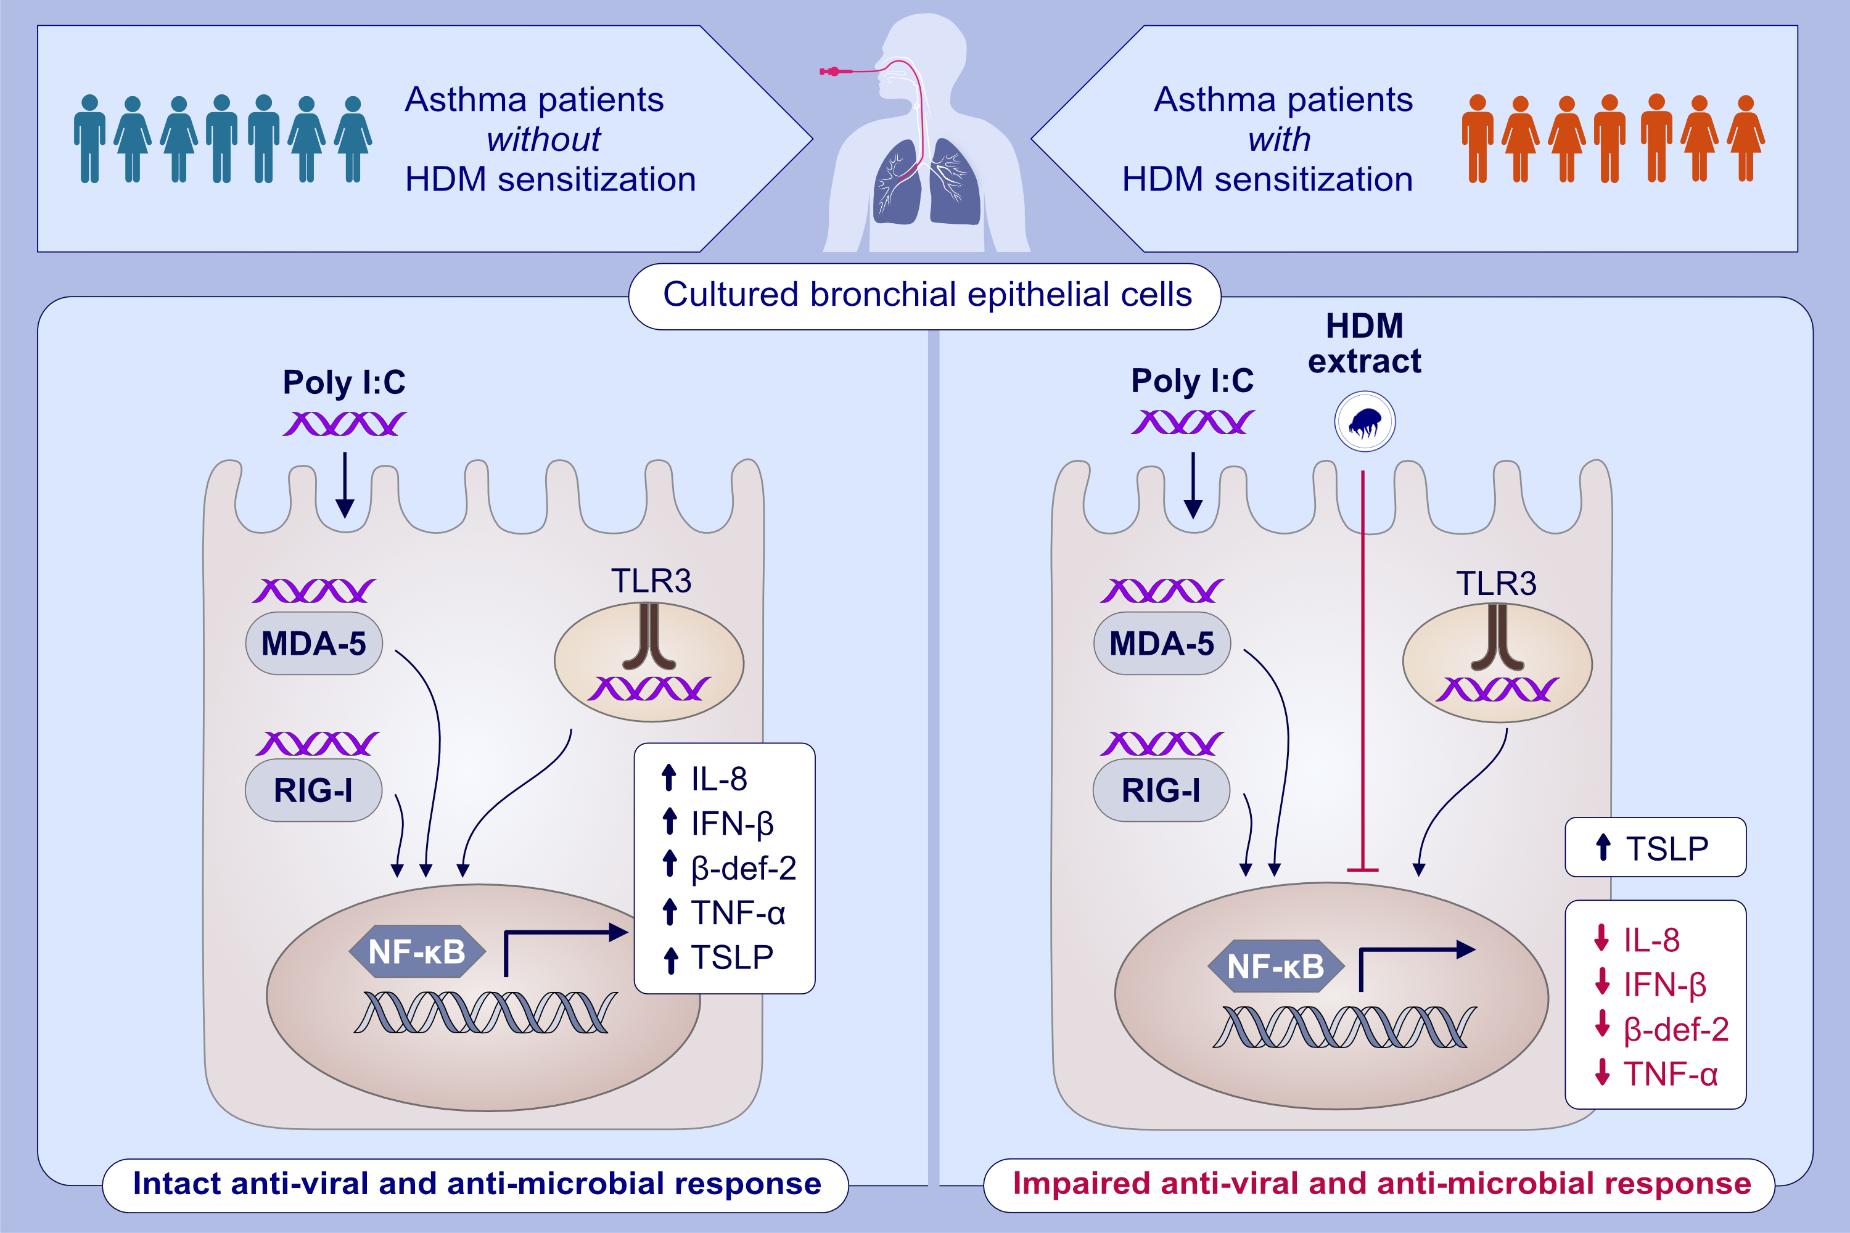
House dust mite sensitization and exposure affects bronchial epithelial anti-microbial response to viral stimuli in patients with asthma
Samuel Cerps, Asger Sverrild, Sangeetha Ramu, Juan José Nieto-Fontarigo, Hamid Akbarshahi, et al.
Allergy. 2022; pages2498-2508 https://doi.org/10.1111/all.15243
© 2019 EAACI and John Wiley and Sons A/S. Published by John Wiley and Sons Ltd.
Notes:
HIGHLIGHTS
In this study, we investigate the role of HDM sensitization and effects of HDM exposure on viral mimic-challenged HBECs from asthmatic donors.
In vitro exposure of viral mimic-challenged HBECs to HDM reduces IFN-β and anti-microbial agents including β-def-2, IL-8, and TNF-α, but not TSLP, across non-allergic as well as allergic asthma.
Data suggest that both HDM sensitization and acute exposure to HDM contribute to reducing infection-evoked immune protection in asthma and thus increase the risk of symptomatic infections and exacerbations.
Abbreviations: β-def-2, β-defensin-2; HBECs, human bronchial epithelial cells; HDM, house dust mite; IFN-β, interferon-β; MDA-5, melanoma differentiation-associated protein; NF-κB, nuclear factor-kappa B; Poly (I:C), polyinosinic-polycytidylic acid; RIG-I, retinoic acid-inducible gene I; TLSP, thymic stromal lymphopoietin

