Slide 1
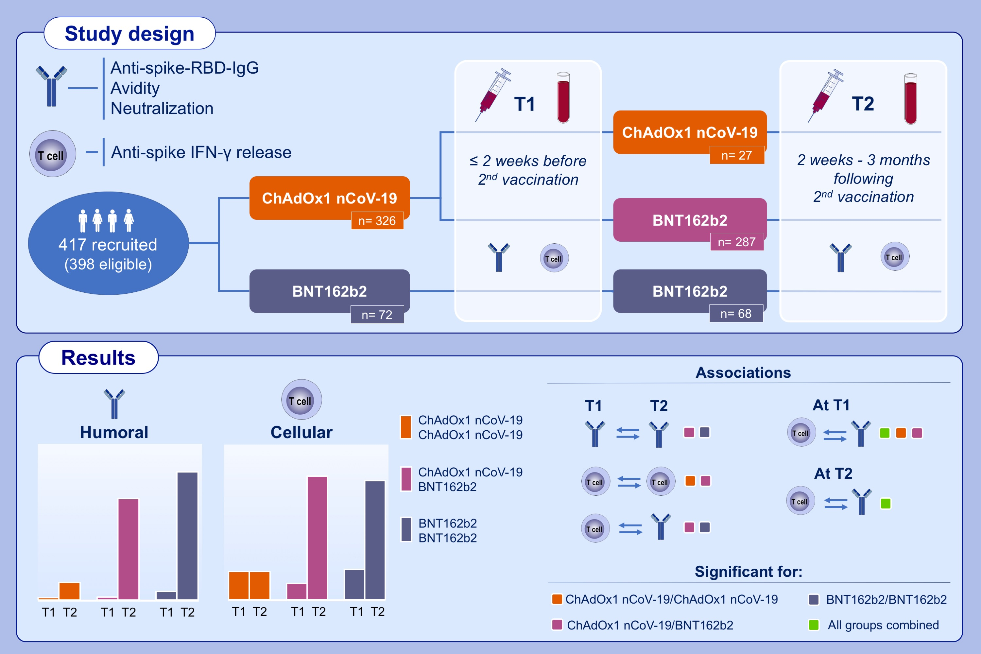
Interdependencies of cellular and humoral immune responses in heterologous and homologous SARS‑CoV‑2 vaccination
Moritz M. Hollstein, Lennart Münsterkötter, Michael P. Schön, Armin Bergmann, Thea M. Husar, et al.
Allergy. 2022; pages: 2381-2392 https://doi.org/10.1111/all.15247
© 2019 EAACI and John Wiley and Sons A/S. Published by John Wiley and Sons Ltd.
Notes:
HIGHLIGHTS
Booster with BNT162b2 elicits strong humoral and cellular immune responses independent of the prime vaccination, whereas ChAdOx1 nCoV-19 booster does not further enhance the cellular response.
Levels of humoral and cellular immune responses following COVID-19 vaccinations are related and interdependencies between them differ amongst vaccination regimes.
Poor humoral immune responses are unlikely to be compensated by strong cellular activation.
Abbreviations: COVID-19, coronavirus disease 2019; IFN, interferon; RBD, receptor binding domain; SARS-CoV-2, severe acute respiratory syndrome coronavirus 2; T, time points

