Slide 1
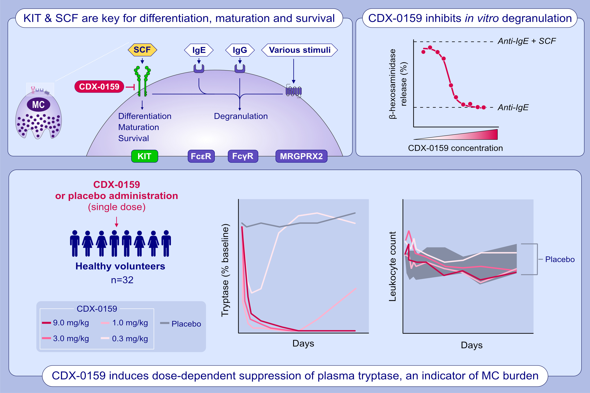
Anti-KIT monoclonal antibody CDX-0159 induces profound and durable mast cell suppression
Diego Alvarado, Marcus Maurer, Richard Gedrich, Scott B. Seibel, Michael B. Murphy, et al.
Allergy. 2022; pages: 2393-2403 https://doi.org/10.1111/all.15262
© 2019 EAACI and John Wiley and Sons A/S. Published by John Wiley and Sons Ltd.
Notes:
HIGHLIGHTS
This study presents the preclinical characterization, safety, pharmacokinetic and pharmacodynamic activity in a placebo-controlled phase 1a healthy volunteer study of CDX-0159, a specific and potent anti-KIT inhibitory monoclonal antibody.
CDX-0159 inhibits SCF-dependent KIT and mast cell activation.
In a dose-dependent manner, CDX-0159 induces suppression of plasma tryptase – a marker of mast cell burden – showing a potential as a therapeutic strategy in mast cell-driven disorders.
Abbreviations: CDX-0159, anti-KIT inhibitory monoclonal antibody; FcR, Fc receptor; KIT, KIT proto-oncogene, receptor tyrosine kinase; MRGPRX2, mas-related G protein-coupled receptor-X2; SCF, stem cell factor.

