Slide 1
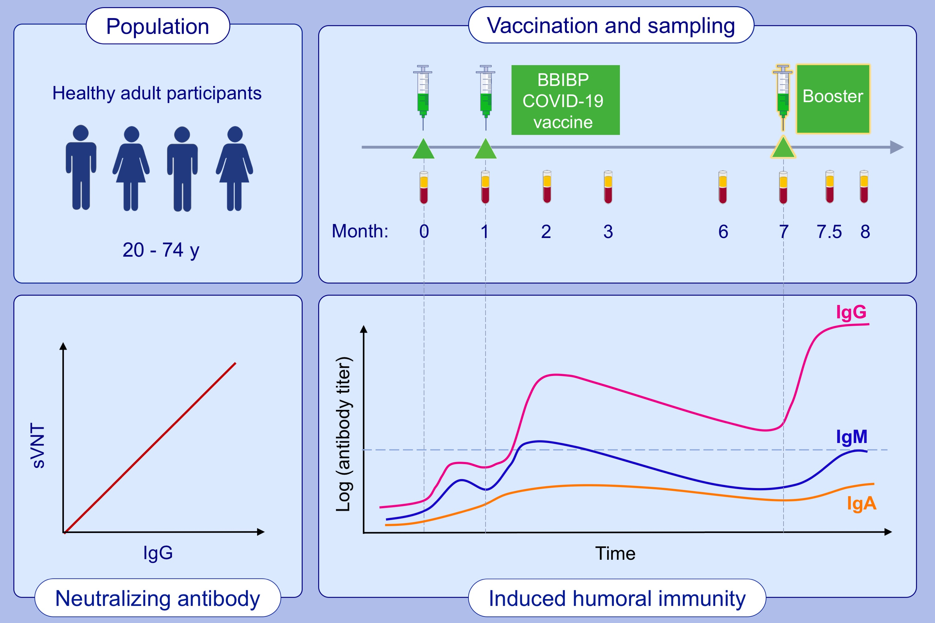
Humoral immune response of Sinopharm/BBIBP COVID-19 vaccination before and after the booster immunization
Zhangkai J. Cheng, Huimin Huang, Peiyan Zheng, Mingshan Xue, Jing Ma, et al.
Allergy. 2022; pages: 2404-2414 https://doi.org/10.1111/all.15271
© 2019 EAACI and John Wiley and Sons A/S. Published by John Wiley and Sons Ltd.
Notes:
HIGHLIGHTS
This study monitored specific antibody levels (IgA/IgM/IgG), cVNT, pVNT, and sVNT tests in 353 healthy adult subjects over the course of vaccination.
The first two injections of the vaccine induce humoral responses with a peak at two months.
Following the booster dose, IgA, IgG and neutralizing antibodies increase, with a neutralizing titer 13.2 times higher than before the booster.
Abbreviations: cVNT, conventional virus neutralization test; Ig, immunoglobulin; pVNT, pseudo virus neutralization test; sVNT, surrogate virus neutralization test

