Slide 1
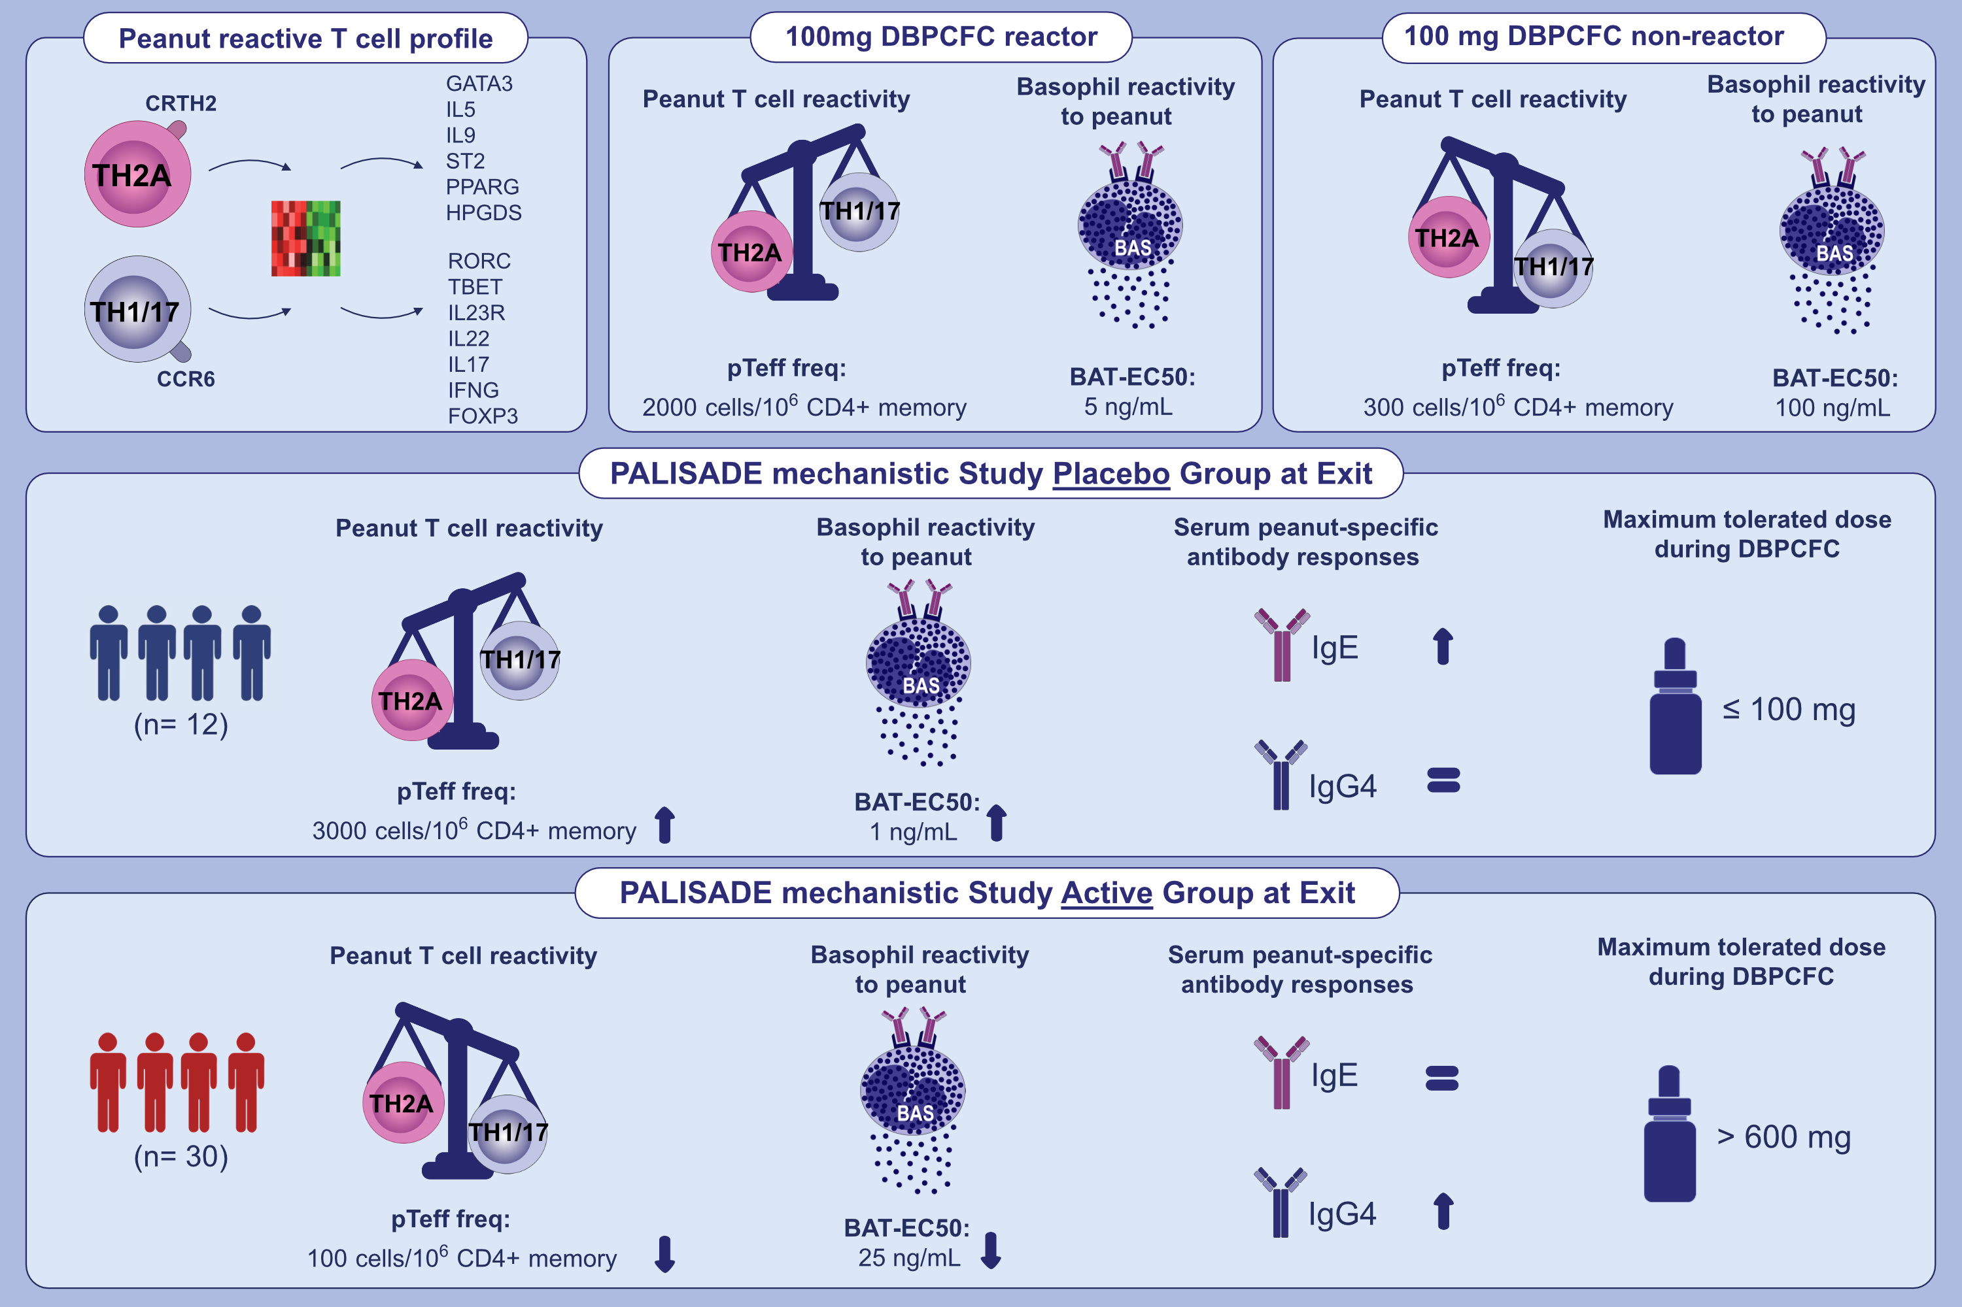
Oral desensitization therapy for peanut allergy induces dynamic changes in peanut-specific immune responses
Veronique Bajzik, Hannah A. DeBerg, Nahir Garabatos, Blake J. Rust, Kimberly K. Obrien, et al.
Allergy. 2022; pages: 2534-2548 https://doi.org/10.1111/all.15276
© 2019 EAACI and John Wiley and Sons A/S. Published by John Wiley and Sons Ltd.
Notes:
HIGHLIGHTS
CRTH2+ pTeff cells and CCR6+ pTeff cells represent two mutually exclusive, non-overlapping cellular and molecular entities involved in food allergic diseases.
Circulating CRTH2+ pTeff cells are mostly restricted to peanut allergic individuals who react to the 100 mg DBPCFC compared to those with lower clinical sensitivity to peanut.
Changes in basophil and T cell responses to peanut closely parallel clinical benefits to POIT and resemble responses in those that did not react to the baseline 100 mg DBPCFC.
Abbreviations: BAT-EC50, concentration of allergen corresponding to 50% of maximal activation of basophils in basophil activation test; CCR6, C-C motif chemokine receptor 6; CRTH2, chemoattractant receptor-homologous molecule expressed on Th2 cells; DBPCFC, double-blinded placebo-controlled peanut challenge; FOXP3, forkhead box P3; freq, frequency; GATA3, GATA binding protein 3; HPGDS, hematopoietic prostaglandin D synthase; IFNG, interferon gamma; IL, interleukin; PALISADE, Peanut Allergy Oral Immunotherapy Study of AR101 for Desensitization in Children and Adults; POIT, peanut oral immunotherapy; PPARG, peroxisome proliferator activated receptor alpha; pTeff, peanut-reactive T cell; RORC, RAR related orphan receptor C; ST2, suppression of tumorigenicity 2

