Slide 1
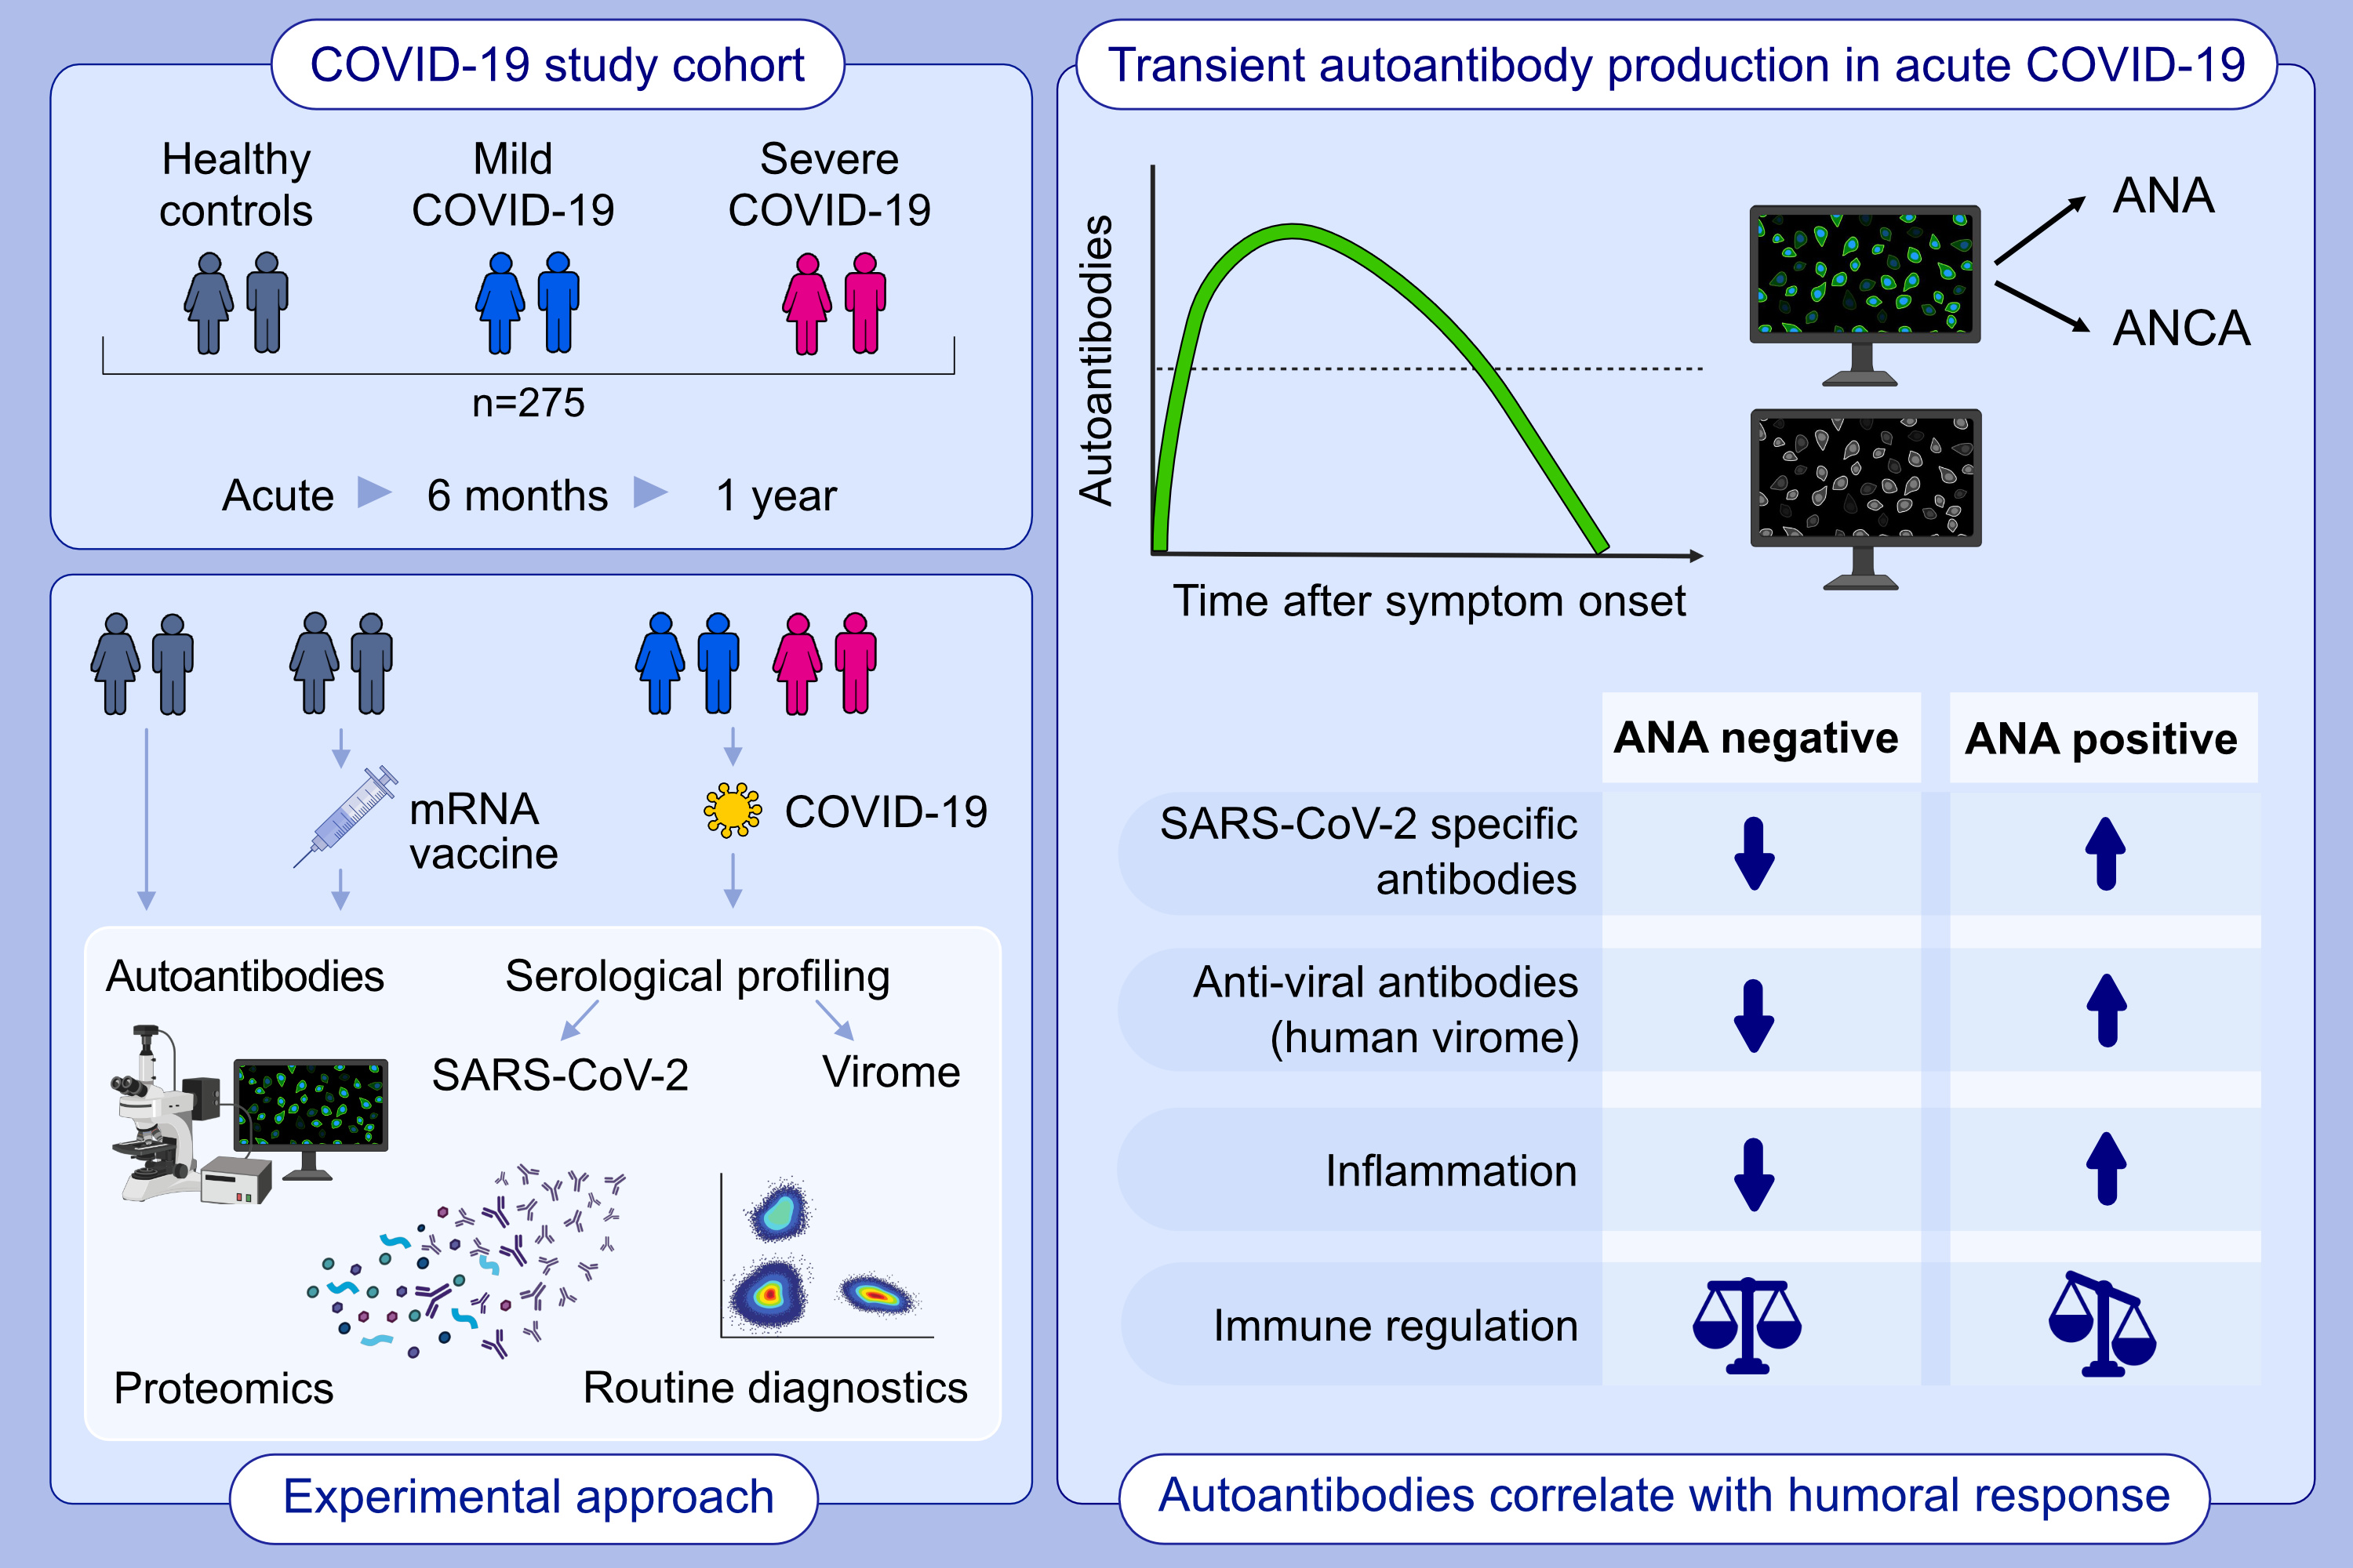
Autoantibodies in COVID-19 correlate with anti-viral humoral responses
and distinct immune signatures
Patrick Taeschler, Carlo Cervia, Yves Zurbuchen, Sara Hasler, Christian Pou, et al.
Allergy. 2022; pages: 2053-2066 https://doi.org/10.1111/all.15302
© 2019 EAACI and John Wiley and Sons A/S. Published by John Wiley and Sons Ltd.
Notes:
HIGHLIGHTS
In a multicentric cohort of 175 COVID-19 patients, 11 vaccinated individuals, and 41 unexposed controls, we measured ANA and ANCA, along with serum proteomics and virome-wide serological profiling.
Paired analysis revealed transient presence of ANA patterns and ANCA during acute COVID-19.
The presence of autoantibodies correlated with increased virus-specific humoral immune responses and a pro-inflammatory immune signature.
Abbreviations: ANA, anti-nuclear antibodies; ANCA, anti-neutrophil cytoplasmic antibodies; COVID-19, coronavirus disease 2019; SARS-CoV-2, severe acute respiratory syndrome coronavirus type 2

