Slide 1
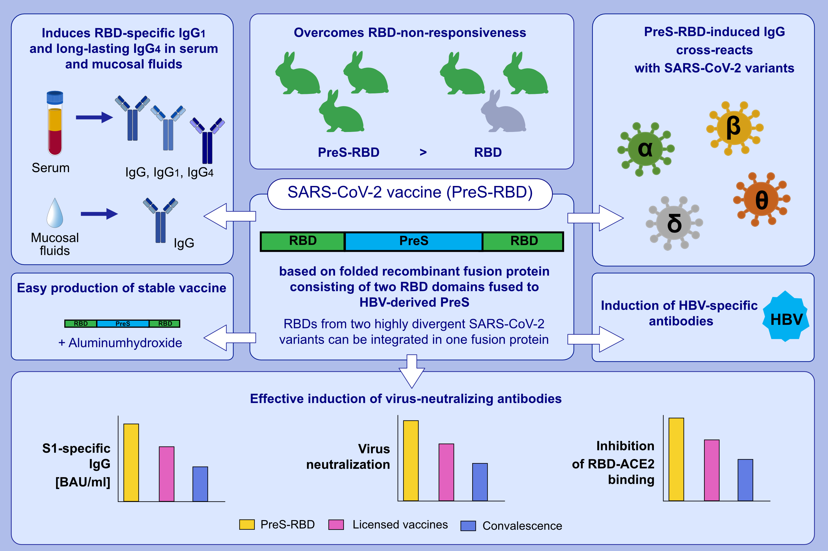
Vaccine based on folded RBD-PreS fusion protein with potential to induce sterilizing immunity
to SARS-CoV-2 variants
Pia Gattinger, Bernhard Kratzer, Inna Tulaeva, Katarzyna Niespodziana, Anna Ohradanova-Repic, et al.
Allergy. 2022; pages: 2431-2445 https://doi.org/10.1111/all.15305
© 2019 EAACI and John Wiley and Sons A/S. Published by John Wiley and Sons Ltd.
Notes:
HIGHLIGHTS
This study reports the design and characterization of a SARS-CoV-2 subunit vaccine (PreS-RBD).
PreS-RBD, but not RBD alone, induces RBD-specific IgG1 and long-lasting IgG4 in serum and mucosal fluids, and cross-reacts with SARS-CoV-2 variants of concern.
PreS-RBD-specific antibodies of the immunized subject more potently inhibit the interaction of RBD with angiotensin converting enzyme 2 (ACE2) and their virus neutralizing titers are higher than median in a random sample of health subjects fully immunized with registered SARS-CoV-2 vaccines or in COVID- 19 convalescent subjects.
Abbreviations: COVID-19, coronavirus disease 2019; IgG, immunoglobulin G; HBV, hepatitis B virus; RBD, receptor-binding domain; PreS, HVB domain; SARS-CoV-2, severe acute respiratory syndrome coronavirus 2

