Slide 1
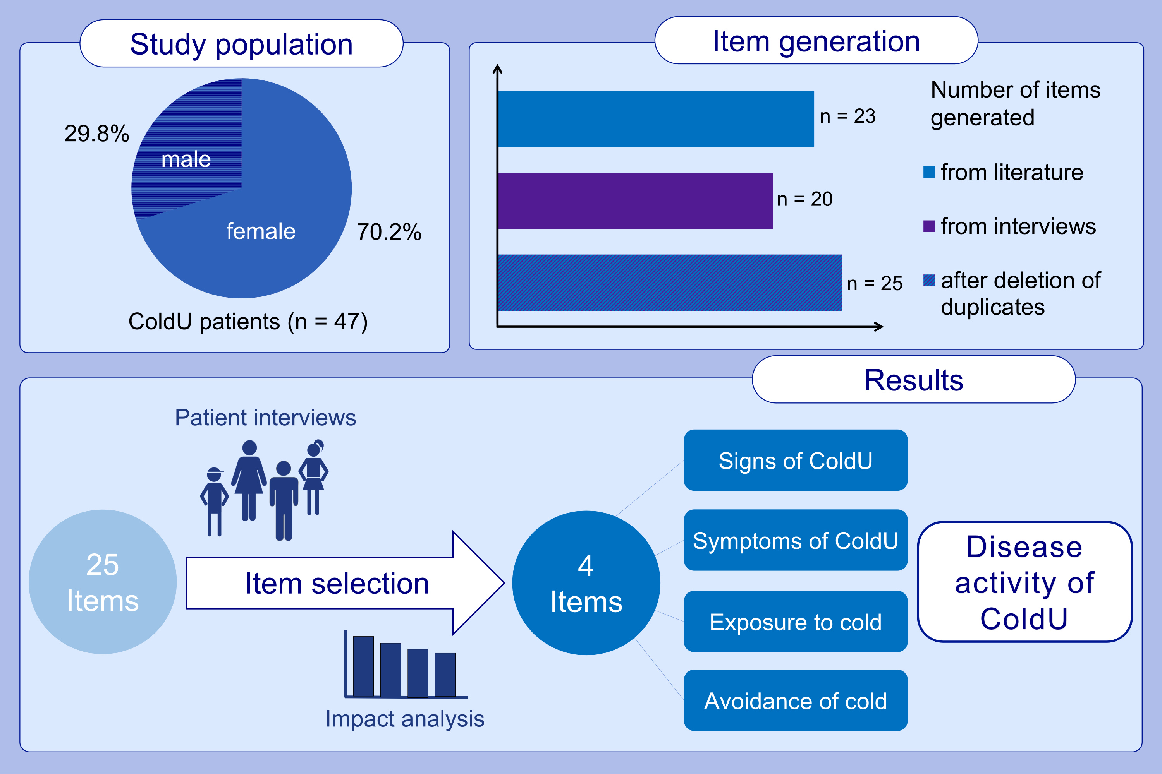
Development of the Cold Urticaria Activity Score
Dalia Melina Ahsan, Sabine Altrichter, Annika Gutsche, Jonathan A. Bernstein, Tatjana Altunergil, et al.
Allergy. 2022; pages: 2509-2519 https://doi.org/10.1111/all.15310
© 2019 EAACI and John Wiley and Sons A/S. Published by John Wiley and Sons Ltd.
Notes:
HIGHLIGHTS
The ColdUAS development process was directed by PROM guidelines.
For item generation 47 interviews with ColdU patients and a comprehensive literature research was performed. By conducting an impact analysis, cognitive debriefings, and an expert review final items were selected.
The 4-item ColdUAS is the first self-administered questionnaire for the prospective assessment of disease activity in ColdU patients.
Abbreviations: ColdU, Cold urticaria; ColdUAS, Cold Urticaria Activity Score; PROM, patient-reported outcome measures

