Slide 1
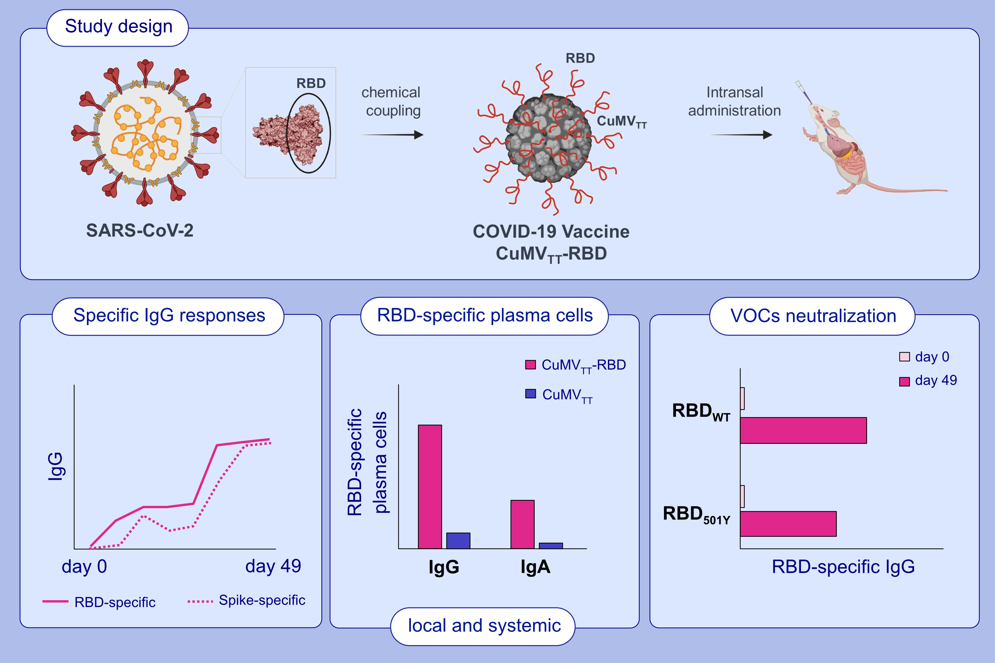
Intranasal administration of a VLP-based vaccine induces neutralizing antibodies against SARS-CoV-2 and variants of concern
Dominik A. Rothen, Pascal S. Krenger, Aleksandra Nonic, Ina Balke, Anne-Cathrine S. Vogt, et al.
Allergy. 2022; pages2446-2458 https://doi.org/10.1111/all.15311
© 2019 EAACI and John Wiley and Sons A/S. Published by John Wiley and Sons Ltd.
Notes:
HIGHLIGHTS
In this study, we describe a COVID-19 vaccine based on virus-like particles (VLPs) for intranasal administration.
We demonstrate that the vaccine candidate (CuMV_{TT}-RBD) is highly immunogenic in mice and is capable of inducing mucosal and systemic RBD as well as spike specific antibody responses.
The induced antibodies are capable of neutralizing SARS-CoV-2 and variants of concern.
Abbreviations: COVID-19, coronavirus disease 2019; RBD, receptor-binding domain; SARS-CoV-2, severe acute respiratory syndrome coronavirus 2; VLPs, virus-like particles; VOC, variant of concern

