Slide 1
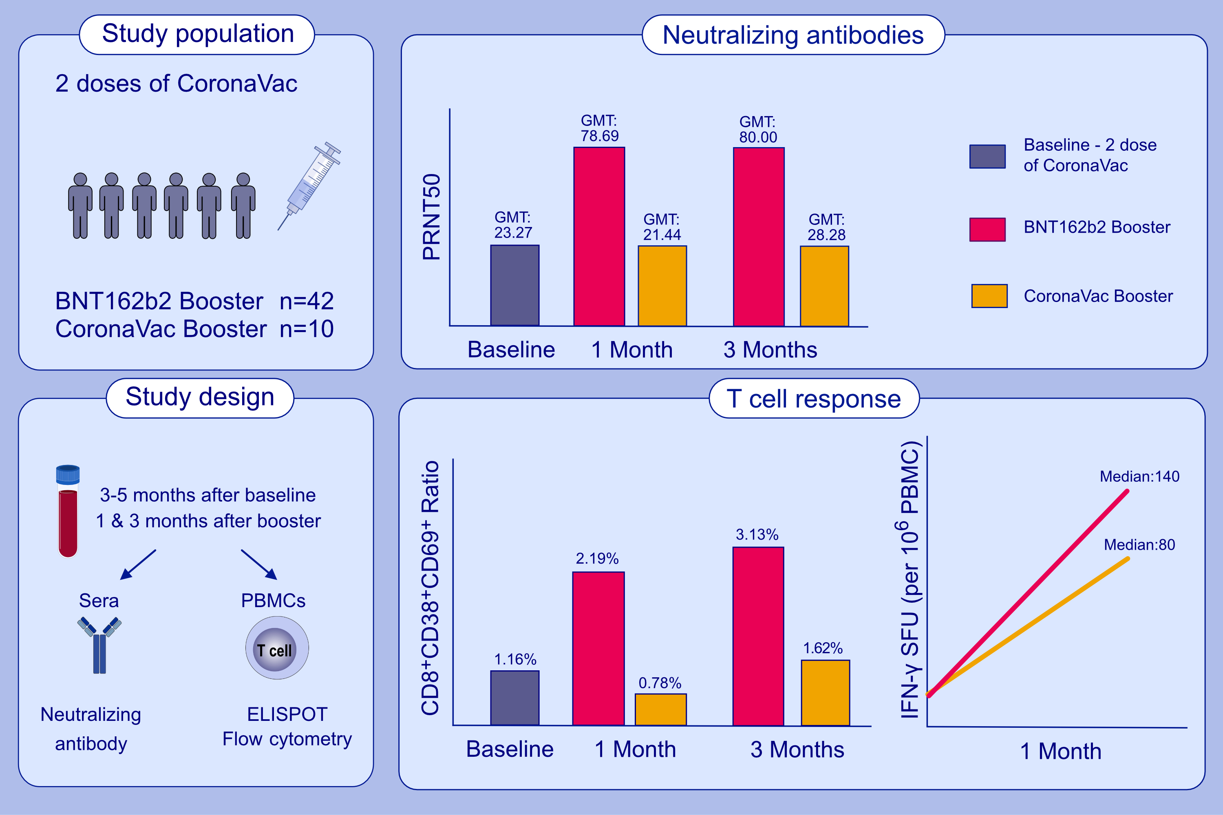
Effect of BTN162b2 and Coronavac boosters on humoral and cellular immunity
of individuals previously fully vaccinated with Coronavac
against SARS-CoV-2: A longitudinal study
Zeynep Ece Kuloğlu, Rojbin El, Gulen Guney-Esken, Yeşim Tok, Zeynep Gülçe Talay, et al.
Allergy. 2022; pages: 2459-2467 https://doi.org/10.1111/all.15316
© 2019 EAACI and John Wiley and Sons A/S. Published by John Wiley and Sons Ltd.
Notes:
HIGHLIGHTS
This study determines the effects of BNT162b2 (BNT) and CoronaVac (CV) boosters on the humoral and cellular immunity of individuals who had two doses of CV vaccination.
The neutralizing antibody levels after three months of the BNT booster are higher than the antibody levels after CV in fully vaccinated individuals.
The ratio of the effector T cells increases along with greater IFN-γ activation after BNT booster.
Abbreviations: GMT, geometric mean titer; PBMCs, peripheral blood mononuclear cells; PRNT50, plaque reduction neutralization test; SFU, spot forming units

