Slide 1
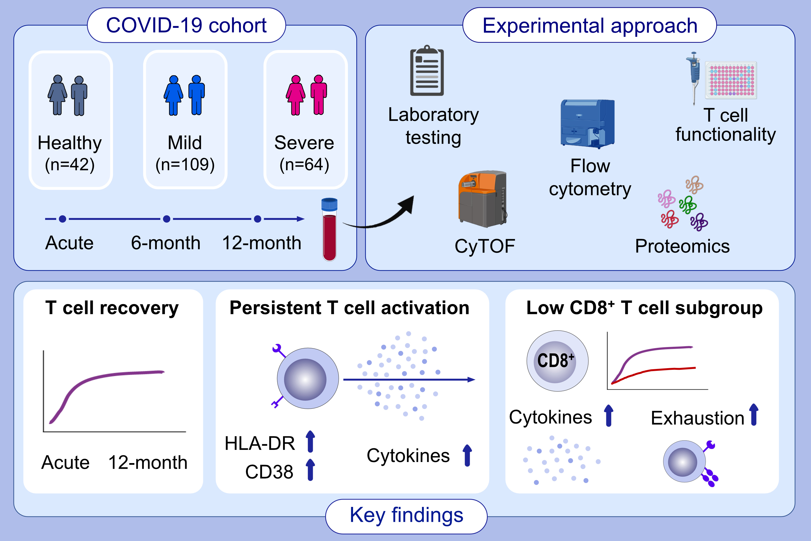
T cell recovery and evidence of persistent immune activation 12 months after severe COVID-19
Patrick Taeschler, Sarah Adamo, Yun Deng, Carlo Cervia, Yves Zurbuchen, et al.
Allergy. 2022; pages: 2468-2481 https://doi.org/10.1111/all.15372
© 2019 EAACI and John Wiley and Sons A/S. Published by John Wiley and Sons Ltd.
Notes:
HIGHLIGHTS
In a multicentric cohort of 173 COVID-19 patients followed-up to one year we found evidence of functional and numeric T cell recovery.
COVID-19 patients showed persistent moderate T cell activation at follow-up timepoints.
A subgroup of severe COVID-19 patients exhibited low CD8⁺ T cell counts at follow-up, coupled to an inflammatory immune signature and T cell exhaustion.
Abbreviations: COVID-19, coronavirus disease 2019; SARS-CoV-2, severe acute respiratory syndrome coronavirus type 2

