Slide 1
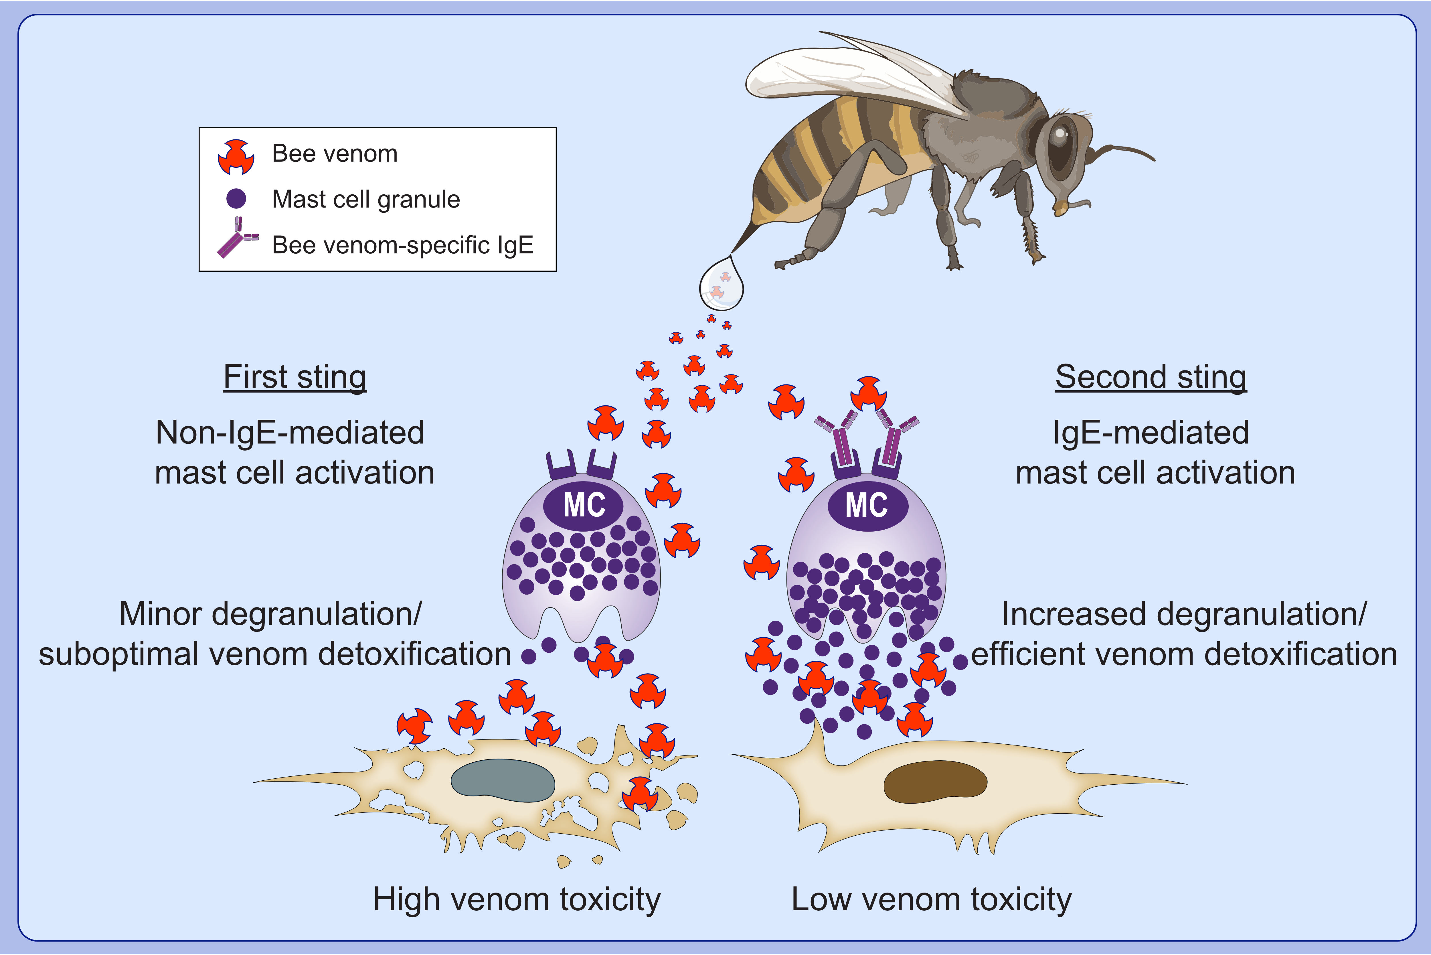
IgE antibodies increase honeybee venom responsiveness and detoxification efficiency of mast cells
Philipp Starkl,, Nicolas Gaudenzio,, Thomas Marichal,, Laurent L. Reber,, Riccardo Sibilano,, et al.
Allergy. Issue; 2022 https://doi.org/10.1111/all.14852
© 2019 EAACI and John Wiley and Sons A/S. Published by John Wiley and Sons Ltd.
Notes:
HIGHLIGHTS
IgE antibodies increase mast cell responsiveness to honeybee venom in vitro and in vivo.
Compounds released by IgE-activated mouse and human mast cells can efficiently detoxify honeybee venom.
Mast cell-derived heparin and proteases contribute to prevention of honeybee venom toxicity.

