Slide 1
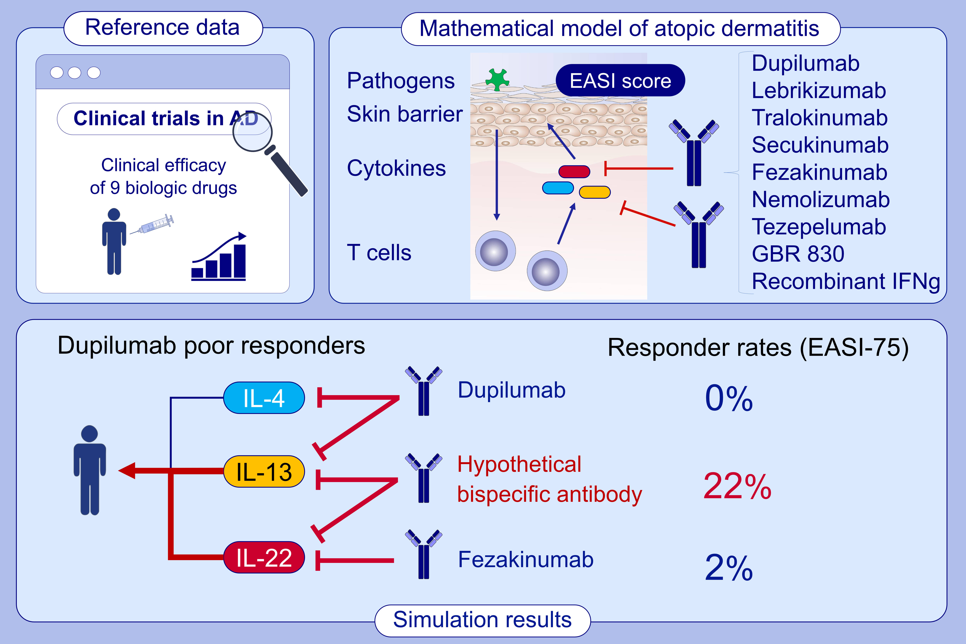
A mathematical model to identify optimal combinations of drug targets for dupilumab poor responders in atopic dermatitis
Takuya Miyano, Alan D. Irvine, Reiko J. Tanaka
Allergy. Issue; 2022 https://doi.org/10.1111/all.14870
© 2019 EAACI and John Wiley and Sons A/S. Published by John Wiley and Sons Ltd.
Notes:
HIGHLIGHTS
We developed a mathematical model that describes systems-level AD pathogenesis and reproduces reported clinical efficacies of published clinical trials for nine biological drugs.
We simulated clinical efficacy of hypothetical therapies on virtual dupilumab poor responders.
Simultaneous inhibition of IL-13 and IL-22 is the most effective among combinations of two cytokines, whereas inhibition of either IL-13 or IL-22 alone is ineffective.
Abbreviations: AD, atopic dermatitis; EASI, Eczema Area and Severity Index; IFN-γ, interferon-gamma; IL, interleukin

