Slide 1
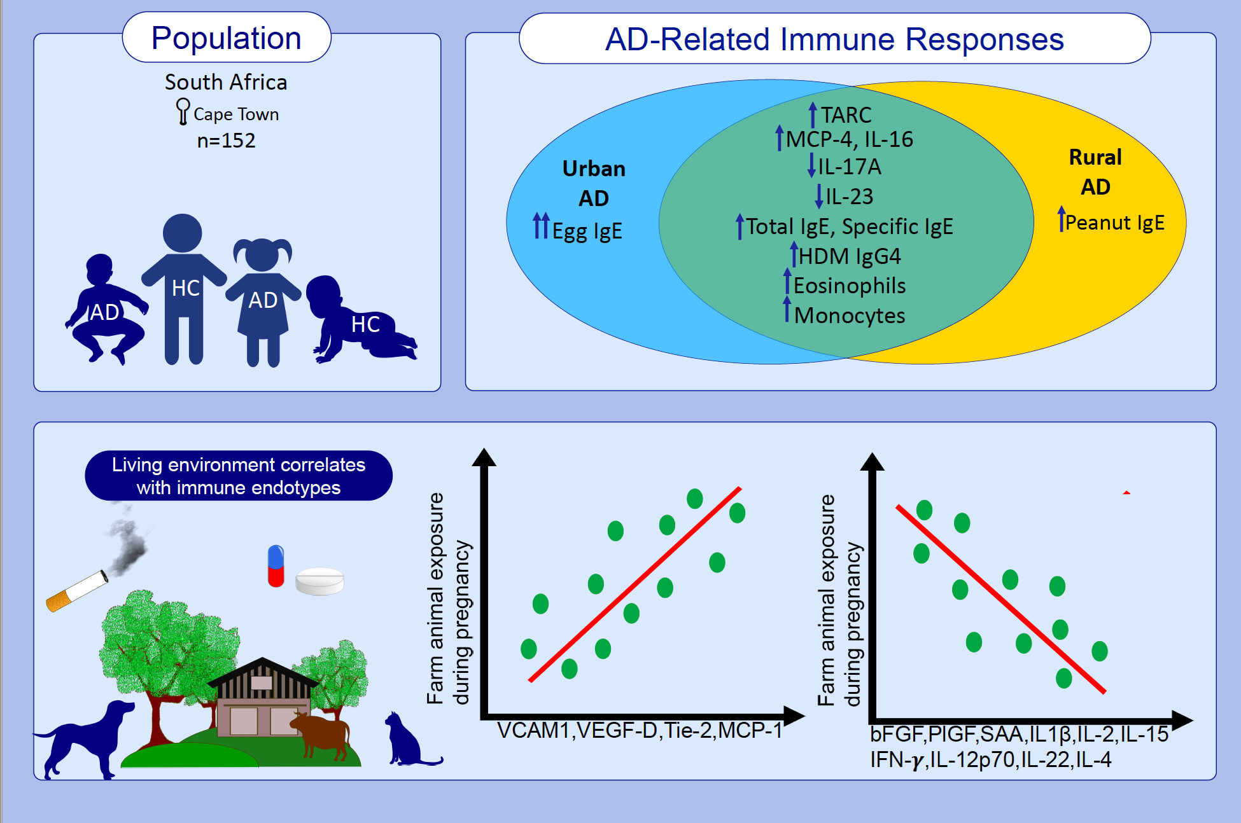
Environment-dependent alterations of immune mediators in urban and rural South African children with atopic dermatitis
Nonhlanhla Lunjani,, Ge Tan,, Anita Dreher,, Milena Sokolowska,, David Groeger,, et al.
Allergy. Issue; 2022 https://doi.org/10.1111/all.14974
© 2019 EAACI and John Wiley and Sons A/S. Published by John Wiley and Sons Ltd.
Notes:
HIGHLIGHTS
In this cohort of children with atopic dermatitis from South Africa, elevated T_{H}2 responses are accompanied by diminished T_{H}17 responses.
Environmental and socio-economic factors dominate the functional reprogramming of immune cell reactivity in children from urban and rural settings.
This data highlights the need to include patients from multiple ethnicities, environments and socio-economic backgrounds in research studies and clinical trials assessing novel immune targeting therapies.

