Slide 1
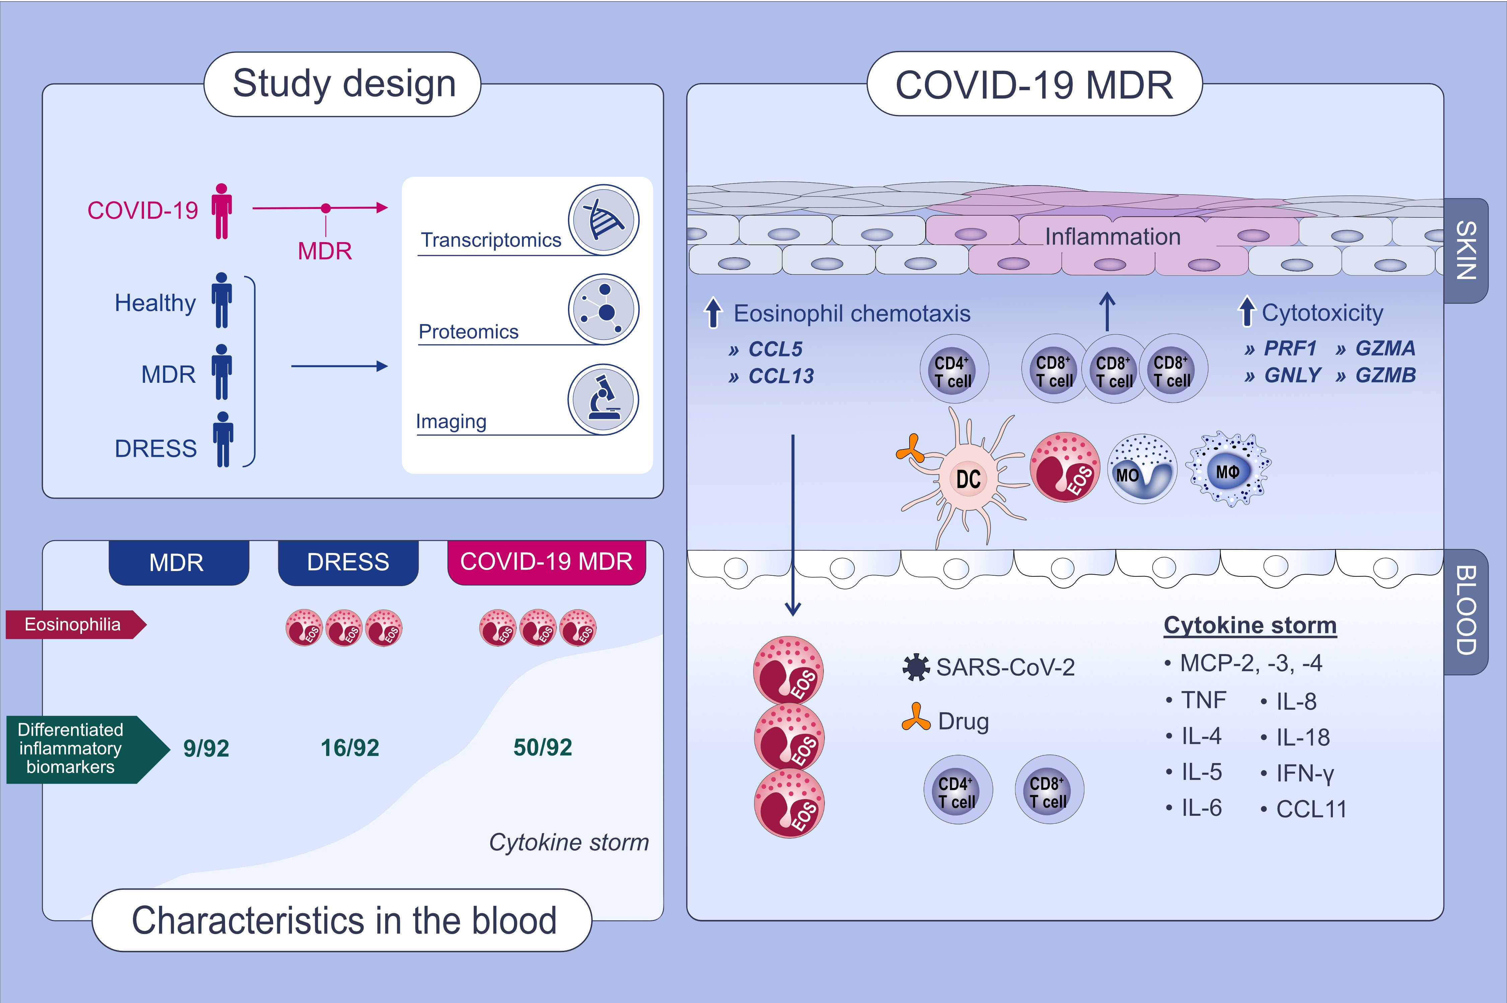
Cutaneous and systemic hyperinflammation drives maculopapular drug exanthema in severely ill COVID-19 patients
Yasutaka Mitamura,, Daniel Schulz,, Saskia Oro,, Nick Li,, Isabel Kolm,, et al.
Allergy. Issue; 2022 https://doi.org/10.1111/all.14983
© 2019 EAACI and John Wiley and Sons A/S. Published by John Wiley and Sons Ltd.
Notes:
HIGHLIGHTS
The combination of imaging mass cytometry, RNA sequencing, and serum proteomics reveals the characteristics in the cutaneous immune response of COVID-19-associated maculopapular drug rashes.
COVID-MDR is characterized by a more prominent infiltration of cytotoxic CD8⁺ T cells and highly activated monocyte/macrophage clusters.
Serum proteomics (92 inflammatory biomarkers) reveals a massive cytokine storm in
COVID-MDR and relatively milder hyper-inflammation in DRESS
Abbreviations: COVID-19, coronavirus disease 19; DERSS, drug reaction with eosinophilia and systemic symptoms; MDR, maculopapular drug rashes

