Slide 1
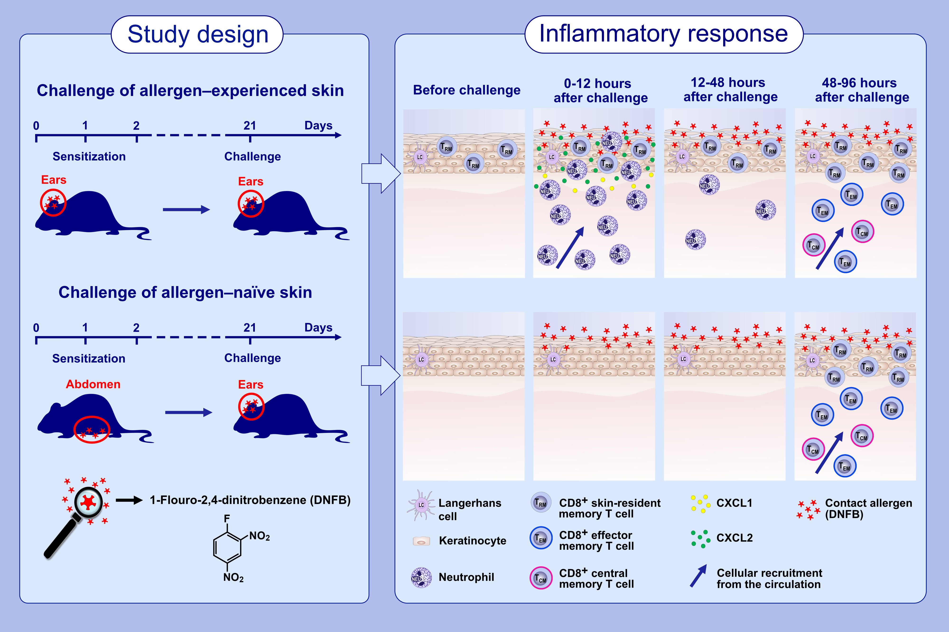
CD8+ tissue-resident memory T cells recruit neutrophils that are essential for flare-ups in contact dermatitis
Anders B. Funch,, Veronika Mraz,, Anne-Sofie Ø. Gadsbøll,, Mia H. Jee,, Julie F. Weber,, et al.
Allergy. Issue; 2022 https://doi.org/10.1111/all.14986
© 2019 EAACI and John Wiley and Sons A/S. Published by John Wiley and Sons Ltd.
Notes:
HIGHLIGHTS
CD8⁺ T_{RM} cells are generated locally in the epidermis of allergen-experienced skin.
Upon re-exposure of allergen-experienced skin to allergen, CD8⁺ T_{RM} cells induce rapid release of CXCL1/2 chemokines leading to massive infiltration of neutrophils already 0-12 hours after the re-exposure.
Upon exposure of allergen-naïve skin to allergen, inflammation is mediated by circulating memory T cells 48-96 hours after the exposure.
Abbreviations: CXCL, (C-X-C motif) ligand; T_{CM}, central memory T cell; T_{EM}, effector memory T cell; T_{RM}, tissue-resident memory T cell

