Slide 1
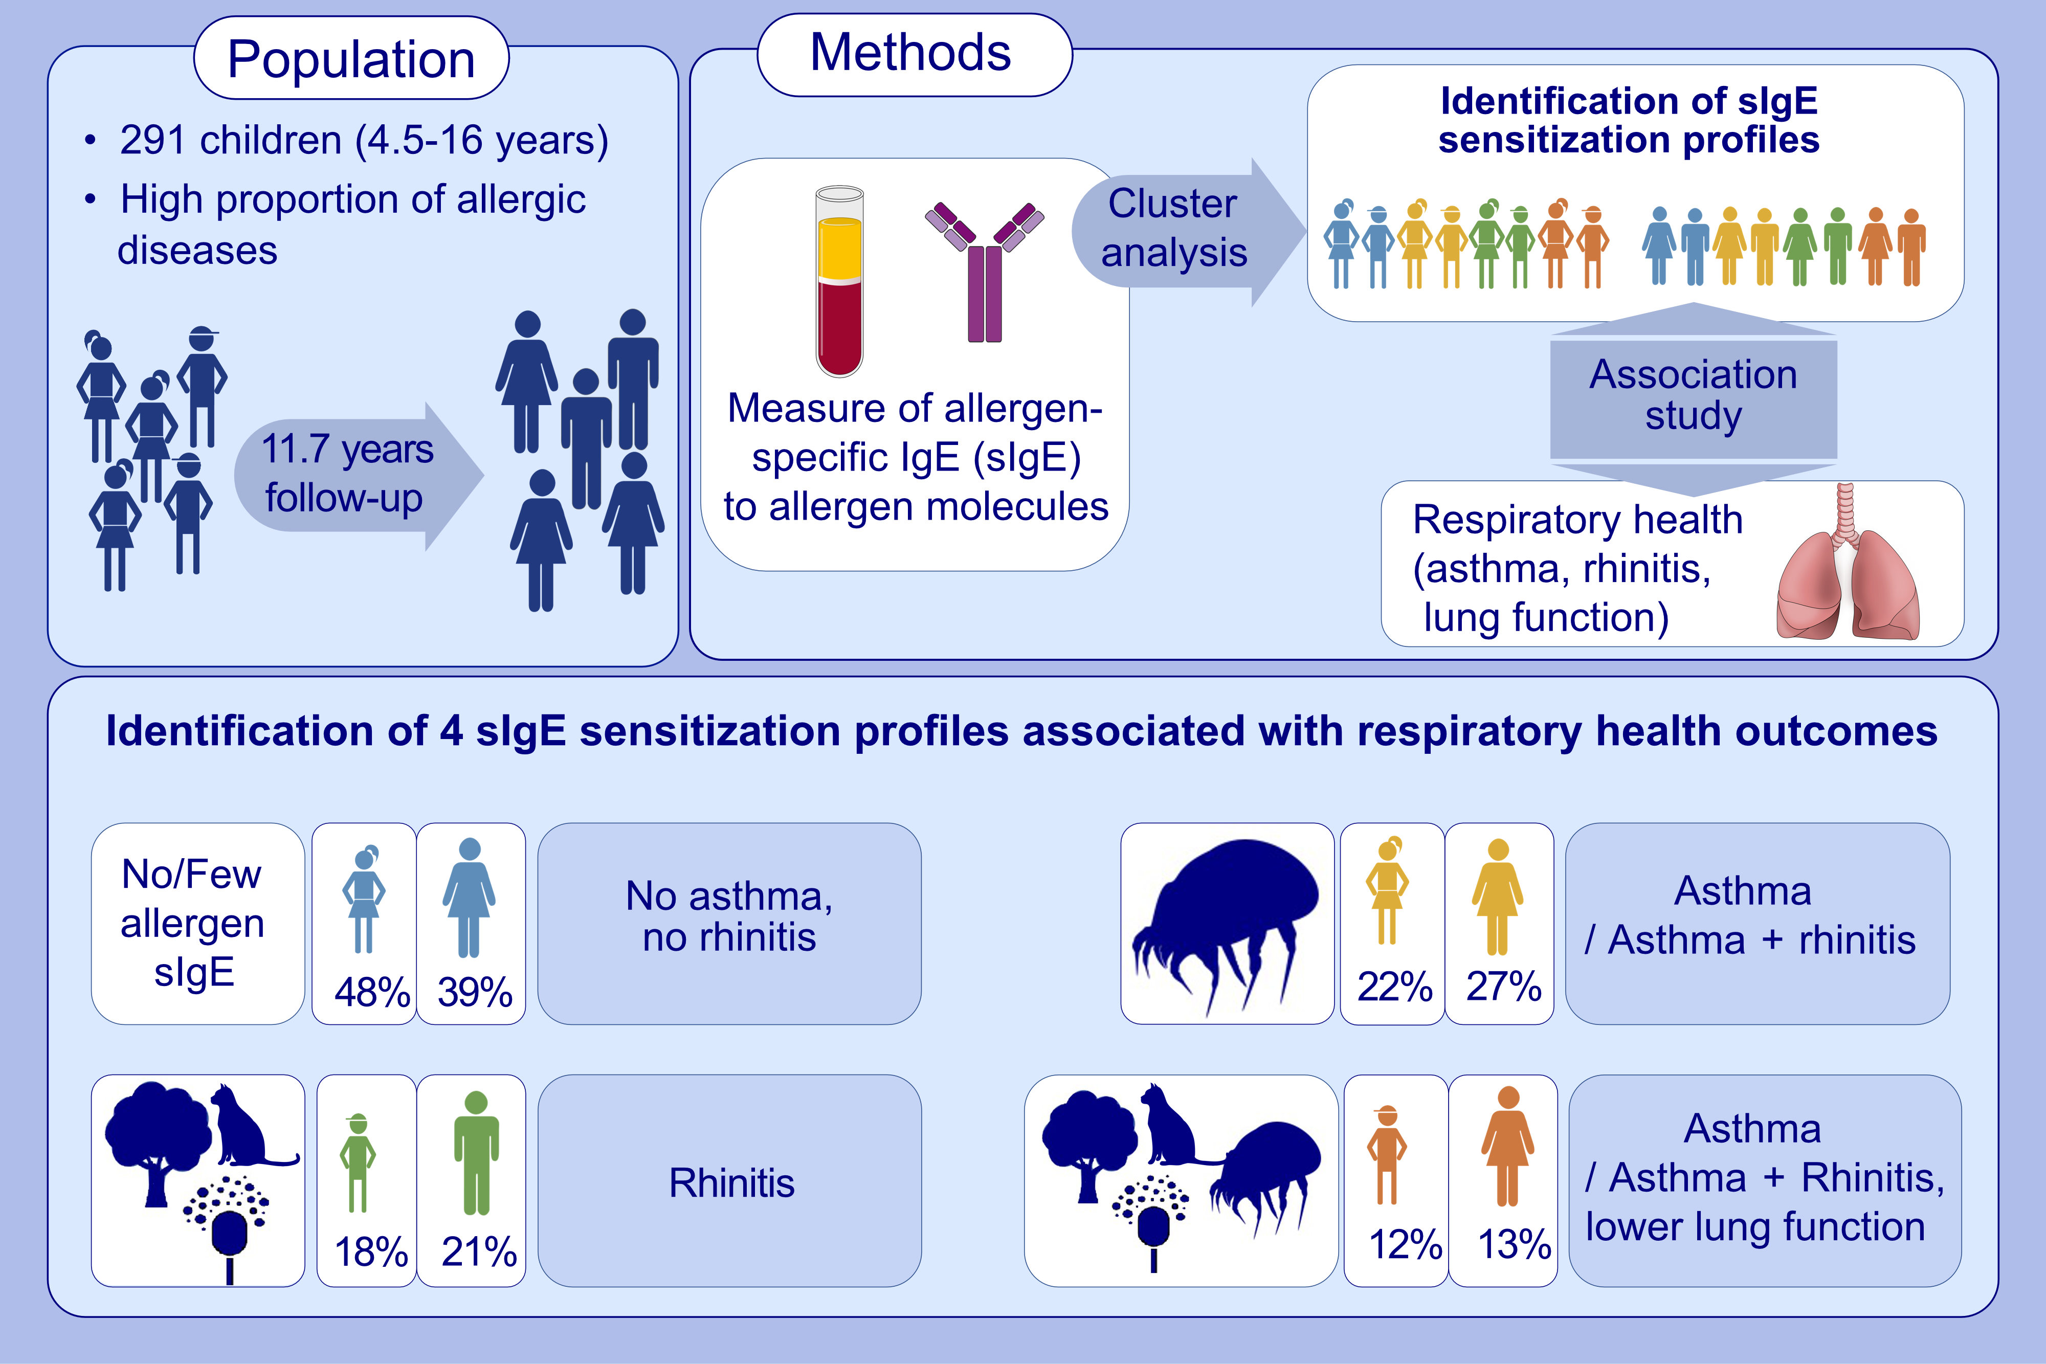
Trajectories of IgE sensitization to allergen molecules from childhood to adulthood and respiratory health in the EGEA cohort
Valérie Siroux,, Anne Boudier,, Jean Bousquet,, Orianne Dumas,, Jocelyne Just,, et al.
Allergy. Issue; 2022 https://doi.org/10.1111/all.14987
© 2019 EAACI and John Wiley and Sons A/S. Published by John Wiley and Sons Ltd.
Notes:
HIGHLIGHTS
This study, using high resolution allergen-specific IgE longitudinal data, identified four molecular sensitization profiles that were mainly stable from childhood to adulthood.
The identified profiles were associated with asthma and rhinitis phenotypes, eosinophil counts, FEV₁ level and FEF₂₅₋₇₅ level.
Our findings suggest that IgE-reactivity towards a large set of respiratory allergen molecules may be summarized by four clinically meaningful sIgE sensitization profiles.
Abbreviations: EGEA, The Epidemiological Study on the Genetics and Environmment of Asthma;
FEV1, forced expiratory volume in 1 second; FEF, forced expiratory flow at 25-75% of forced vital capacity

