Slide 1
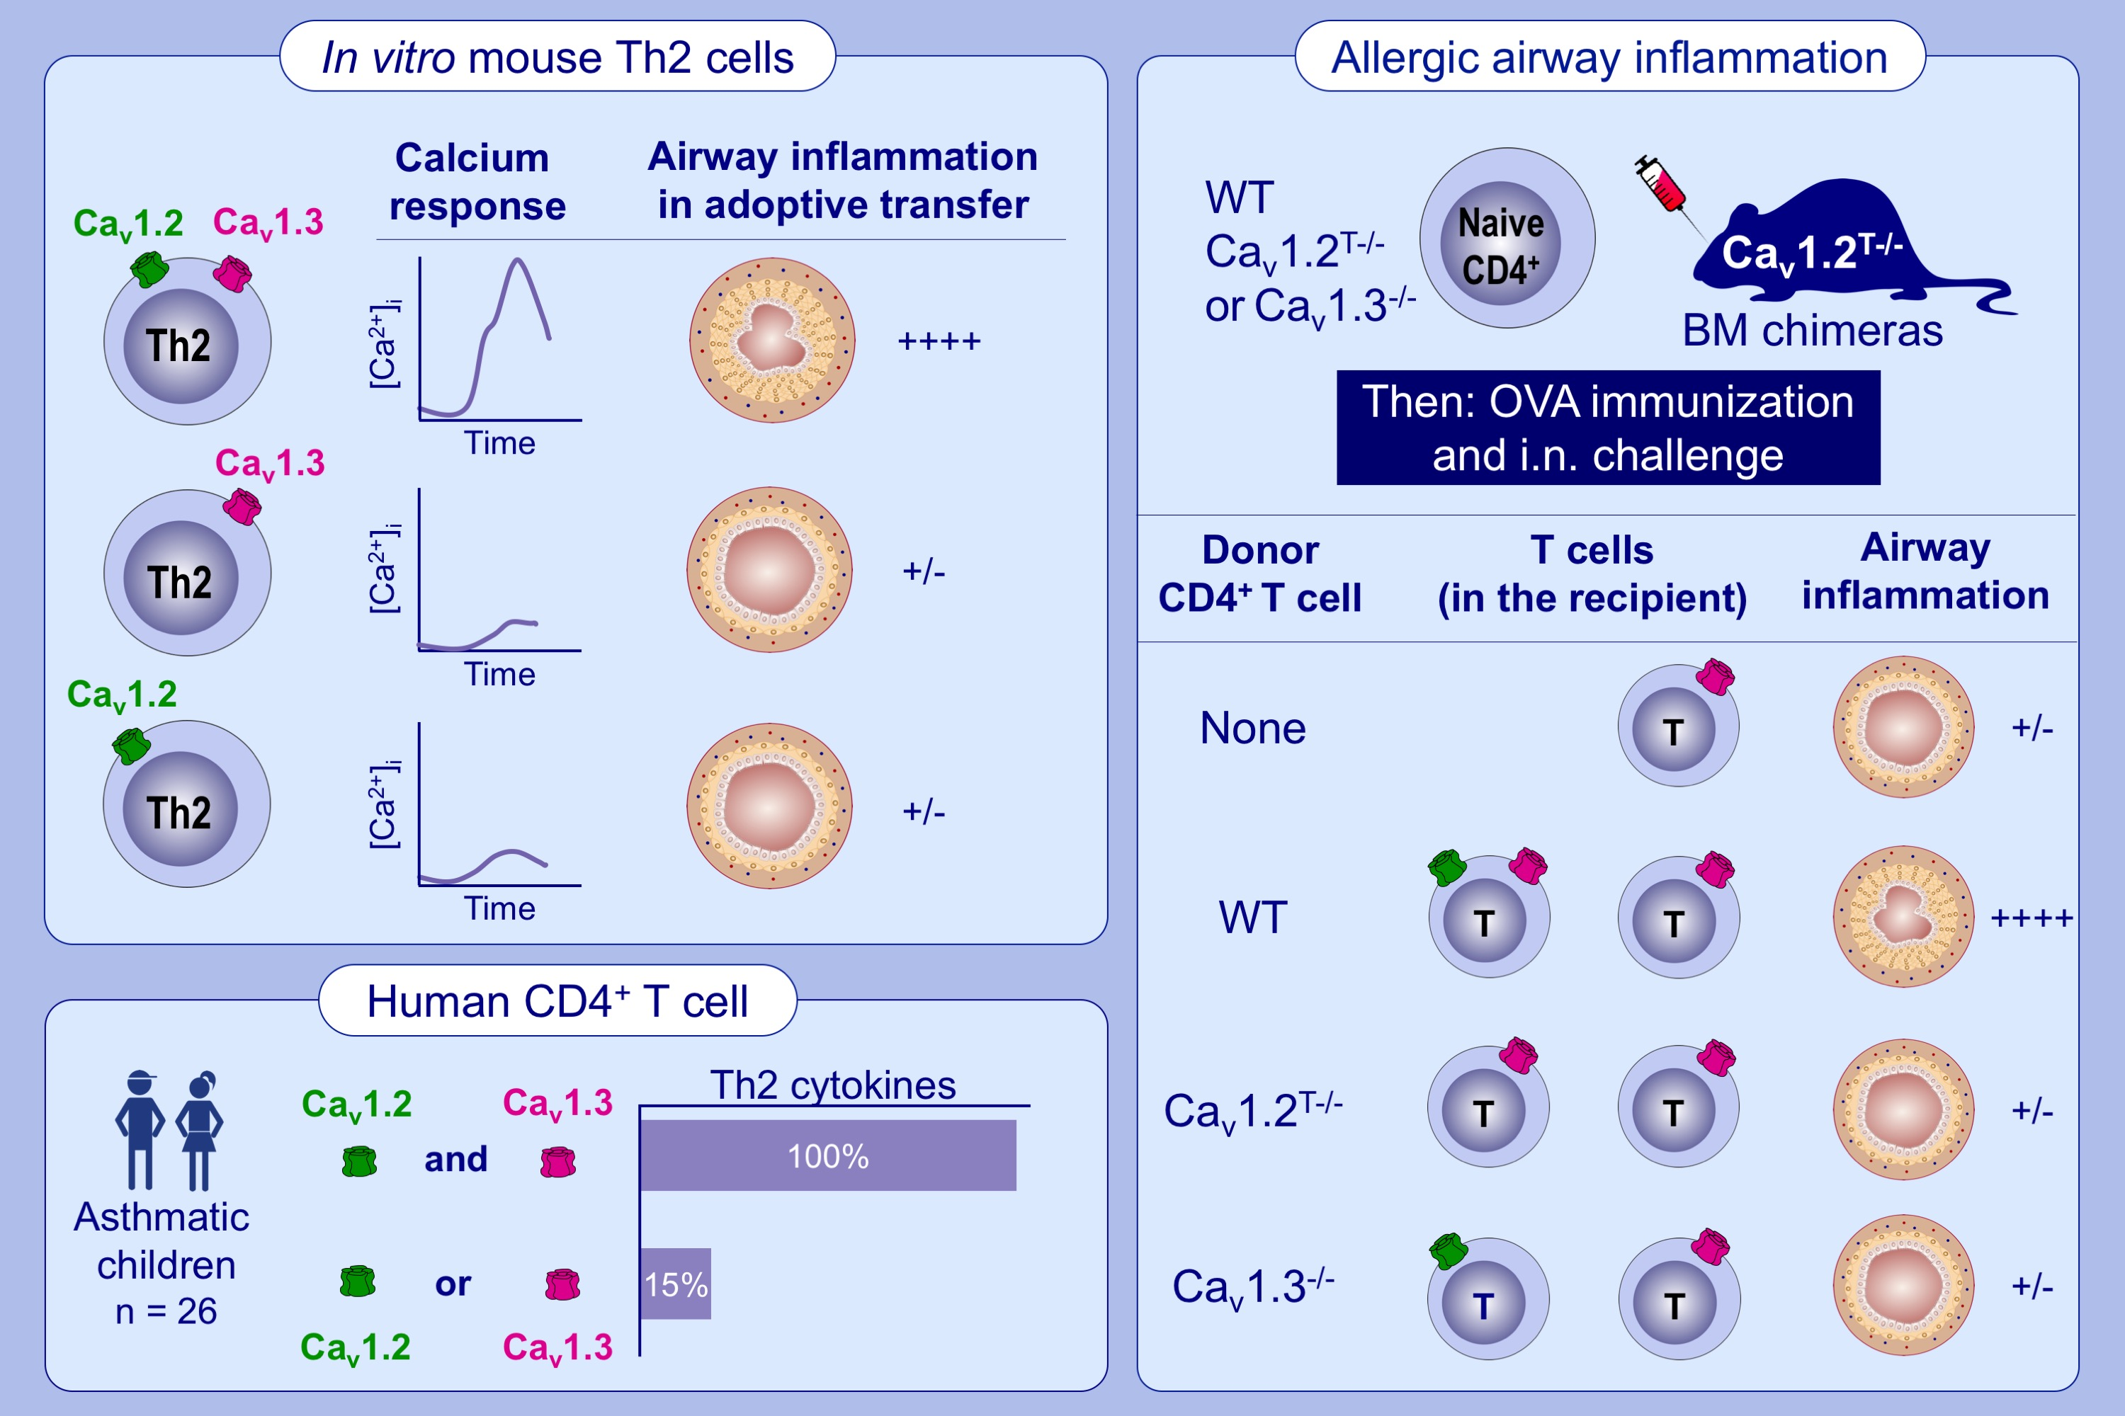
Separation of the CaV1.2-CaV1.3 calcium channel duo prevents type 2 allergic airway inflammation
Nicolas Giang,, Marion Mars,, Marc Moreau,, Jose E. Mejia,, Grégory Bouchaud,, et al.
Allergy. Issue; 2022 https://doi.org/10.1111/all.14993
© 2019 EAACI and John Wiley and Sons A/S. Published by John Wiley and Sons Ltd.
Notes:
HIGHLIGHTS
Each of Ca_{v}1.2 and Ca_{v}1.3 calcium channels plays a role in the full TCR-induced activation of Th2 lymphocytes.
Ca_{v}1.2 and Ca_{v}1.3 channels have concerted roles and must be co-expressed within the same CD4⁺ T cell to trigger allergic airway inflammation.
Expression of both channels by CD4⁺ T cells from asthmatic children is associated with increased Th2-cytokine expression.
Abbreviations: BM, bone marrow; Cav, voltage-gated calcium channel; i.n., intranasal; TCR, T cell receptor; Th, T helper cell; WT, wild-type

