Slide 1
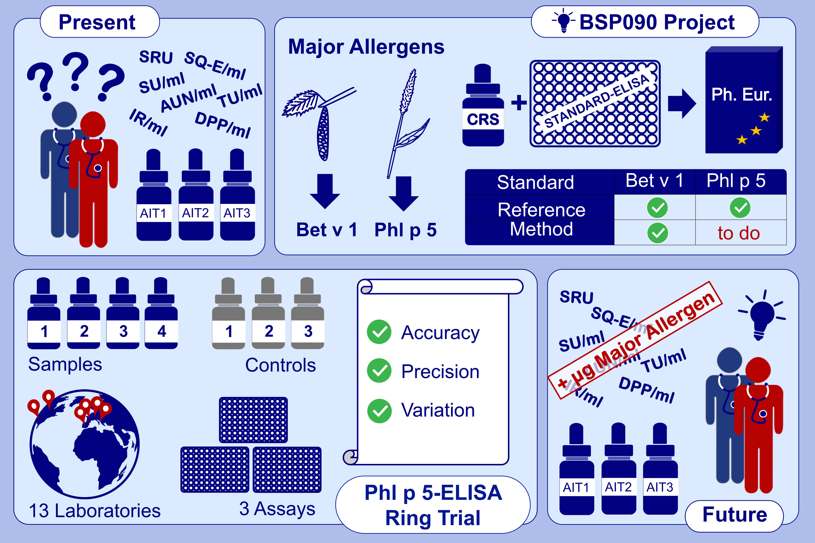
Standardisation of allergen products: 4. Calidation of a candidate European Pharmacopoeia standard method for quantification of major grass pollen allergen phl p 5
Julia Zimmer, Sandra Schmidt, Susanne Kaul, Angèle Costanzo, Karl-Heinz Buchheit, et al.
Allergy. Issue; 2022 https://doi.org/10.1111/all.15003
© 2019 EAACI and John Wiley and Sons A/S. Published by John Wiley and Sons Ltd.
Notes:
HIGHLIGHTS
We present the findings of an international ring trial on the validation of a Phl p 5-specific ELISA system.
The ELISA systems selected in the course of BSP090 will present the first examples of obligatory standard methods for allergen quantification in Europe.
After implementation as standard methods, allergists will, for the first time, be able to compare marketed birch pollen and Timothy grass pollen allergen products based on major allergen content.
Abbreviations: AIT, allergen immunotherapy; AUN, allergy units native; Bet v 1, Betula verrucosa allergen 1 (from birch pollen); BSP, Biological Standardisation Programme; CRS, chemical reference standard; DPP/ml, depigmented polymerized unit; ELISA, enzyme-linked immunosorbent assay; IR, index of reactivity; Phl p 5, Phleum pratense allergen 5 (from Timothy grass pollen); SRU, standard reactivity unit; SQ-E, standardized quality unit; SU, standardized unit; TU, transducing unit

