Slide 1
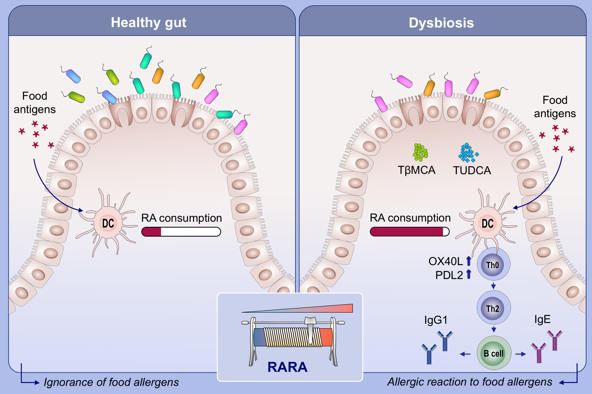
The bile acid-activated retinoic acid response in dendritic cells is involved in food allergen sensitization
Renlan Wu,, Xiefang Yuan,, Xingjie Li,, Ning Ma,, Hongyu Jiang,, et al.
Allergy. Issue; 2022 https://doi.org/10.1111/all.15039
© 2019 EAACI and John Wiley and Sons A/S. Published by John Wiley and Sons Ltd.
Notes:
HIGHLIGHTS
Dysbiosis leads to enhanced retinoic acid RA signaling in mucosal DCs and induce food allergens sensitization.
Antibiotic-induced dysregulated bile acid profiles contribute to enhanced RA signaling in mucosal DCs.
RARA act as a “rheostat” and modulate food sensitization in mucosal dendritic cells.
Abbreviations: DCs, dendritic cells; FXR, farnesoid X receptor; RA, retinoic acid; RARA, retinoic acid receptor alpha; TβMCA, tauro-beta-muricholic acid; TUDCA, tauroursodeoxycholic acid

