Slide 1
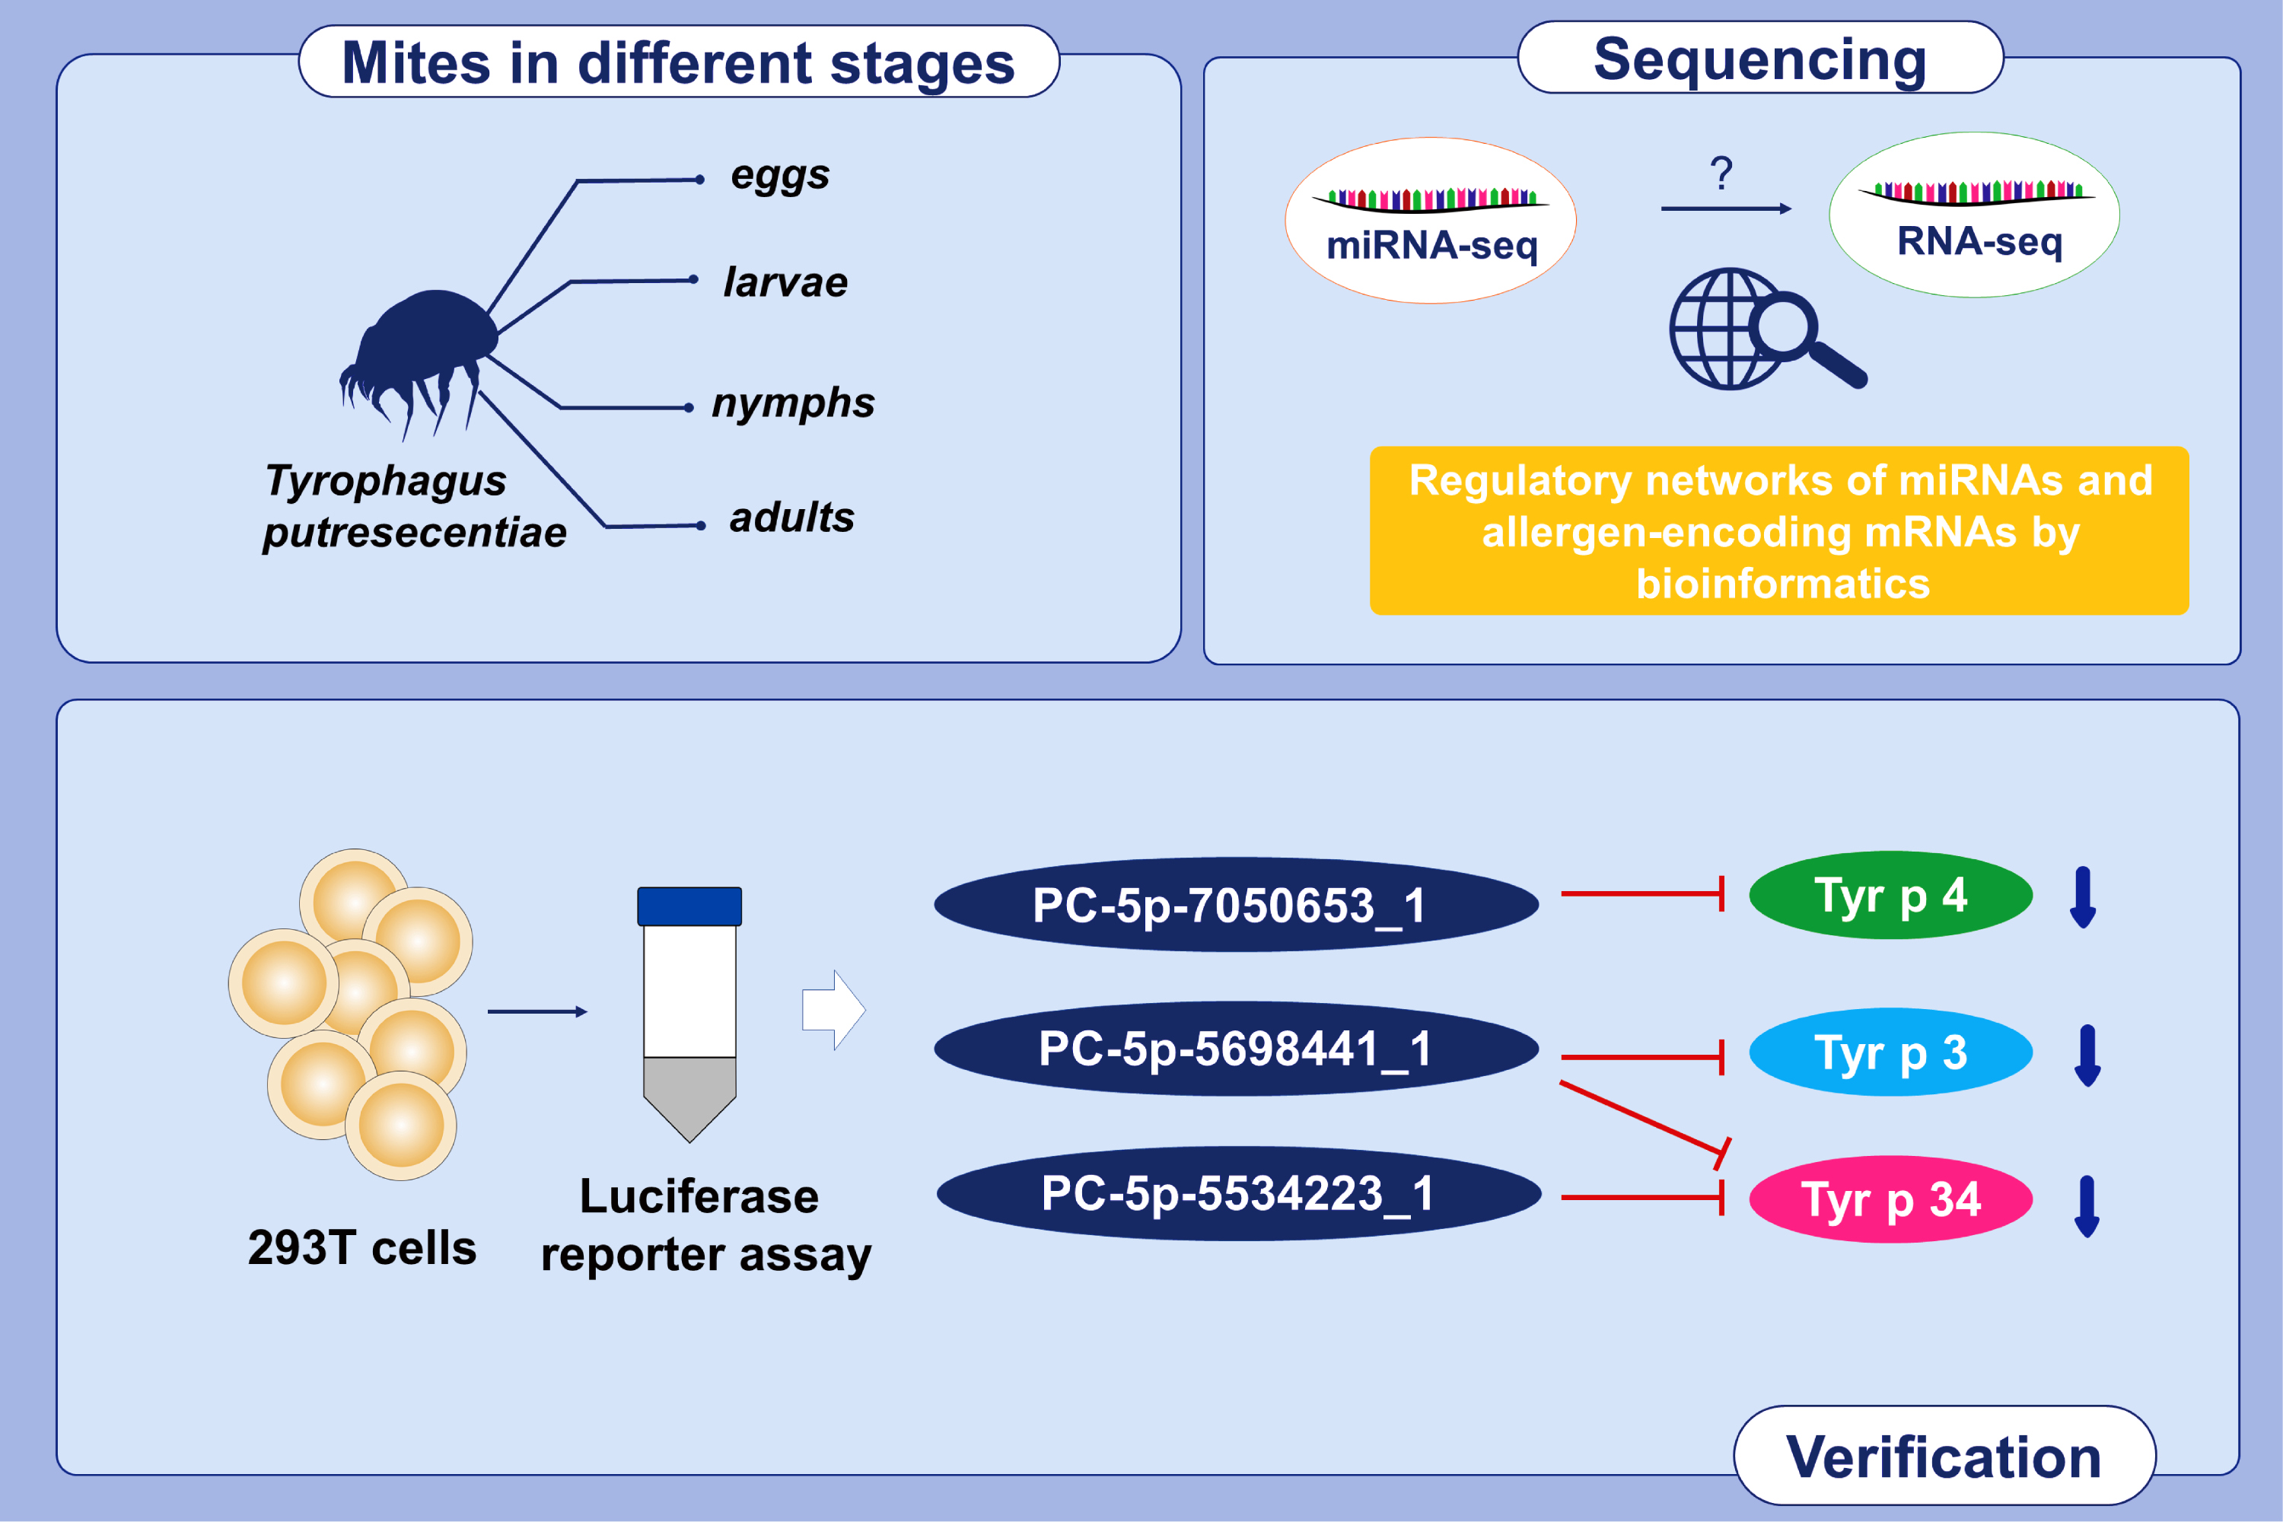
Regulatory roles of three miRNAs on allergen mRNA expression in Tyrophagus putrescentiae
Ying Zhou,, Qingqing Li,, Ruilin Pan,, Qiong Wang,, Xuming Zhu,, et al.
Allergy. Issue; 2022 https://doi.org/10.1111/all.15111
© 2019 EAACI and John Wiley and Sons A/S. Published by John Wiley and Sons Ltd.
Notes:
HIGHLIGHTS
We collected the eggs, larvae, nymphs, and adults of T. putrescentiae.
We verified mRNA (Tyr p 3, Tyr p 4, Tyr p 34) and microRNA (PC-5p-5698441_1, PC-5p-7050653_1, PC-5p-5534223_1, PC-5p-5698441_1) expression by RT-PCR.
The luciferase reporter assay showed that Tyr p 3 was regulated by the miRNA PC-5p-5698441_1, Tyr p 4 was regulated by PC-5p-7050653_1 and Tyr p 34 was regulated by both PC-5p-5534223_1 and PC-5p-5698441_1.

