Slide 1
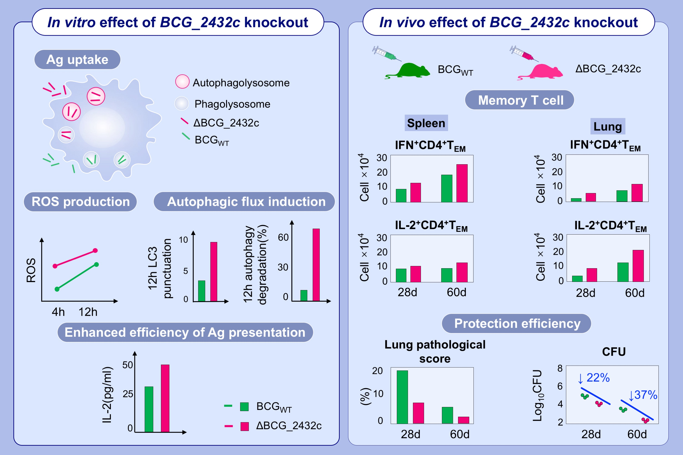
Deletion of BCG_2432c from the Bacillus Calmette-Guérin vaccine enhances autophagy-mediated immunity against tuberculosis
Yaqi Wu,, Maopeng Tian,, Yandi Zhang,, Huiming Peng,, Qing Lei,, et al.
Allergy. Issue; 2022 https://doi.org/10.1111/all.15158
© 2019 EAACI and John Wiley and Sons A/S. Published by John Wiley and Sons Ltd.
Notes:
HIGHLIGHTS
ΔBCG_2432c showed a stronger ability to trigger intracellular ROS-mediated complete autophagic flux in infected THP-1 cells that resulted in higher antigen presentation.
ΔBCG_2432c induced higher numbers of IFN-γ⁺ CD4⁺ TEM and IL-2⁺ CD4⁺ TCM cells than BCG_{WT}.
ΔBCG_2432c confers stronger protection against TB.
Abbreviations: Ag, antigen; BCG, Bacillus Calmette-Guérin; CFU, colony-forming units; ROS, reactive oxygen species; TEM, effector memory T cell; TCM, central memory T cell; TB, tuberculosis; THP-1, human monocytic leukemia cell line; WT, wild type

