Slide 1
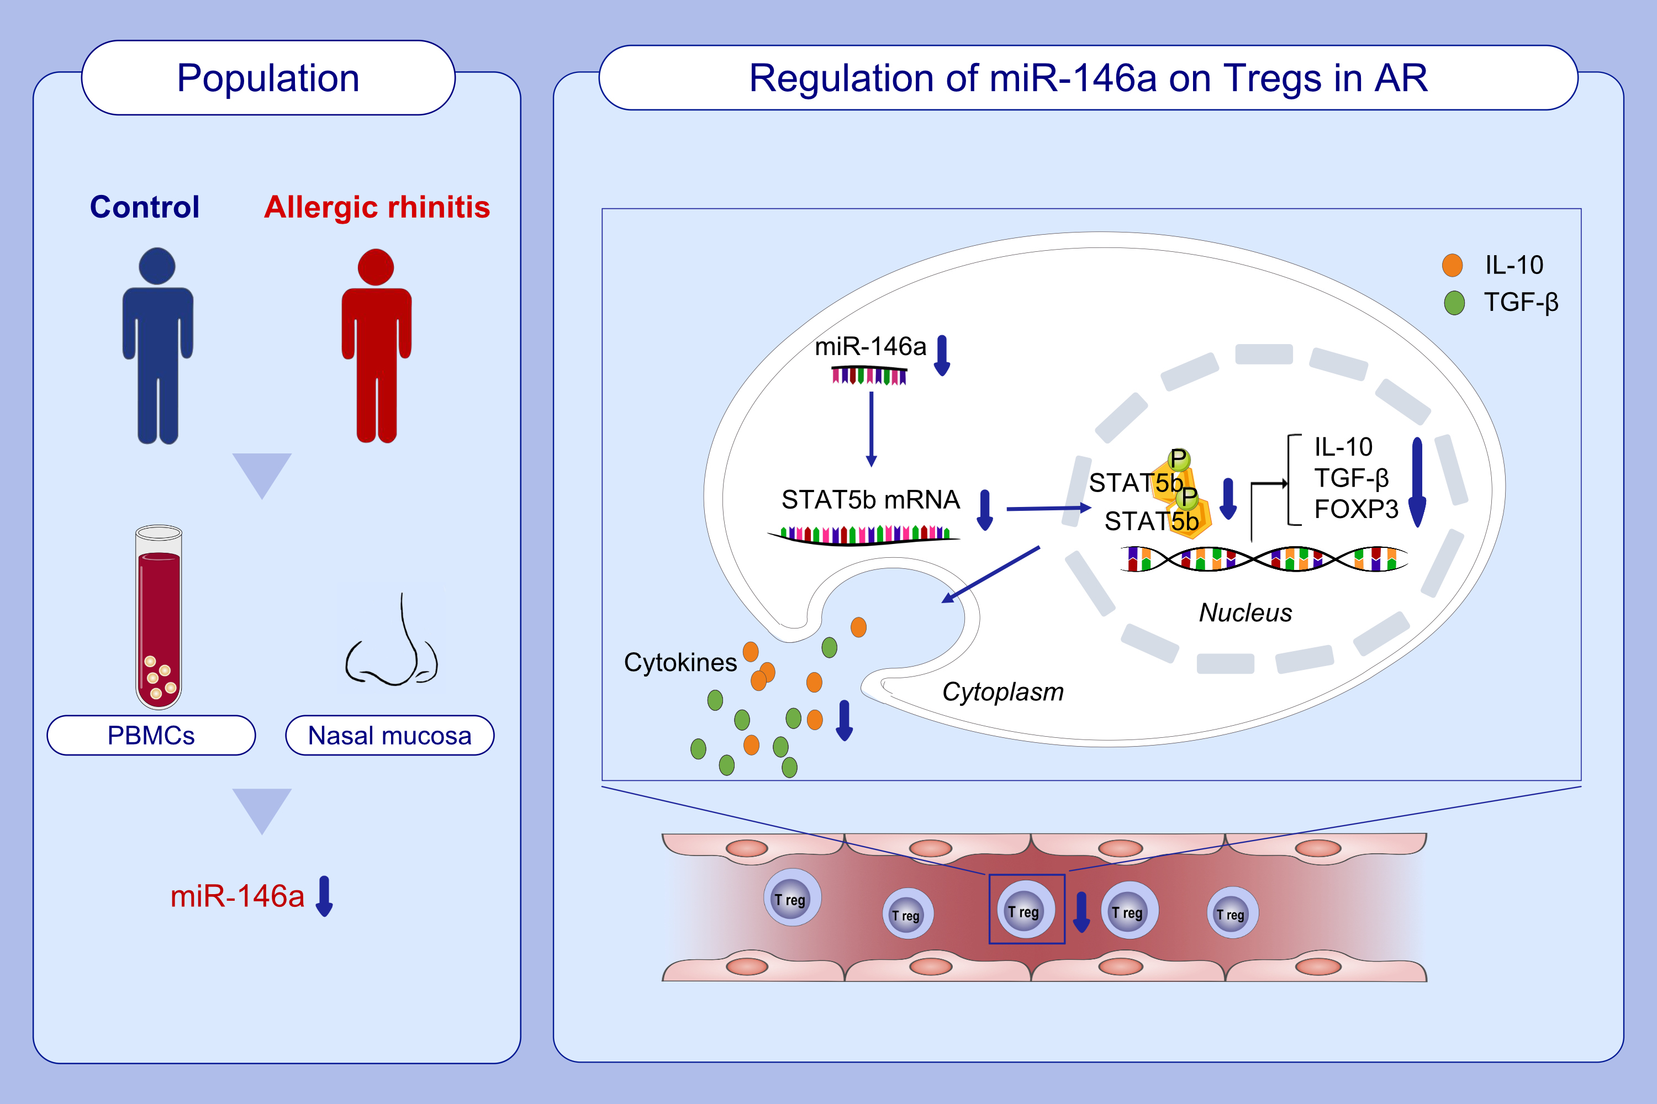
miR-146a enhances regulatory T-cell differentiation and function in allergic rhinitis by targeting STAT5b
Yu Zhang,, Yujuan Yang,, Jing Guo,, Limei Cui,, Liping Yang,, et al.
Allergy. Issue; 2022 https://doi.org/10.1111/all.15163
© 2019 EAACI and John Wiley and Sons A/S. Published by John Wiley and Sons Ltd.
Notes:
HIGHLIGHTS
miR-146a and STAT5b expression is lower in PBMCs and nasal mucosa of AR patients.
There are significantly fewer Tregs in miR-146a knockdown or STAT5b knockdown PBMCs compared to control PBMCs. Expression of FOXP3, IL-10, and TGF-β is decreased in the miR-146a knockdown cells, but increased in the STAT5b overexpression.
miR-146a controls Tregs differentiation and function by binding directly to STAT5b and up-regulating its expression.
Abbreviations: AR, allergic rhinitis; FOXP3, forkhead box P3; IL-10, interlukin-10; miR, microRNA; PBMCs, peripheral blood mononuclear cells; STAT5b, signal transducer and activator of transcription 5b; TGF-β, transforming growth factor-β; Tregs, regulatory T cells

