Slide 1
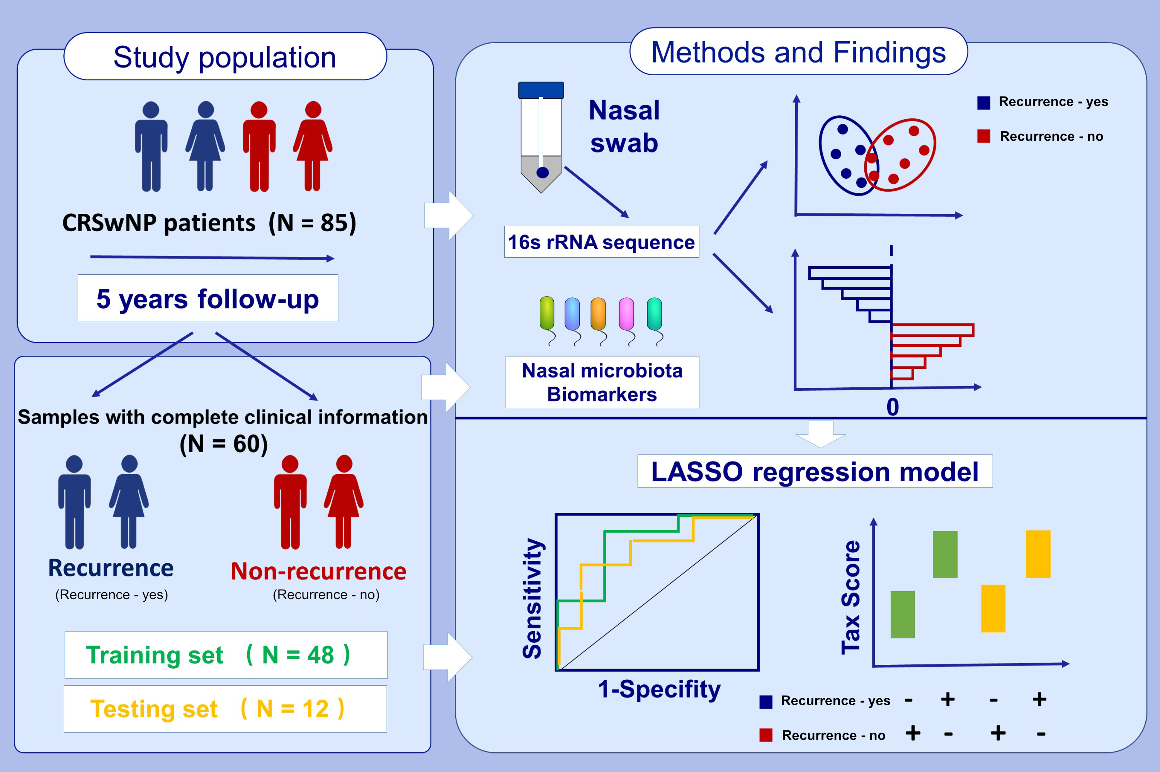
Predicting the recurrence of chronic rhinosinusitis with nasal polyps using nasal microbiota
Yan Zhao,, Junru Chen,, Yun Hao,, Boqian Wang,, Yue Wang,, et al.
Allergy. Issue; 2022 https://doi.org/10.1111/all.15168
© 2019 EAACI and John Wiley and Sons A/S. Published by John Wiley and Sons Ltd.
Notes:
HIGHLIGHTS
Principal component analysis revealed differences between CRSwNP specimens based on recurrence.
LASSO regression was employed for the establishment of a predictive model of CRSwNP recurrence.
A nasal microbiota-based model predicted CRSwNP recurrence with greater accuracy than a combined model of microbiota and clinical features.
Abbreviations: CRSwNP, chronic rhinosinusitis with nasal polyps; LASSO, least absolute shrinkage and selection operator; recur, recurrence

