Slide 1
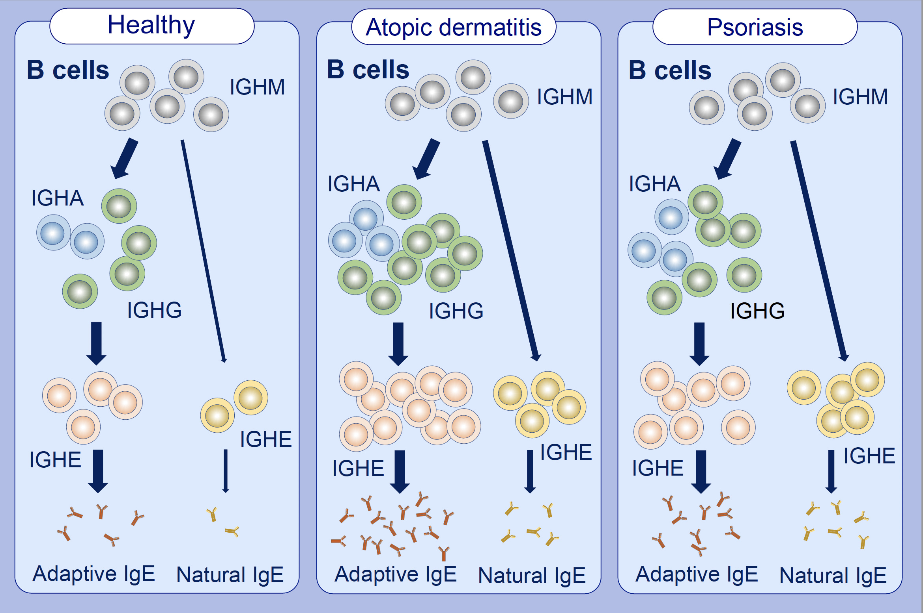
Heterogeneous origin of IgE in atopic dermatitis and psoriasis revealed by B cell receptor repertoire analysis
Lihua Luo,, Yang Luo,, Jing Xu,, Ronghui Zhu,, Jinghua Wu,, et al.
Allergy. Issue; 2022 https://doi.org/10.1111/all.15173
© 2019 EAACI and John Wiley and Sons A/S. Published by John Wiley and Sons Ltd.
Notes:
HIGHLIGHTS
Heterogeneous origin of IgE was revealed in atopic dermatitis and psoriasis by sequencing the B cell receptor repertoire.
Sequential switching from IGHG was the primary pathway for IGHE production in healthy individuals; while IGHE switching directly from IGHM increased in atopic dermatitis and psoriasis.
Psoriasis patients had relatively higher proportion of natural IgE than atopic dermatitis.
Abbreviations: IGH, immunoglobulin heavy chain

