Slide 1
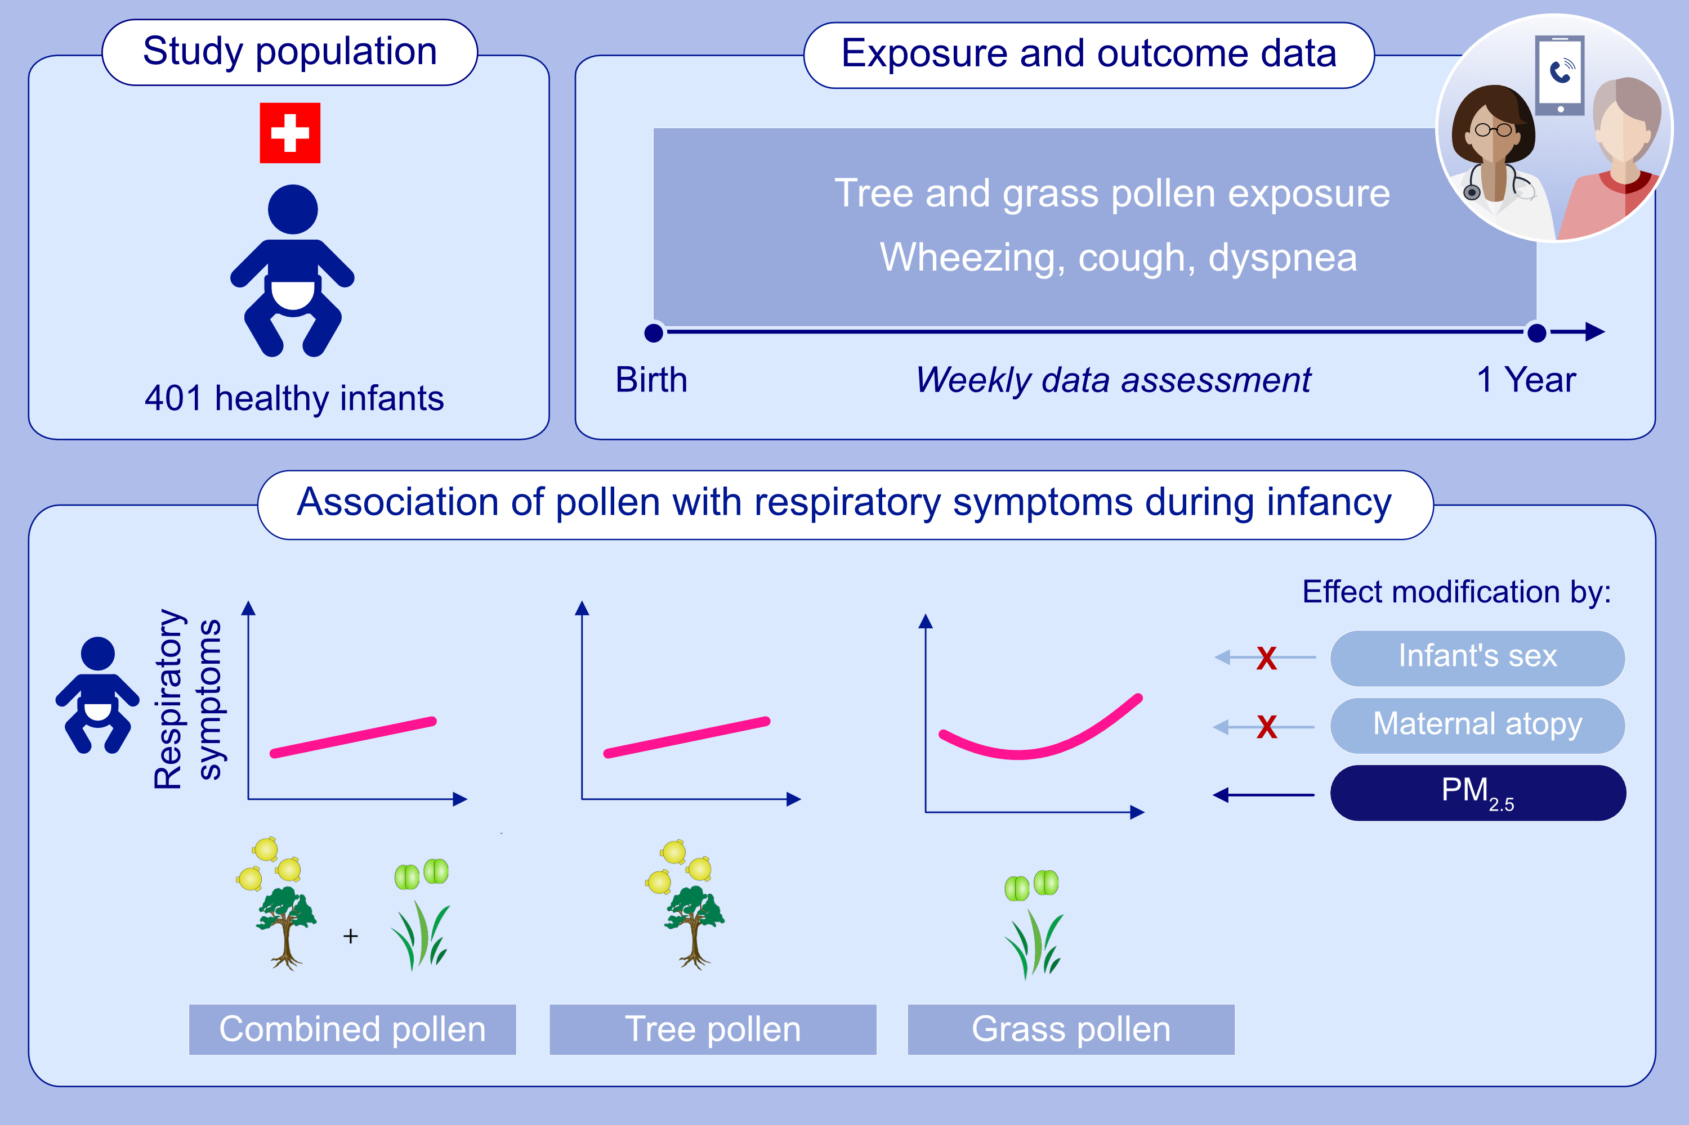
Pollen exposure is associated with risk of respiratory symptoms during the first year of life
Amanda Gisler, Marloes Eeftens, Kees de Hoogh, Danielle Vienneau, Yasmin Salem, et al.
Allergy. 2022; pages: 3606-3616
https://doi.org/10.1111/all.15284
© 2019 EAACI and John Wiley and Sons A/S. Published by John Wiley and Sons Ltd.
Notes:
HIGHLIGHTS
This longitudinal study included 401 healthy infants from the Basel Bern Infant Lung Development (BILD) cohort.
The association between pollen exposure and weekly telephone-assessed respiratory symptoms were evaluated.
Increased exposure to tree and grass pollen, both combined and separately, was associated with an increased risk of respiratory symptoms during the first year of life. There was no effect modification by maternal atopy and infant’s sex, however we found a complex interaction between combined pollen and PM_{2.5}.
Abbreviations: PM_{2.5}, particulate matter with an aerodynamic diameter ≤ 2.5 μm

