Slide 1
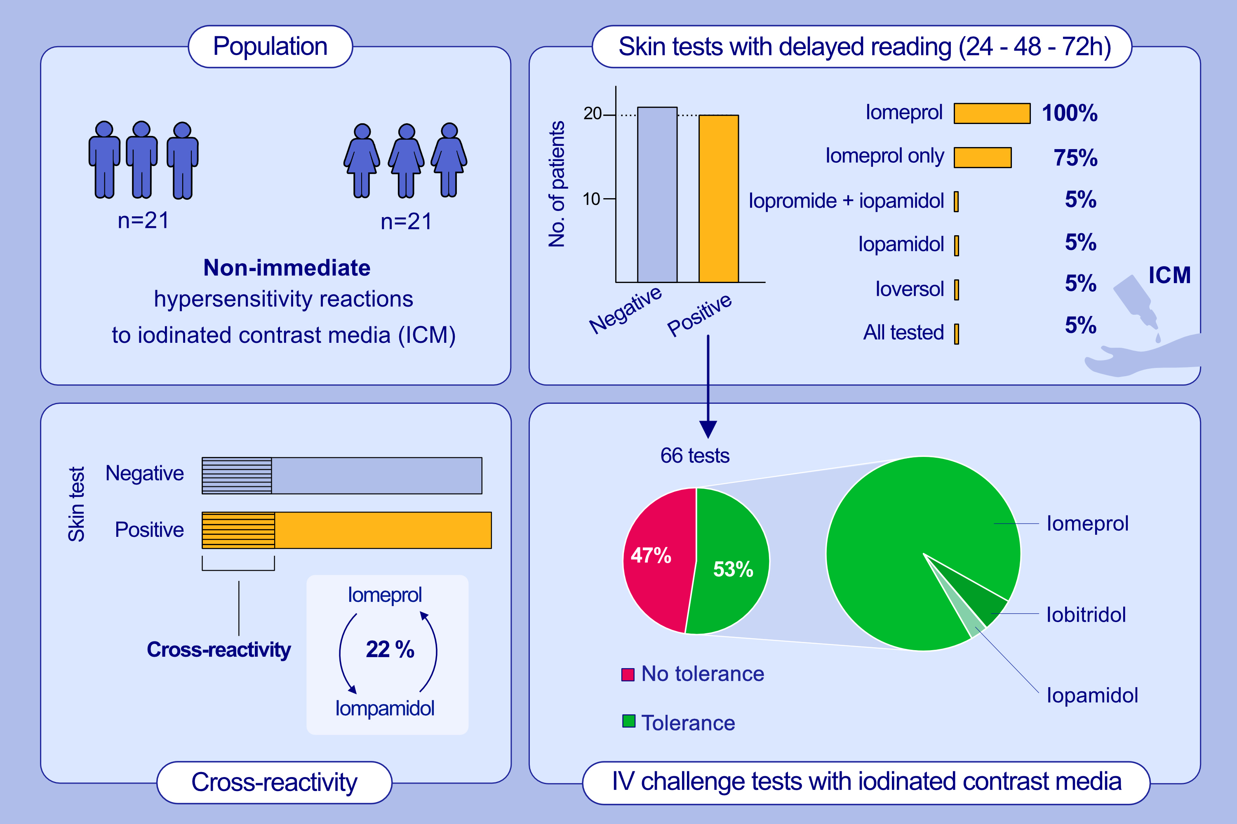
Non-immediate hypersensitivity reactions to iomeprol: diagnostic value of skin tests and cross reactivity with other iodinated contrast media
Pedro Gamboa, Javier Sánchez de Vicente, Cristina Galán, Ignacio Jáuregui, Aritza Segurola, et al.
Allergy. 2022; pages: 3641-3647
https://doi.org/10.1111/all.15433
© 2019 EAACI and John Wiley and Sons A/S. Published by John Wiley and Sons Ltd.
Notes:
HIGHLIGHTS
This study determines the utility of skin tests and the subsequent tolerance to negative skin-tested ICM in patients with NIHR caused by iomeprol.
In iomeprol-induced NIHR, skin tests sensitivity is less than 50%, though the negative predictive value of skin tests in patients who tolerated alternative contrasts (mainly iopamidol) is 53%.
There is a high cross-reactivity between iomeprol and iopamidol.
Abbreviations: ICM, iodinated contrast media; NIHR, non-immediate hypersensitivity reactions

