Slide 1
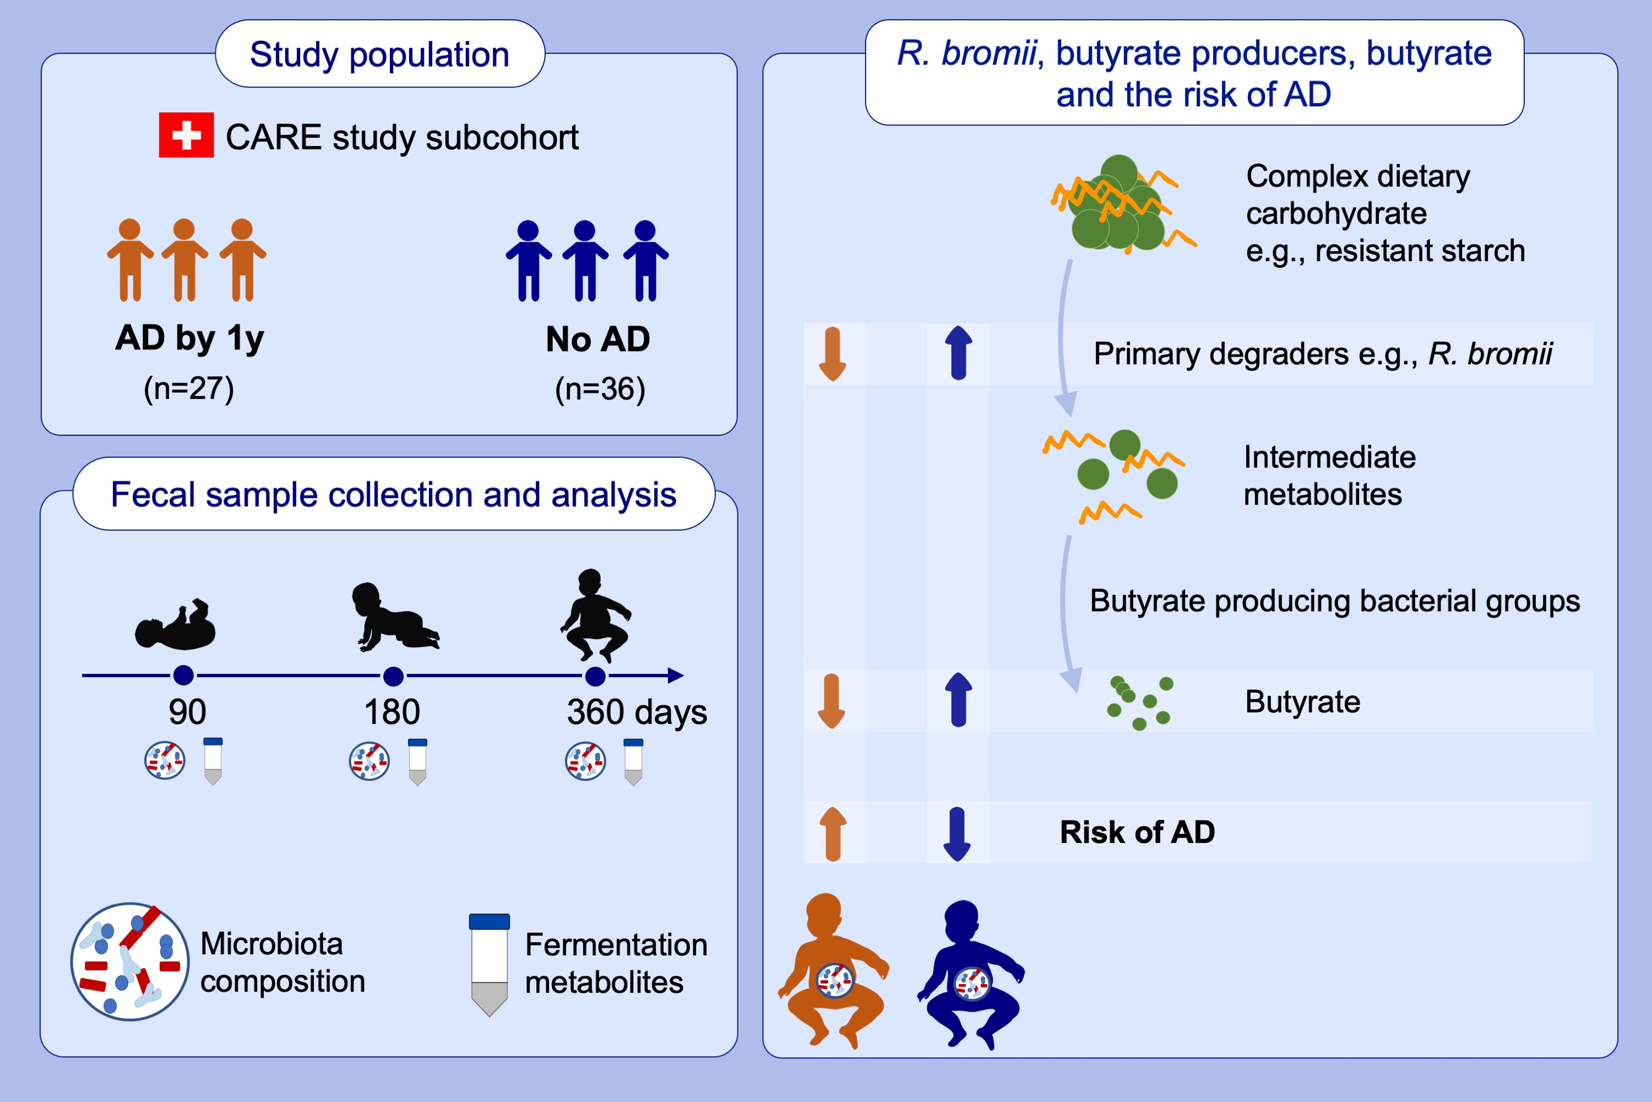
The abundance of Ruminococcus bromii is associated with faecal butyrate levels
and atopic dermatitis in infancy
Mari Sasaki, Clarissa Schwab, Alejandro Ramirez Garcia, Qing Li, Ruth Ferstl, et al.
Allergy. 2022; pages: 3629-3640
https://doi.org/10.1111/all.15440
© 2019 EAACI and John Wiley and Sons A/S. Published by John Wiley and Sons Ltd.
Notes:
HIGHLIGHTS
Children who developed atopic dermatitis in infancy are less likely to have high faecal butyrate levels at one year old, compared to children who did not.
The abundance of Ruminococcus bromii, a keystone starch degrader, is lower in children who developed atopic dermatitis than in children who did not, while the abundances of major butyrate producers are similar.
Abbreviations: AD, atopic dermatitis; CARE study, Childhood AlleRgy, nutrition and Environment study; R. bromii, Ruminococcus bromii

