Slide 1
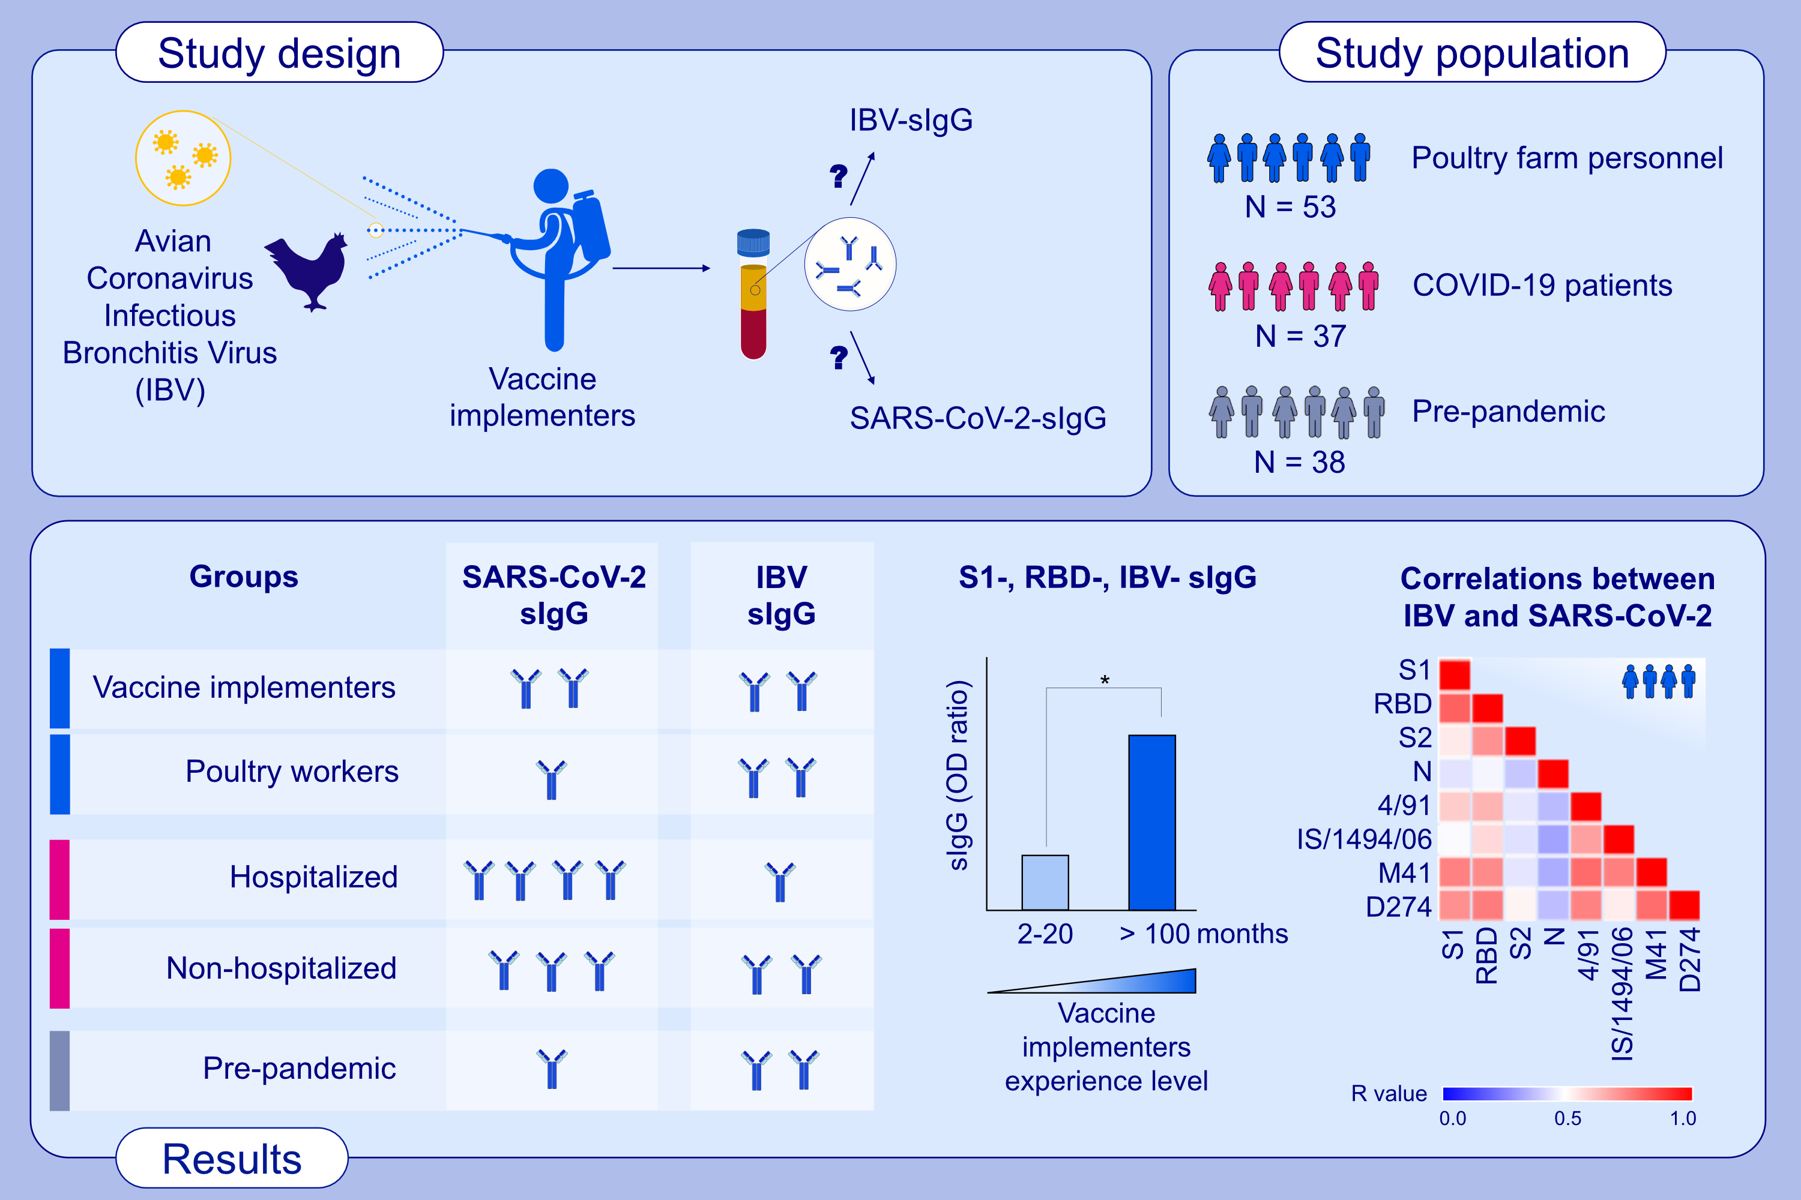
Exposure to avian coronavirus vaccines is associated with increased levels
of SARS-CoV-2-cross-reactive antibodies
Ozge Ardicli, K. Tayfun Carli, Pattraporn Satitsuksanoa, Anita Dreher, Alexia Cusini, Sandra Hutter, et al.
Allergy. 2022; pages: 3648-3662
https://doi.org/10.1111/all.15441
© 2019 EAACI and John Wiley and Sons A/S. Published by John Wiley and Sons Ltd.
Notes:
HIGHLIGHTS
IBV- and SARS-CoV-2-sIgG were detected in a subgroup of poultry farm personnel.
S1-, RBD-, 4/91-, IS/1494/06-, M41-, D274-sIgG were present in vaccine implementers with longer work experience.
Significant positive correlations were observed between IBV-specific IgG and SARS-CoV-2-specific IgG in poultry farm personnel but not in COVID-19 patients or pre-pandemic controls.
Abbreviations: COVID-19, coronavirus disease 2019; IBV, avian coronavirus infectious bronchitis virüs; RBD, receptor binding domain; SARS-CoV-2, severe acute respiratory syndrome coronavirus-2; sIgG, antigen-specific immunoglobulin G

