Slide 1
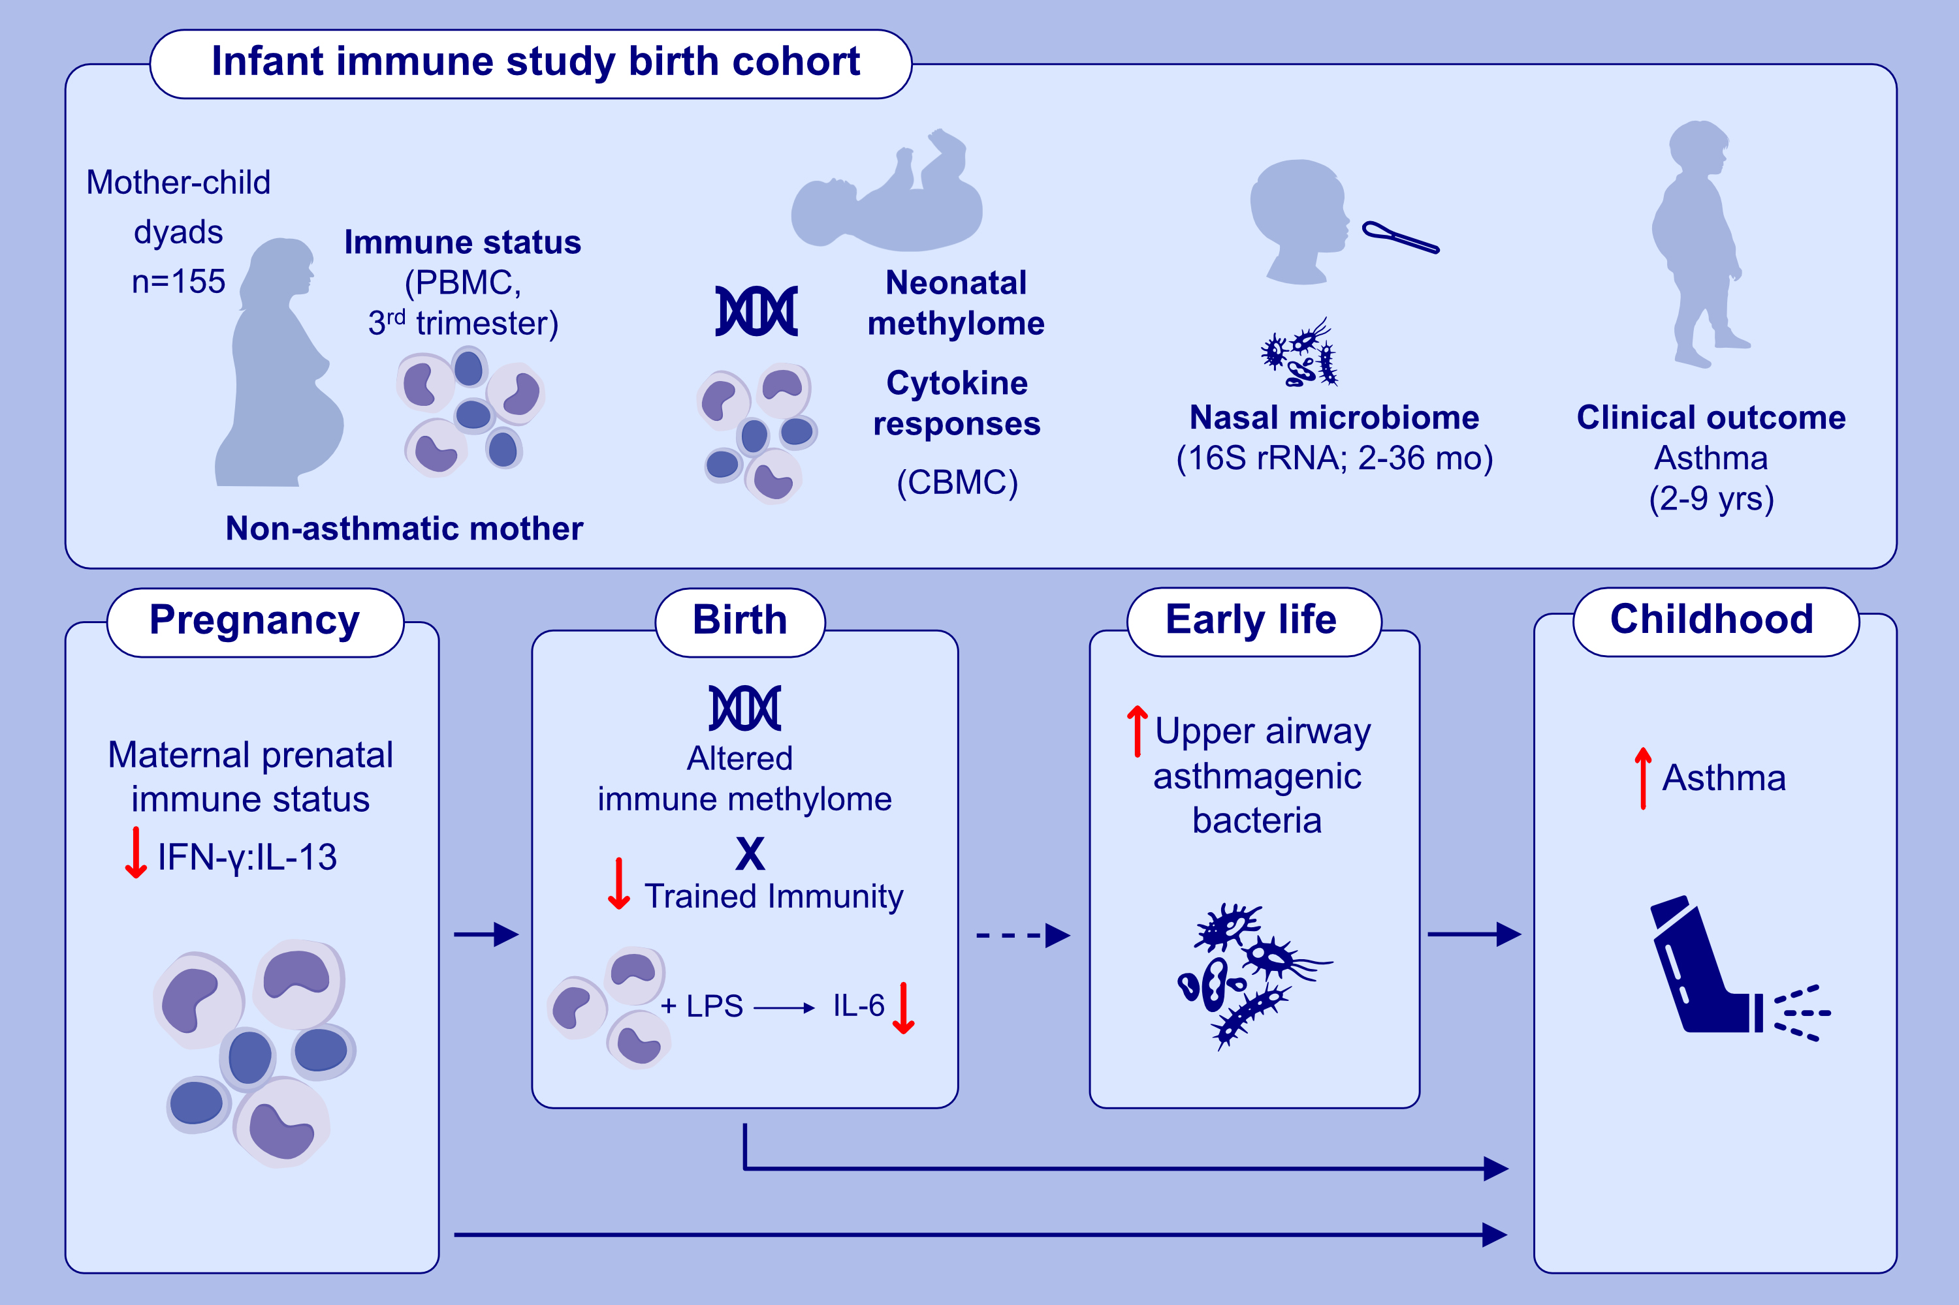
Maternal prenatal immunity, neonatal trained immunity, and early airway microbiota shape childhood asthma development
Avery DeVries, Kathryn McCauley, Douglas Fadrosh, Kei E. Fujimura, Debra A. Stern, Susan V. Lynch et al.
Allergy. 2022; pages: 3617-3628
https://doi.org/10.1111/all.15442
© 2019 EAACI and John Wiley and Sons A/S. Published by John Wiley and Sons Ltd.
Notes:
HIGHLIGHTS
Through an integrated, inter-generational approach, we characterized maternal and early-life epigenetic, immunologic and microbial features that influence asthma development during childhood.
We demonstrate that, in children of non-asthmatic mothers, maternal prenatal immune status (IFN-γ:IL-13) shapes the child’s path to asthma by altering the epigenome and trained innate immunity in the neonate, and promoting pathologic upper airway microbial colonization in early life.
These results provide a novel framework for mechanistic research linking maternal prenatal health to childhood asthma pathogenesis.
Abbreviations: CBMC, cord blood mononuclear cells; IFN, interferon; IL, interleukin; LPS, lipopolysaccharide; PBMC, peripheral blood mononuclear cells; rRNA, ribosomal RNA

