Slide 1
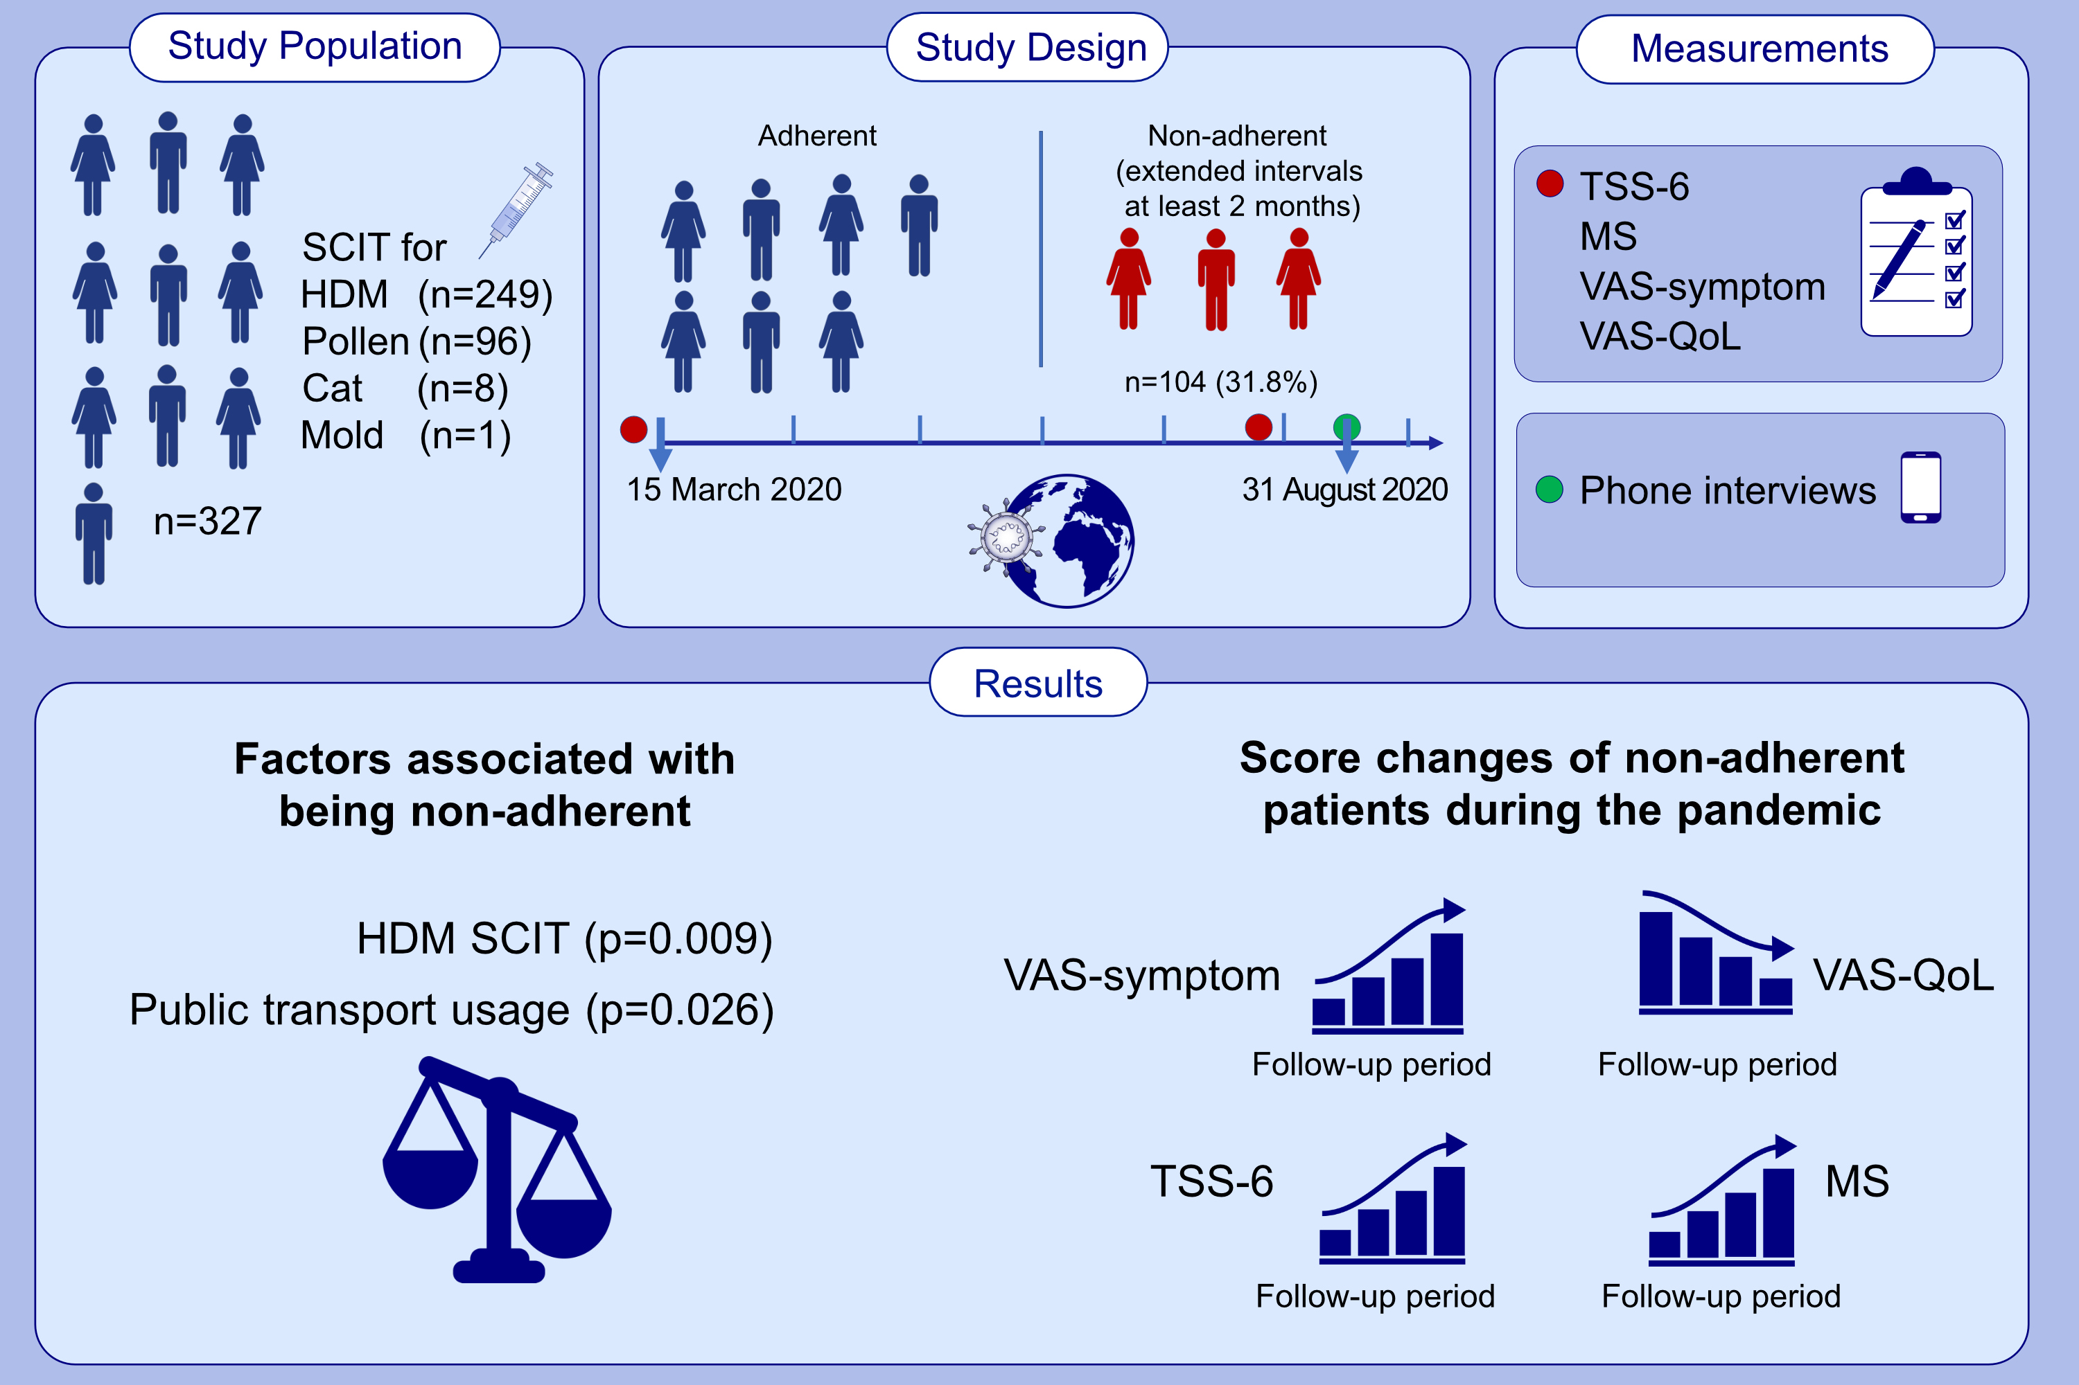
Adherence to subcutaneous immunotherapy with aeroallergens in real-life practice during the COVID-19 pandemic
Osman Ozan Yeğit,, Semra Demir,, Derya Ünal,, Müge Olgaç,, Kadriye Terzioğlu,, et al.
Allergy. 2022; 197-206 https://doi.org/10.1111/all.14876
© 2019 EAACI and John Wiley and Sons A/S. Published by John Wiley and Sons Ltd.
Notes:
HIGHLIGHTS
In this real-life study, the non-adherence rate of patients receiving SCIT during the COVID-19 pandemic is 31.8%.
In the non-adherent patients, the use of HDM SCIT and the use of public transport for reaching the hospital are significantly higher.
SCIT effectiveness and QoL levels are lower during the pandemic period than before the pandemic in the non-adherent patients.
Abbreviations: HDM, house dust mite; MS, medical score; QoL, quality of life; SCIT, subcutaneous immunotherapy; TSS-6, total symptom score-6; VAS, visual analogue scale

