Slide 1
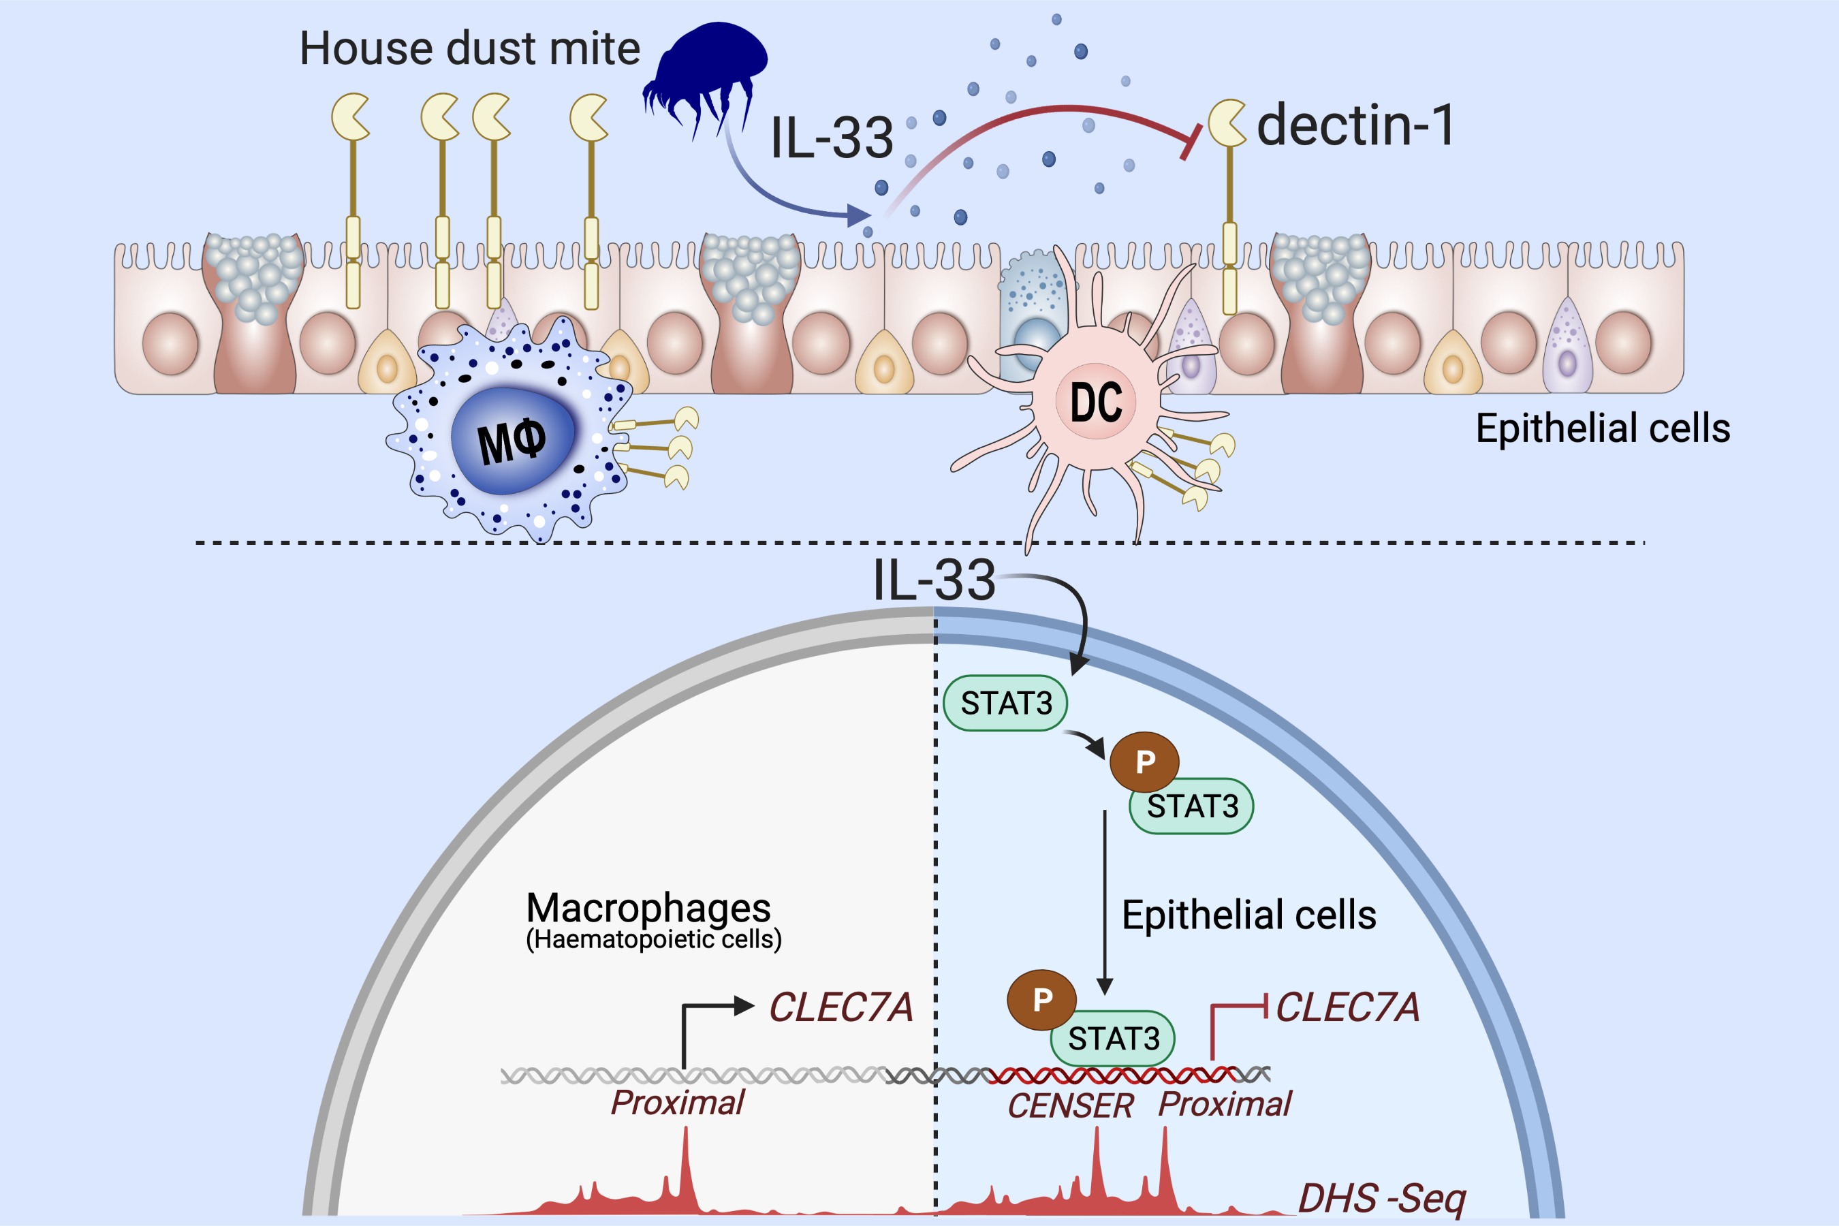
Unique molecular signatures typify skin inflammation induced by chemical allergens and irritants
Marine-Alexia Lefevre,, Audrey Nosbaum,, Aurore Rozieres,, Vanina Lenief,, Amandine Mosnier,, et al.
Allergy. 2021; 3697-3712 https://doi.org/10.1111/all.14989
© 2019 EAACI and John Wiley and Sons A/S. Published by John Wiley and Sons Ltd.
Notes:
HIGHLIGHTS

