Slide 1
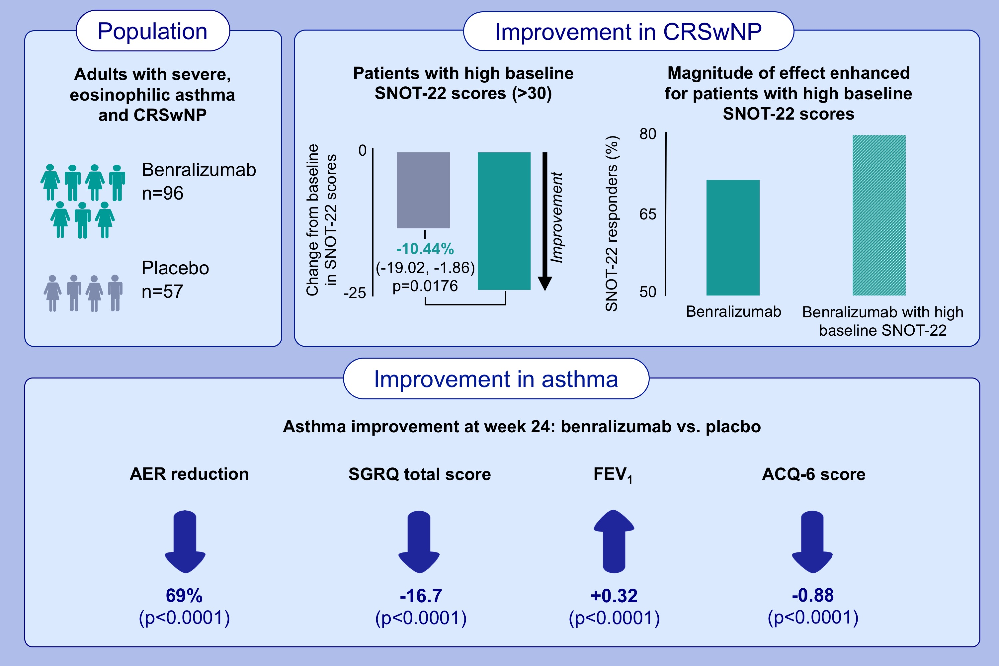
Benralizumab improves symptoms of patients with severe, eosinophilic asthma with a diagnosis of nasal polyposis
Canonica, G.W., Harrison, T.W., Chanez, P., Menzella, F., Louis, R., Cosio, B.G., Lugogo, N.L., Mohan, A., et al.
Allergy. 2022; 77: 150-161. https://doi.org/10.1111/all.14902
© 2019 EAACI and John Wiley and Sons A/S. Published by John Wiley and Sons Ltd.
Notes:
HIGHLIGHTS
The combination of asthma and nasal polyposis provides significant treatment challenges and substantial disease burden, including a greater number of asthma exacerbations annually, which negatively impacts quality of life.
Clinically meaningful improvement in the SNOT-22 was observed early and maintained over time for patients with severe, eosinophilic asthma and nasal polyposis treated with benralizumab in the ANDHI trial.
This ANDHI substudy demonstrated that benralizumab is safe and efficacious for patients with severe, eosinophilic asthma and nasal polyposis, with improvement in SNOT-22 total scores and asthma outcomes.
Abbreviation: ACQ-6, Asthma Control Questionnaire-6; AER, asthma exacerbation rate; CRSwNP, chronic rhinosinusitis with nasal polyposis; FEV1, forced expiratory volume in 1 second; SGRQ, St. George’s Respiratory Questionnaire; SNOT-22, Sino-Nasal Outcome Test

