Slide 1
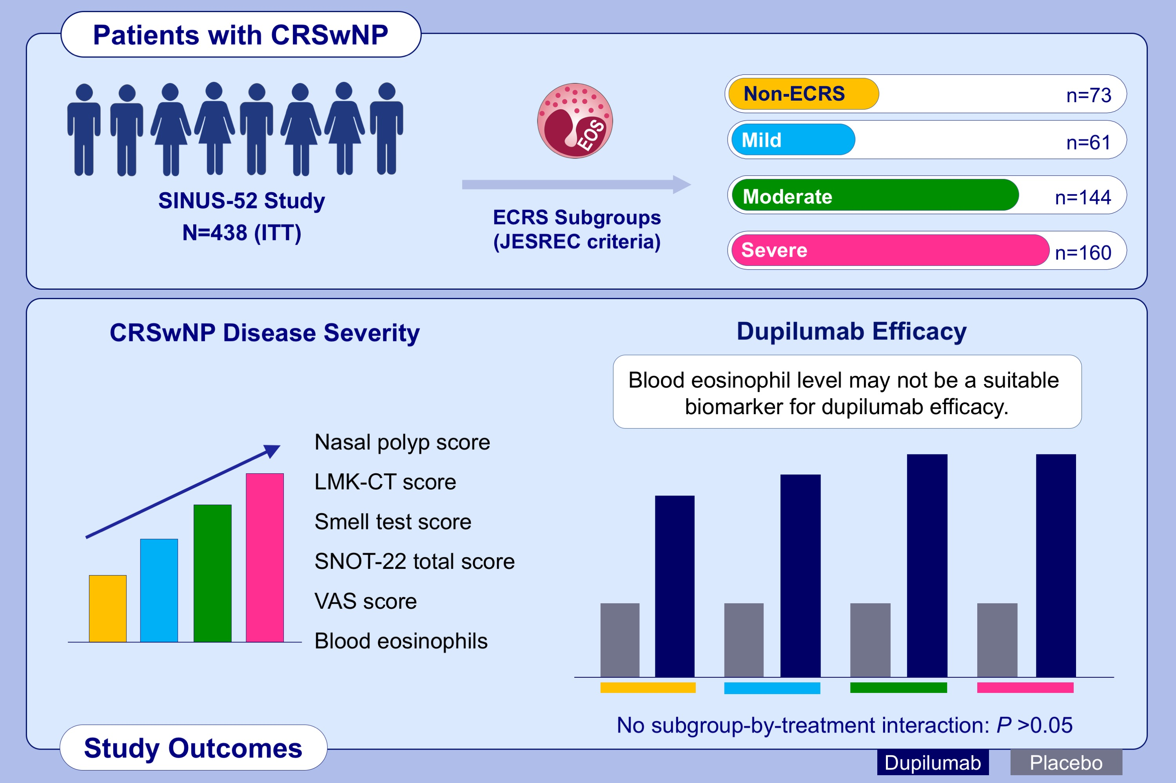
Dupilumab efficacy in chronic rhinosinusitis with nasal polyps from SINUS-52 is unaffected by eosinophilic status
Shigeharu Fujieda,, Shoji Matsune,, Sachio Takeno,, Nobuo Ohta,, Mikiya Asako,, et al.
Allergy. 2022; 186-196 https://doi.org/10.1111/all.14906
© 2019 EAACI and John Wiley and Sons A/S. Published by John Wiley and Sons Ltd.
Notes:
HIGHLIGHTS
Patients with CRSwNP from SINUS-52 were classified by eosinophilic status (ECRS subgroup; JESREC criteria).
Although moderate/severe ECRS shows greater baseline disease burden than mild/no ECRS, improvements in disease control, symptom burden, sense of smell, and HRQoL with dupilumab versus placebo are unaffected by ECRS status.
Eosinophilic status is not a biomarker for dupilumab efficacy in CRSwNP patients meeting SINUS-52 inclusion criteria.
Abbreviations: CRSwNP, chronic rhinosinusitis with nasal polyps; ECRS, eosinophilic chronic rhinosinusitis; EOS, eosinophil; HRQoL, health-related quality of life; ITT, intention-to-treat; JESREC, Japanese Epidemiological Survey of Refractory Eosinophilic Rhinosinusitis; LMK-CT, Lund-Mackay score assessed by CT; SINUS-52, controlled clinical study of dupilumab in patients with nasal polyps; SNOT-22, 22-item sinonasal outcome test; VAS, visual analog scale

