Slide 1
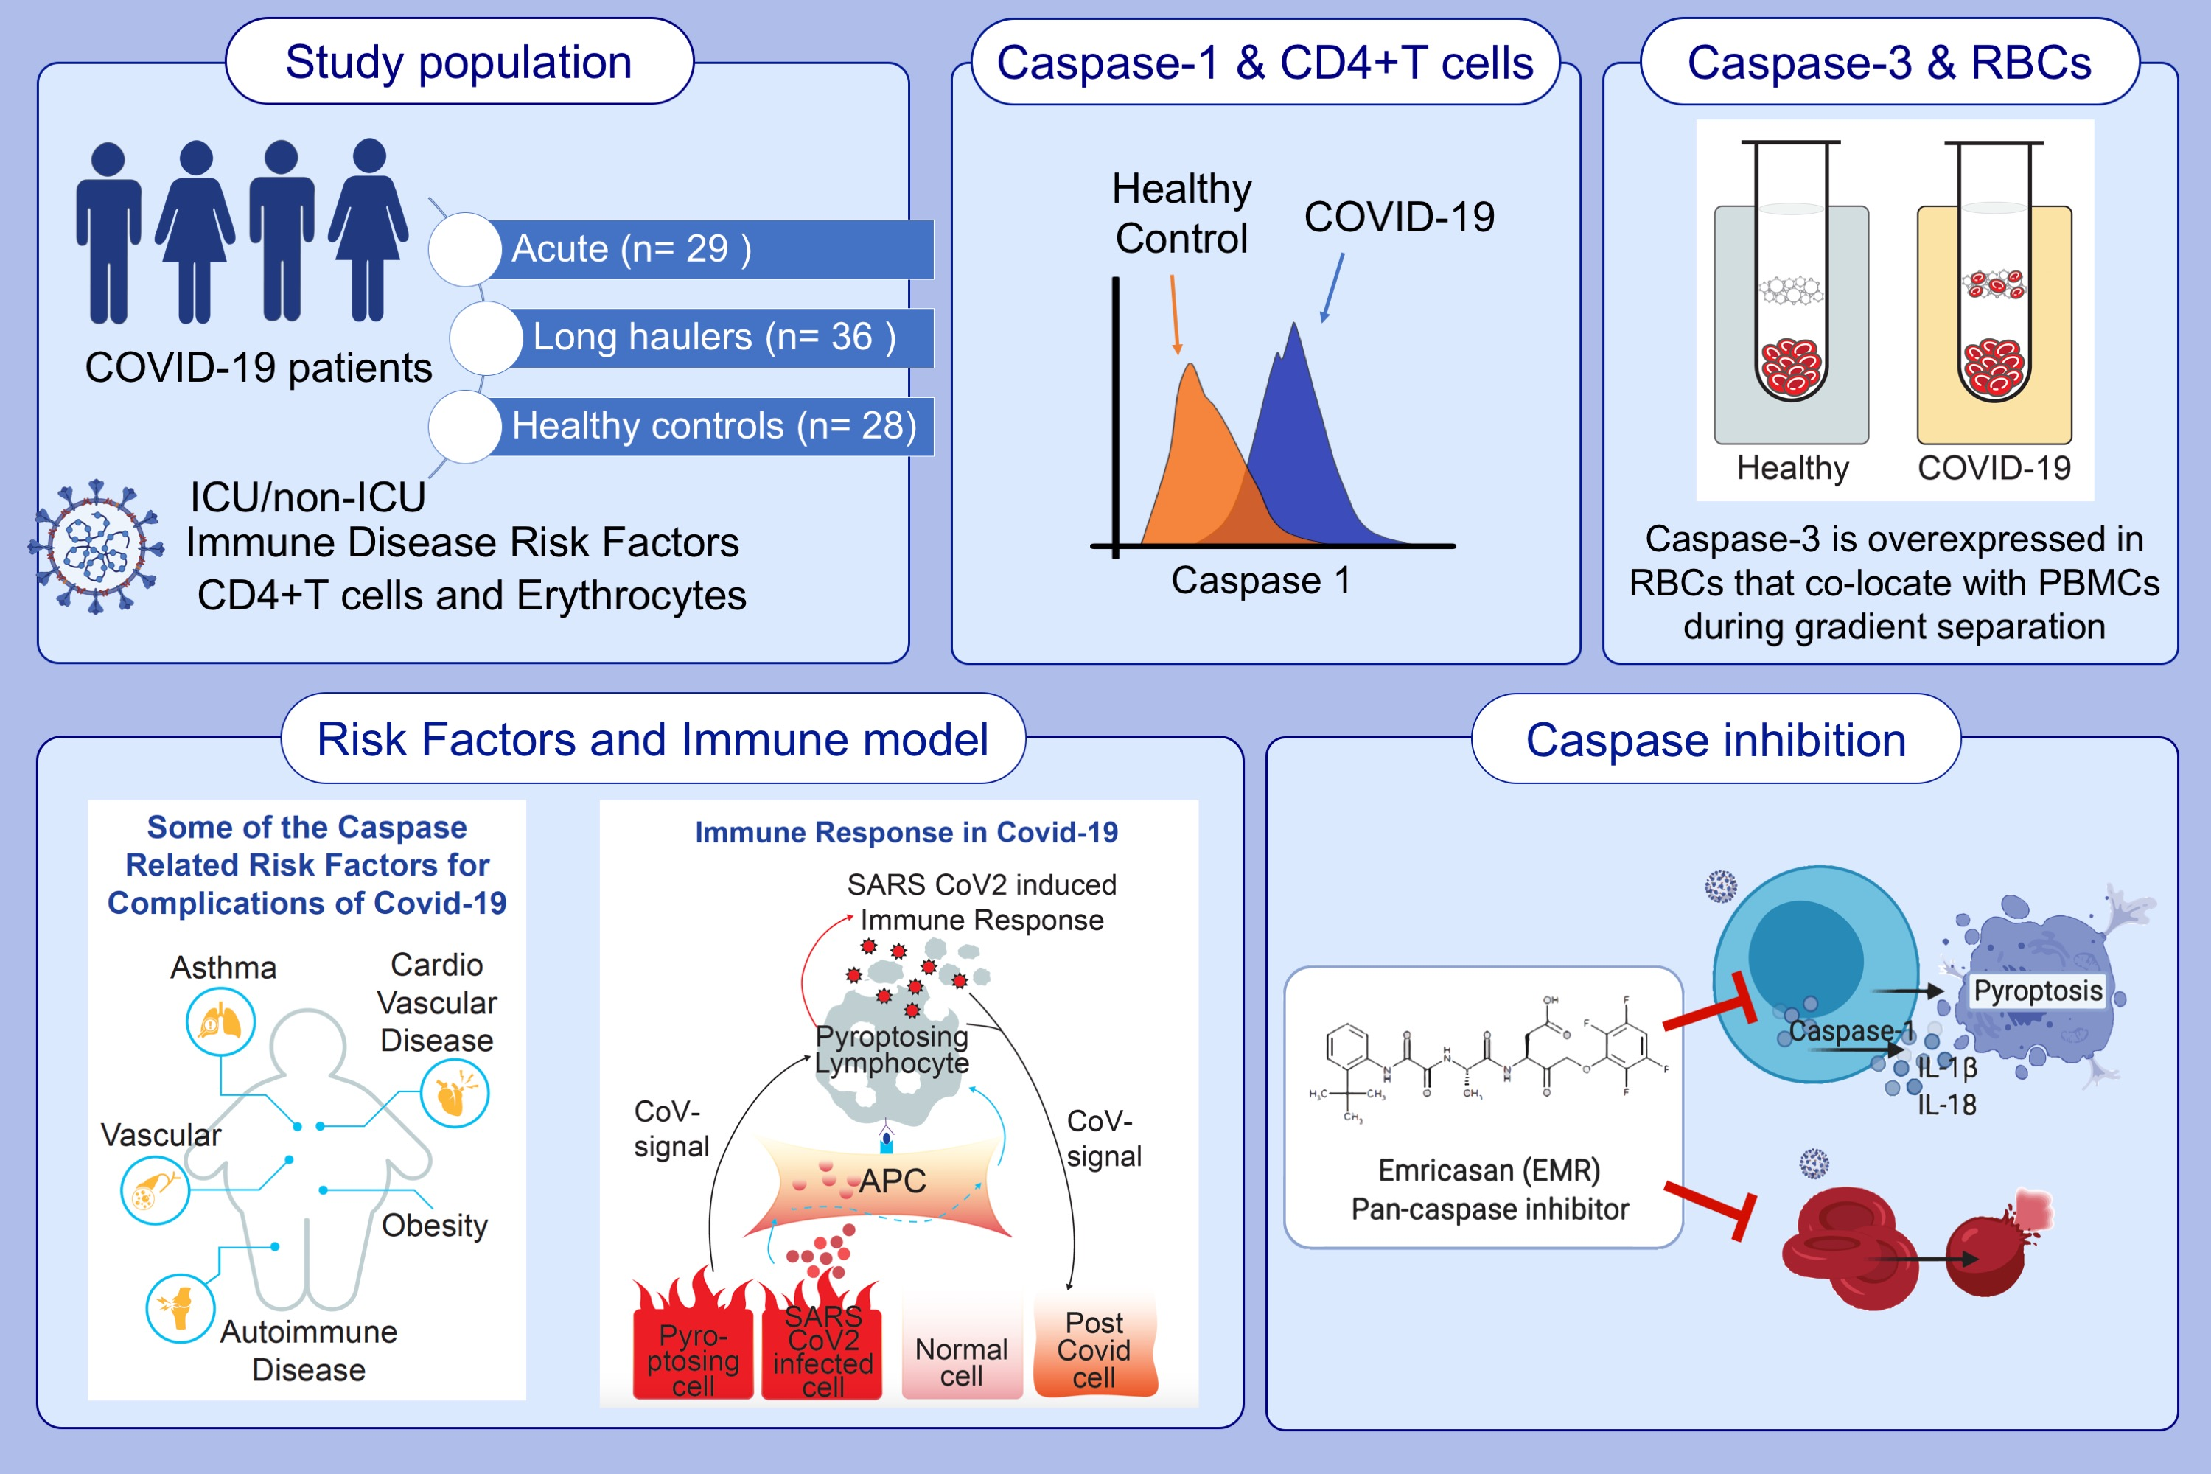
Caspases and therapeutic potential of caspase inhibitors in moderate–severe SARS-CoV-2 infection and long COVID
Matthew Plassmeyer,, Oral Alpan,, Michael J. Corley,, Thomas A. Premeaux,, Kimberleigh Lillard,, et al.
Allergy. 2022; 118-129 https://doi.org/10.1111/all.14907
© 2019 EAACI and John Wiley and Sons A/S. Published by John Wiley and Sons Ltd.
Notes:
HIGHLIGHTS
This study assesses transcriptional states of multiple caspases and the expression of active caspase-1 in blood cells from COVID-19 patients in acute and convalescent stages of disease.
Elevated caspase-3/7 levels in red blood cells is observed in COVID-19 patients compared to controls. Post-COVID-19 patients with lingering symptoms show up-regulated caspase-1 activity in CD4+ T-cells that is attenuated ex vivo with a select pan-caspase inhibitor.
An exuberant caspase response in COVID-19 that may facilitate immune-related pathological processes leading to severe outcomes.
Abbreviations: APC, antigen-presenting cell; COVID-19, coronavirus disease 2019; ICU, intensive care unit; PBMC, peripheral blood mononuclear cell; RBC, red blood cell; SARS-CoV-2, severe acute respiratory syndrome coronavirus 2

