Slide 1
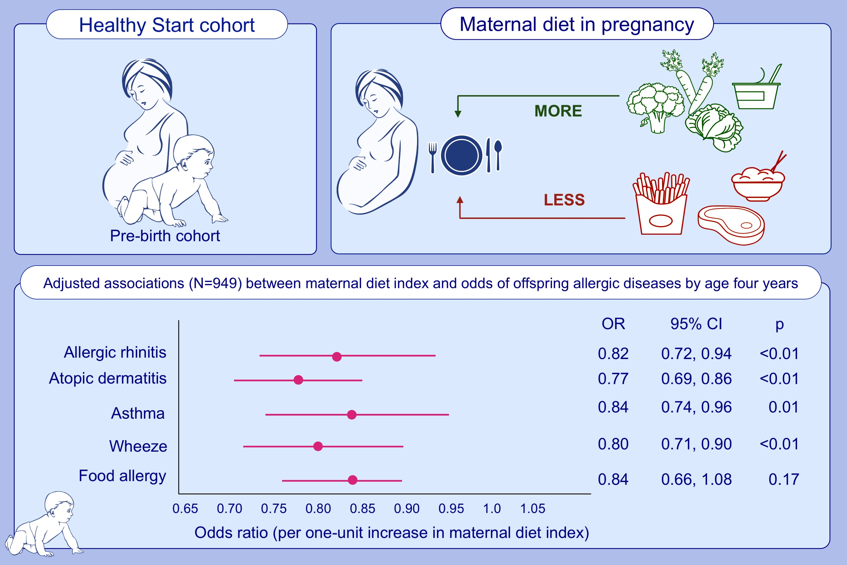
The maternal diet index in pregnancy is associated with offspring allergic diseases: the Healthy Start study
Venter, C, Palumbo, MP, Glueck, DH, et al.
Allergy. 2022; 162– 172. https://doi.org/10.1111/all.14949
© 2019 EAACI and John Wiley and Sons A/S. Published by John Wiley and Sons Ltd.
Notes:
HIGHLIGHTS
The maternal diet in pregnancy appears to be associated with offspring allergy outcomes.
A maternal allergy-preventive diet index in pregnancy was developed and validated. Vegetables and yogurt were associated with prevention of any allergy, while red meat, cold cereals, fried potatoes, rice/grains, and 100% fruit juice were associated with increased disease.
For a one-unit increase in the maternal diet index, the odds of allergic diseases in offspring were significantly reduced by 18% for allergic rhinitis, 23% for atopic dermatitis, 16% for asthma, and 20% for wheeze.
Abbreviations: OR, odds ratio; CI, confidence interval

