Slide 1
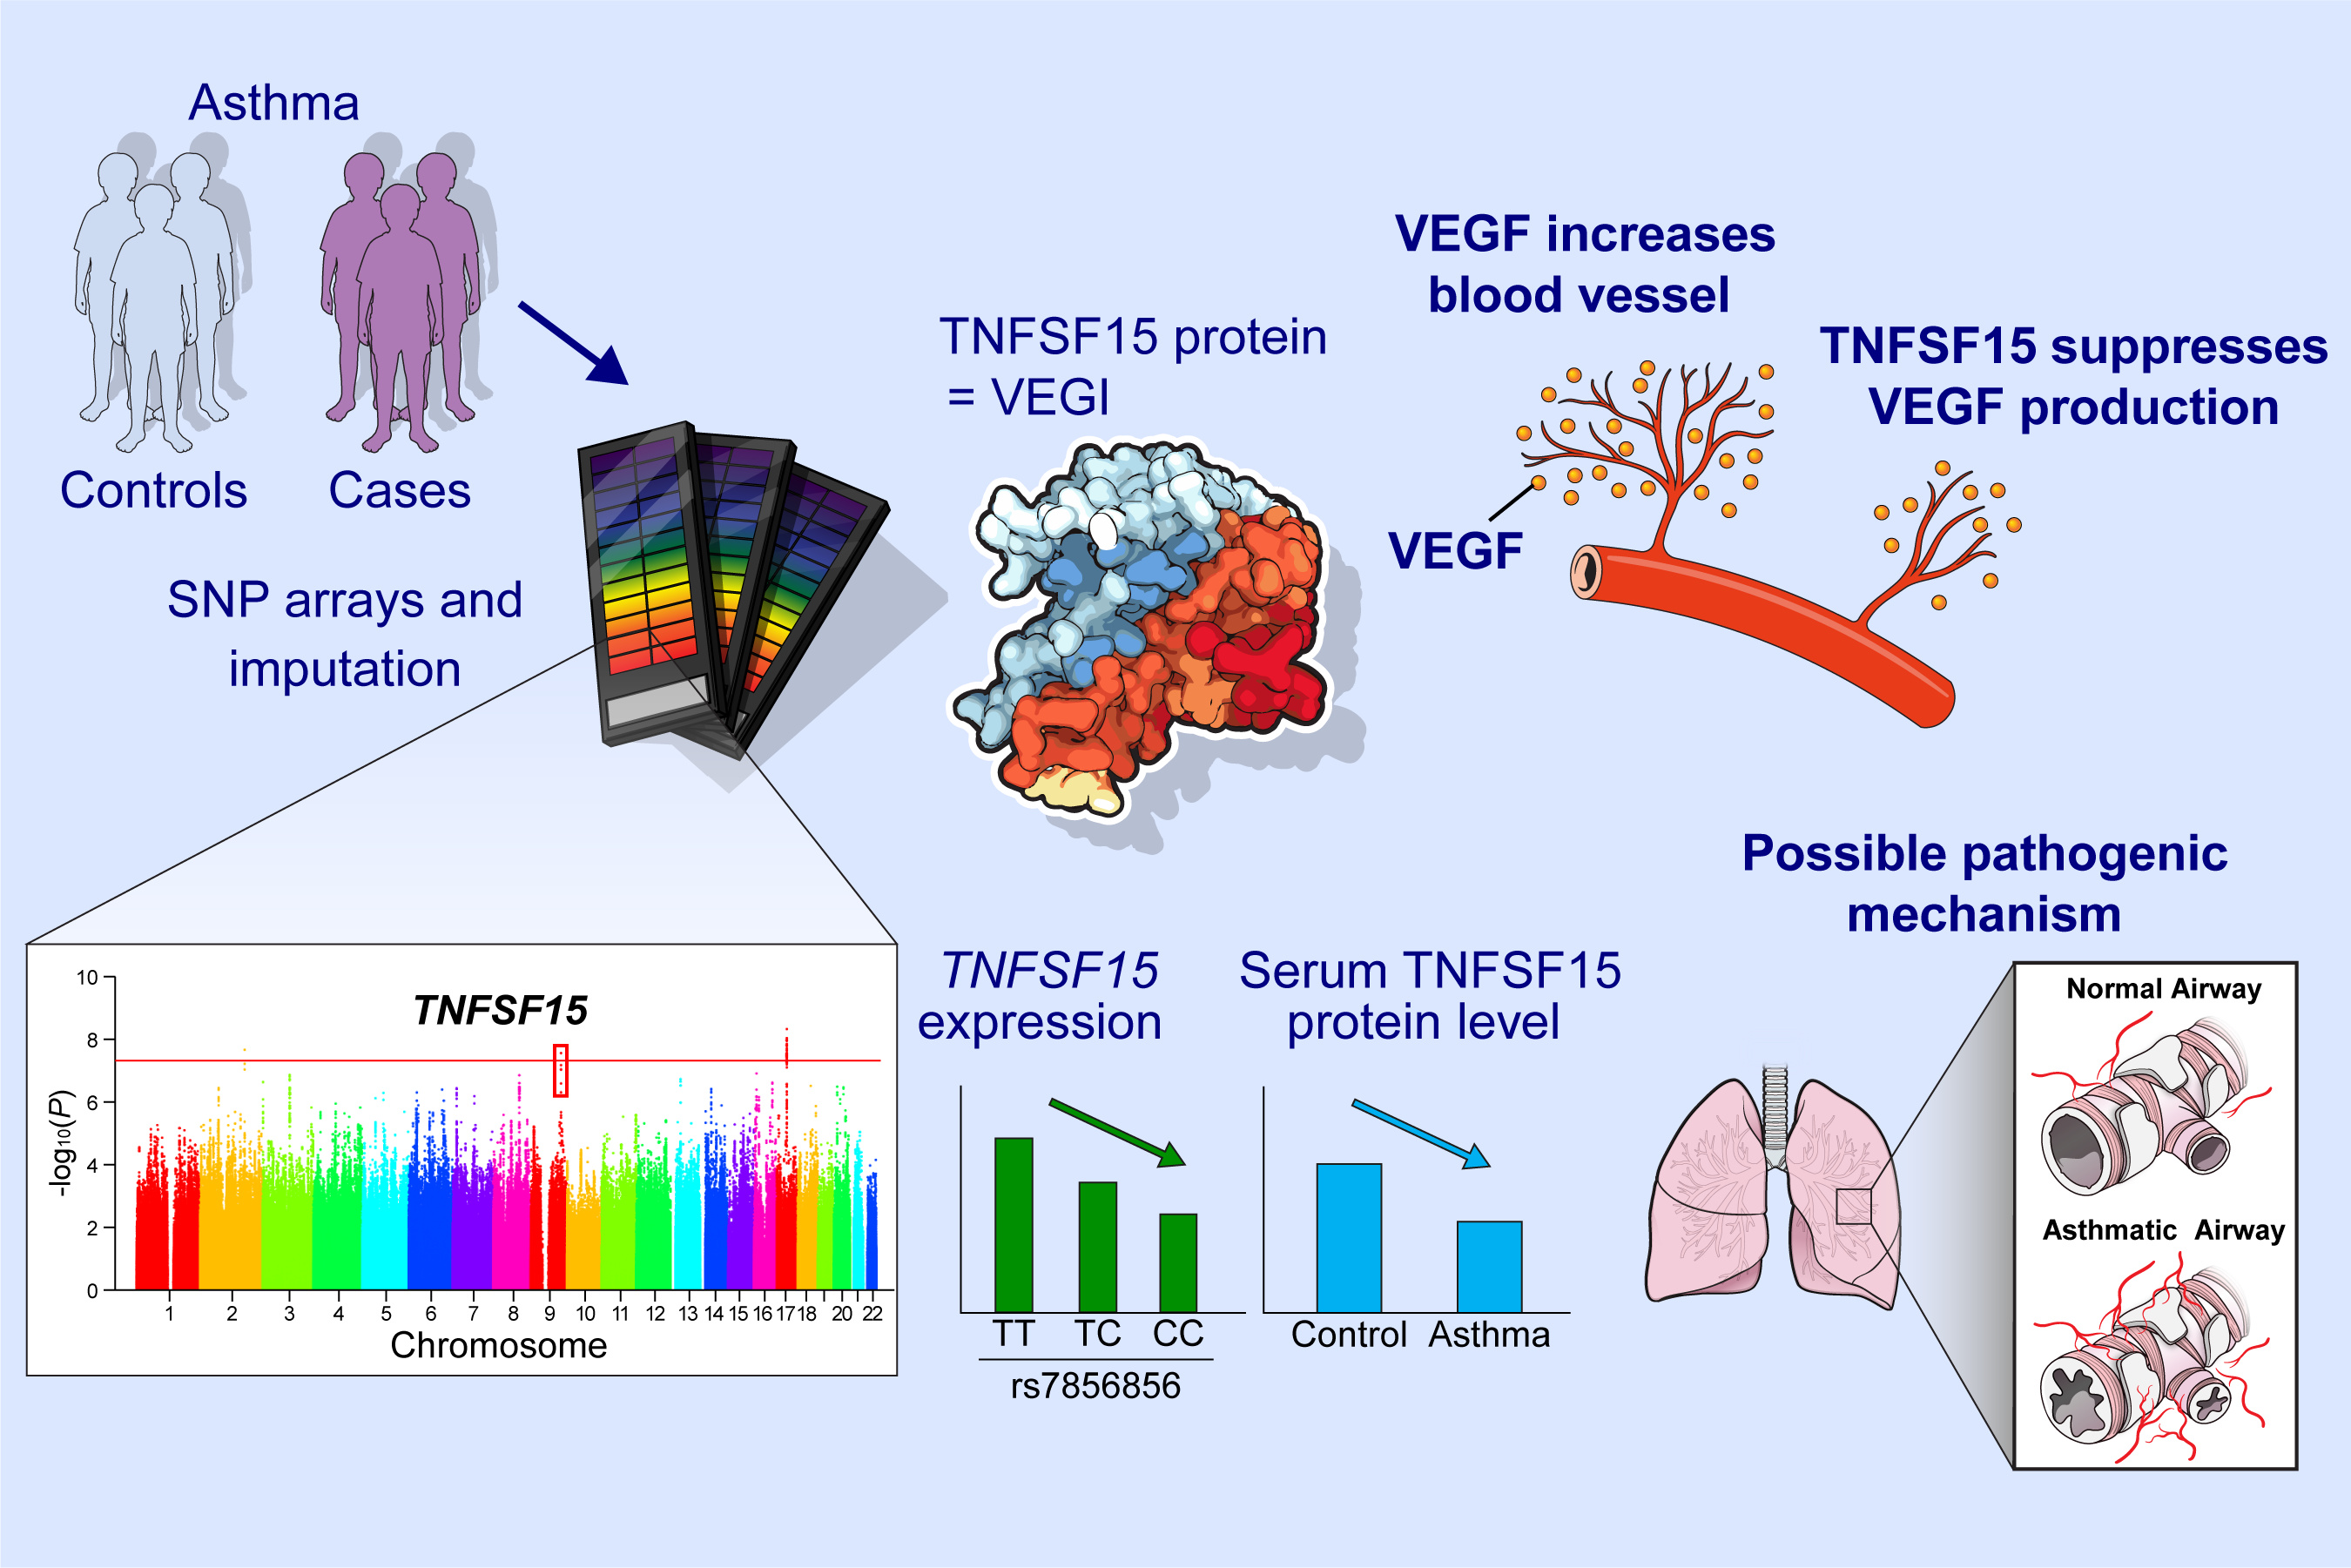
Genome-wide association study identifies TNFSF15 associated with childhood asthma
Kim, KW, Kim, DY, Yoon, D, et al.
Allergy. 2022; 218– 229. https://doi.org/10.1111/all.14952
© 2019 EAACI and John Wiley and Sons A/S. Published by John Wiley and Sons Ltd.
Notes:
HIGHLIGHTS
Our genome-wide association studies identify a new susceptibility gene, TNFSF15 for persistent asthma in children.
Children with asthma have lower serum TNFSF15 levels than controls, and those with the asthma risk rs7856856-CC genotype exhibit the lowest serum TNFSF15 levels.
This novel association may be mediated by loss of suppression of angiogenesis via lower expression of TNFSF15.
Abbreviations: SNP, single nucleotide polymorphism; TNFSF15, tumor necrosis factor superfamily 15; VEGF, vascular endothelial growth factor; VEGI, vascular endothelial growth inhibitor

