Slide 1
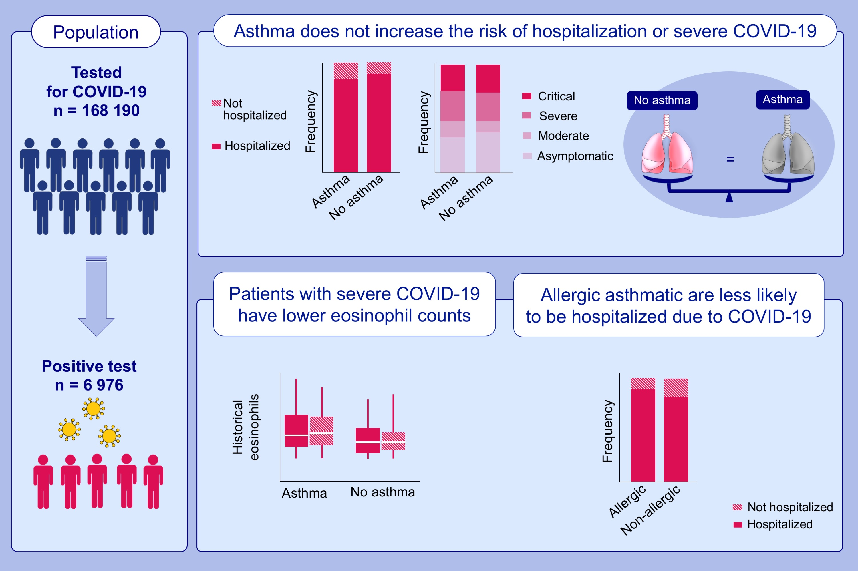
Asthma phenotypes, associated comorbidities, and long-term symptoms in COVID-19
Lauren E. Eggert,, Ziyuan He,, William Collins,, Alexandra S. Lee,, Gopal Dhondalay,, et al.
Allergy. 2022; 173-185 https://doi.org/10.1111/all.14972
© 2019 EAACI and John Wiley and Sons A/S. Published by John Wiley and Sons Ltd.
Notes:
HIGHLIGHTS
Asthma is not a risk factor for more severe COVID-19 disease.
Allergic asthmatics are half as likely to be hospitalized compared to non-allergic asthmatics and lower levels of eosinophil counts (allergic biomarkers) are associated with a more severe COVID-19 disease trajectory.
Recovery is similar among asthmatics and non-asthmatics.
Abbreviations: COVID, coronavirus disease 2019

