Slide 1
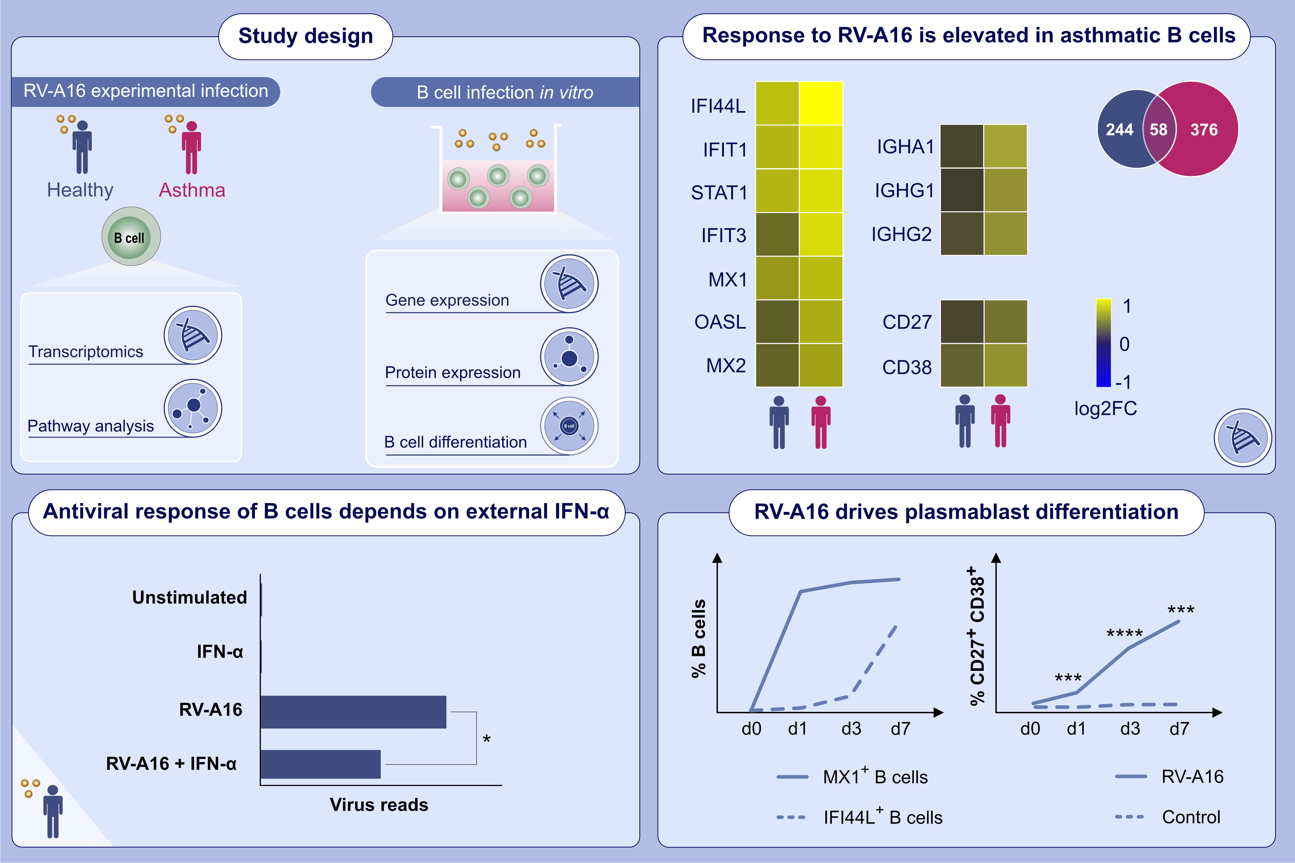
Experimental rhinovirus infection induces an antiviral response in circulating B cells which is dysregulated in patients with asthma
Oliver F. Wirz,, Kirstin Jansen,, Pattraporn Satitsuksanoa,, Willem van de Veen,, Ge Tan,, et al.
Allergy. 2022; 130-142 https://doi.org/10.1111/all.14985
© 2019 EAACI and John Wiley and Sons A/S. Published by John Wiley and Sons Ltd.
Notes:
HIGHLIGHTS
Intranasal infection with rhinovirus-A16 elicits antiviral response in peripheral B cells, characterized by upregulated antiviral response and cytokine genes.
Peripheral B cells are dependent on external type-I-IFN to develop an antiviral activation state.
Rhinovirus stimulation induces strong antiviral response in plasmablasts.
Dysregulated expression of antiviral response and antibody genes in individuals with asthma is observed after rhinovirus infection.
Abbreviations: IFI44L, interferon induced protein 44 like; IFIT, interferon induced protein with tetratricopeptide repeats; IGHA, immunoglobulin heavy constant alpha; IGHG, immunoglobulin heavy constant gamma; IFN- α, IFN-alpha; MX, MX dynamin like GTPase; OASL, 2'-5'-oligoadenylate synthetase like; RV-A16, rhinovirus-A16; STAT1, signal transducer and activator of transcription 1

