Slide 1
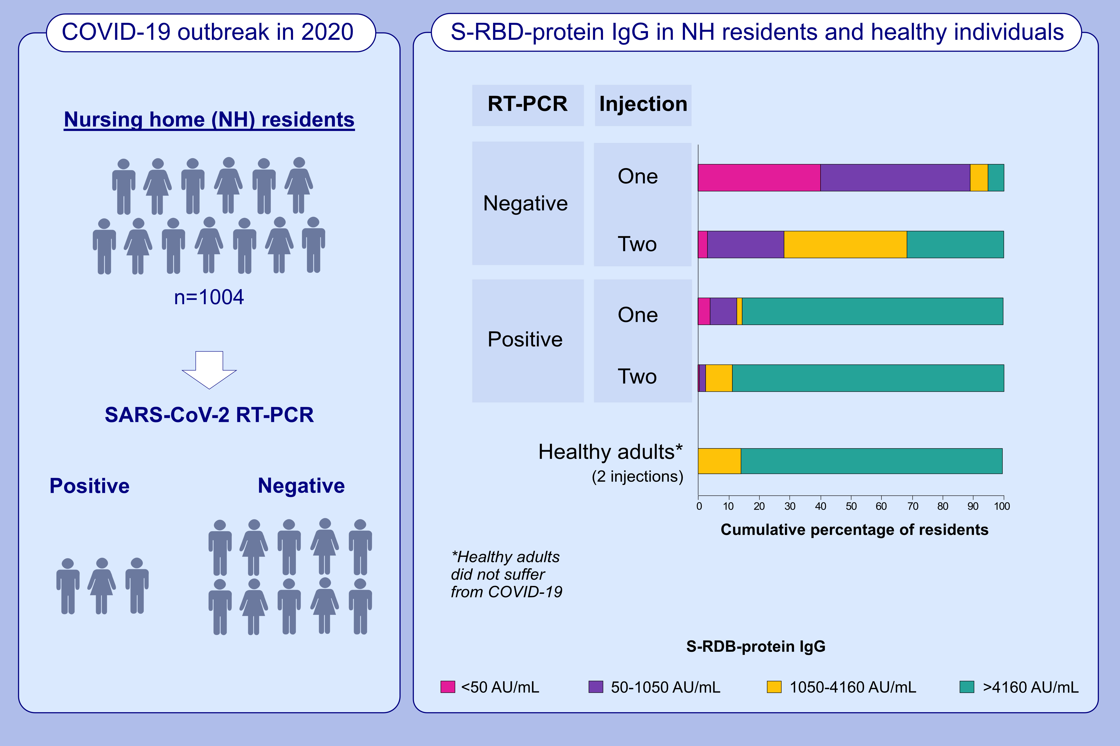
Antibody response after one and two jabs of the BNT162b2 vaccine in nursing home residents: The CONsort-19 study
Hubert Blain,, Edouard Tuaillon,, Lucie Gamon,, Amandine Pisoni,, Stéphanie Miot,, et al.
Allergy. 2022; 271-281 https://doi.org/10.1111/all.15007
© 2019 EAACI and John Wiley and Sons A/S. Published by John Wiley and Sons Ltd.
Notes:
HIGHLIGHTS
This study compares levels of IgG antibodies against the spike protein (S-RBD IgG) (S-RDB protein IgG) after one and two BNT162b2/Pfizer jabs in residents with and without prior COVID-19.
One BNT162b2 jab is sufficient to reach a level of S-RBD protein IgG level
of 1050 AU/mL in 98% of nursing home residents with prior COVID-19.
After two jabs, levels of S-RBD IgG are below 1050 AU/mL in 29.5 %
of residents without prior COVID-19.
Abbreviations: AU/ml, arbitrary units per mL; COVID-19, coronavirus disease 2019; RT-PCR, real-time reverse- transcriptase polymerase chain reaction; SARS-CoV-2, severe acute respiratory syndrome coronavirus 2; S-RBD IgG, IgG antibodies against the spike protein

