Slide 1
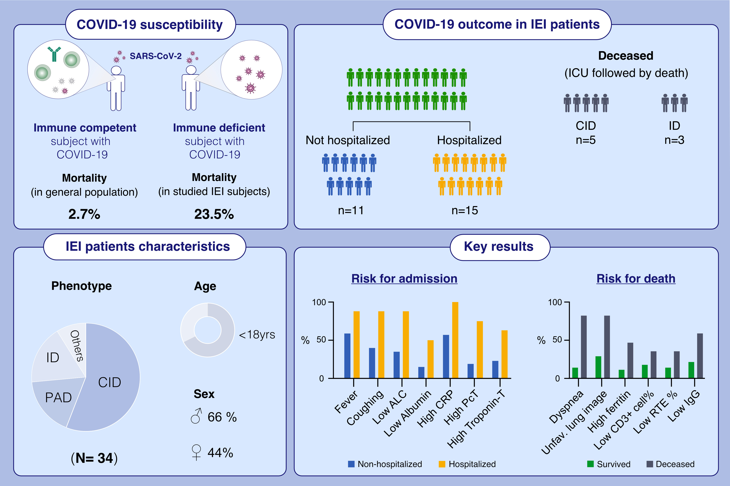
Adverse COVID-19 outcomes in immune deficiencies: Inequality exists between subclasses
Elif Karakoc Aydiner,, Sevgi Bilgic Eltan,, Royale Babayeva,, Omer Aydiner,, Eda Kepenekli,, et al.
Allergy. 2022; 282-295 https://doi.org/10.1111/all.15025
© 2019 EAACI and John Wiley and Sons A/S. Published by John Wiley and Sons Ltd.
Notes:
HIGHLIGHTS
34 IEI patients aged between 0.6 and 43 years, eight patients (23.5%) succumbed to COVID-19, indicating a highly vulnerable condition to COVID-19.
Laboratory markers associated with mortality included elevated acute phase reactants, ferritin, troponin T, TLS, and reduced ALC levels, albumin, and baseline IgG.
Coughing, dyspnea, CORADS category 4-6, and negative SARS-CoV-2 PCR at admission were among the predictors of lethal outcome.
Abbreviations: ALC, absolute lymphocye count; CID, combined immune deficiency; COVID-19, coronavirus infectious disease 2019; CRP, C-reactive protein; F, female; ICU, intensive care unit; ID, immune dysregulation; IEI, inbor errors of immunity; Ig, immunoglobulin; M, male; PAD, predominantly antibody deficiency; PcT, procalcitonin; RTE, recent thymic emigrants; SARS-CoV-2, severe acute respiratory syndrome coronavirus 2; Unfav, unfavorable
.

