Slide 1
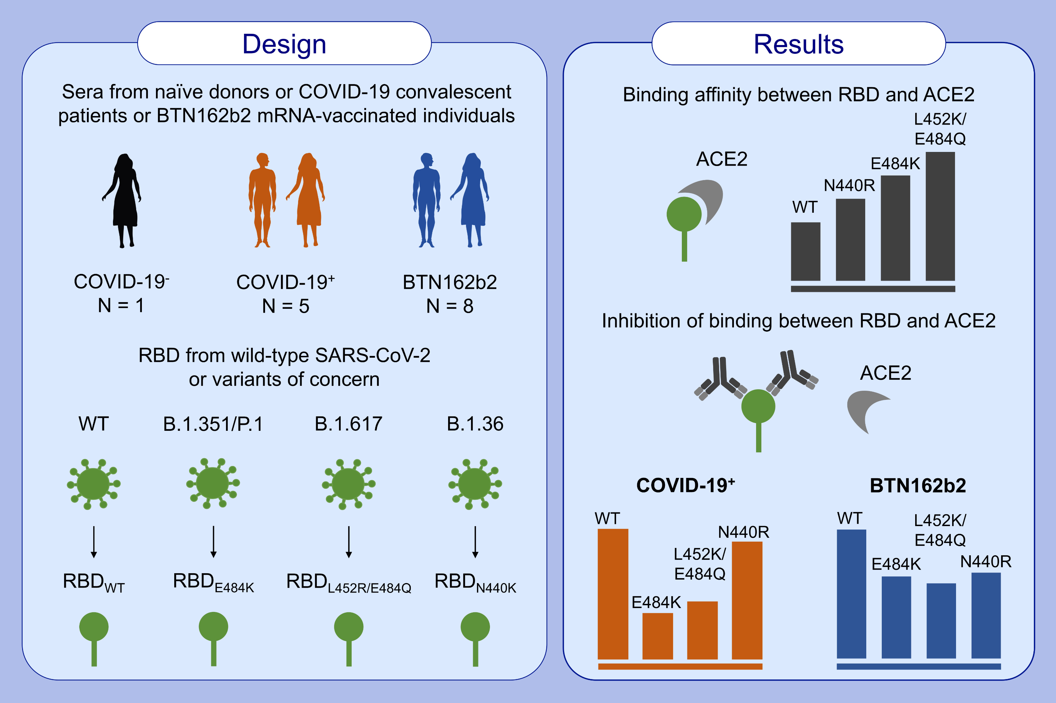
In vitro data suggest that Indian delta variant B.1.617 of SARS-CoV-2 escapes neutralization by both receptor affinity and immune evasion
Gilles Augusto,, Mona O. Mohsen,, Simon Zinkhan,, Xuelan Liu,, Monique Vogel,, et al.
Allergy. 2022; 111-117 https://doi.org/10.1111/all.15065
© 2019 EAACI and John Wiley and Sons A/S. Published by John Wiley and Sons Ltd.
Notes:
HIGHLIGHTS
Binding assays using Biolayer Interferometry showed that the RBD containing L452R/E484Q present in the new SARS-CoV-2 variant B.1.617 interacts with ACE2 with higher affinity than wild-type or single-mutants N440K and E484K.
Sera from convalescent and BTN162b2 vaccinated individual showed reduced ability to block the interaction between ACE2 and RBD mutants E484K and L452R/E484Q suggesting that the new SARS-CoV-2 variant B.1.617 bypass immunity generated against the wild-type virus.
Abbreviations: ACE2, angiotensin-converting enzyme 2; COVID-19, coronavirus disease 2019; RBD, receptor binding domain; RBDE_{484K}, RBD containing mutation E484K on S; RBD_{L452R/E484Q}, RBD containing both mutations L452K and E484Q on S; RBD_{N440K}, RBD containing mutation N440K on S; RBD_{WT}, wild-type RBD; SARS-CoV-2, severe acute respiratory syndrome coronavirus type 2

