Slide 1
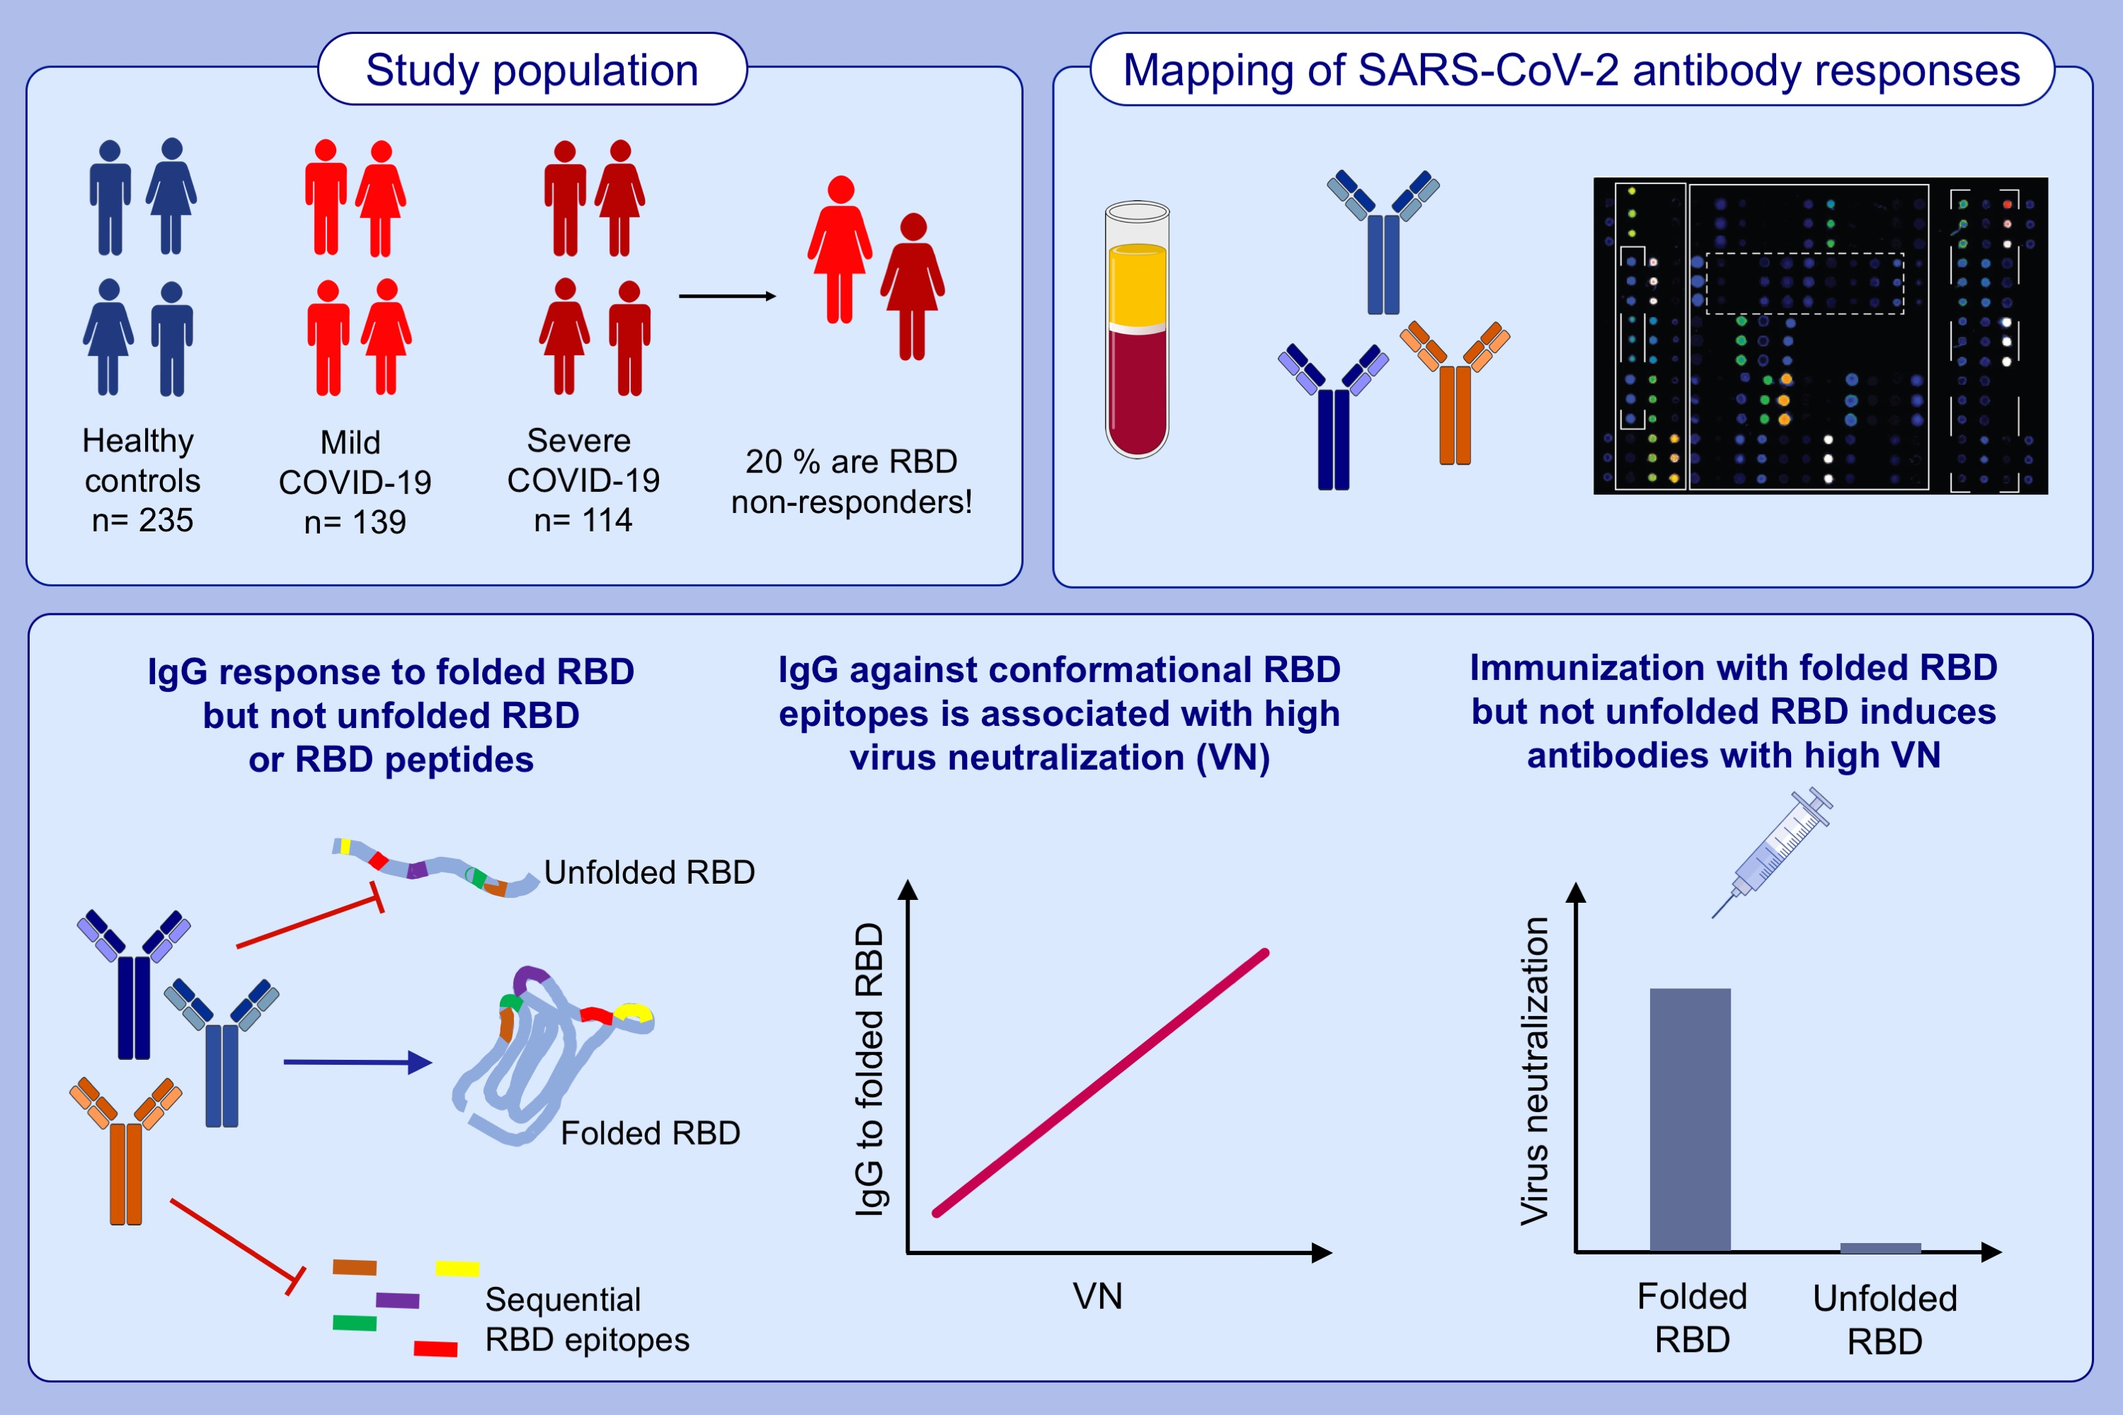
Neutralization of SARS-CoV-2 requires antibodies against conformational receptor-binding domain epitopes
Pia Gattinger,, Katarzyna Niespodziana,, Karin Stiasny,, Sabina Sahanic,, Inna Tulaeva,, et al.
Allergy. 2022; 230-242 https://doi.org/10.1111/all.15066
© 2019 EAACI and John Wiley and Sons A/S. Published by John Wiley and Sons Ltd.
Notes:
HIGHLIGHTS
IgG response in convalescent COVID-19 patients is directed to folded but not to unfolded RBD or RBD peptides. IgGs to folded RBD are required for virus neutralization.
Twenty percent of convalescent COVID-19 patients selectively lack RBD-specific IgG.
Only immunisation with folded, but not with unfolded RBD, induces antibodies with virus neutralizing activity.
Abbreviations: COVID-19, coronavirus disease 2019; IgG, immunoglobulin G; RBD, receptor-binding domain; SARS-CoV-2, severe acute respiratory syndrome coronavirus 2

